Slide 1
Co-operation, Networks and Networking:
Concepts and Examples

Slide 2
Overview
Principles
Models and framework
Examples for networks
Supplementary Literature

Slide 3
Principles

Slide 4
Transformative competence and collaboration
“Transformative Competence is the ability to shape one's own life, one's own living space and the future of societies through active participation in the sense of sustainable development.“ (BLK 2005)
“Collaboration, collaboration, collaboration could be called the order of the day” (Haag 2015).
BLK (2005). Bildung für eine nachhaltige Entwicklung ("21") – Final report BLK program. DOI: 10.25656/01:340. https://www.pedocs.de/volltexte/2008/340/pdf/heft123.pdf
Haag, L. (2015). Expertise zu interkultureller Öffnung und Schulentwicklung: aktueller Stand und Konsequenzen unter besonderer Berücksichtigung Bayerns. München: Landeshauptstadt München, Stelle für Interkulturelle Arbeit/Sozialreferat. https://www.edu.lmu.de/spe/forschung/forschungsprojekte/schulefueralle/expertise.pdf

Slide 5
Professional learning concept
Autonomy
Reflection
Action
Networking
Zehetmeier, S., Erlacher, W., Andreitz, I. & Rauch, F. (2015). Researching the impact of teacher professional development programmes based on action research, constructivism, and systems theory. Educational Action Research, 23 (2), 162-176. (http://www.tandfonline.com/doi/abs/10.1080/09650792.2014.997261

Slide 6
Groups/teams are essential
Groups as a central development axis for school development
Communities of Practice (Wenger 1998):
- joint interest
- joint engagement
- joint repertoire
Features of professional teacher teams:
- joint goal
- the learning of the students is central
- reflection
Wenger, E. (1998). Communities of practice: Learning, meaning, and identity. Cambridge University Press. https://doi.org/10.1017/CBO9780511803932

Slide 7
Models and framework

Slide 8
Model of school development
development of staff
environment
environment
pedagogical
school
development
development of teaching
organisational
development
environment
Rolff, H.- G. (1998). Entwicklung von Einzelschulen: Viel Praxis, wenig Theorie und kaum Forschung - ein Versuch, Schulentwicklung zu systematisieren. In H. Rolff et al. (eds.), Jahrbuch der Schulentwicklung. Daten, Beispiele und Perspektiven. Weinheim: Beltz Juventa, 295-326.

Slide 9
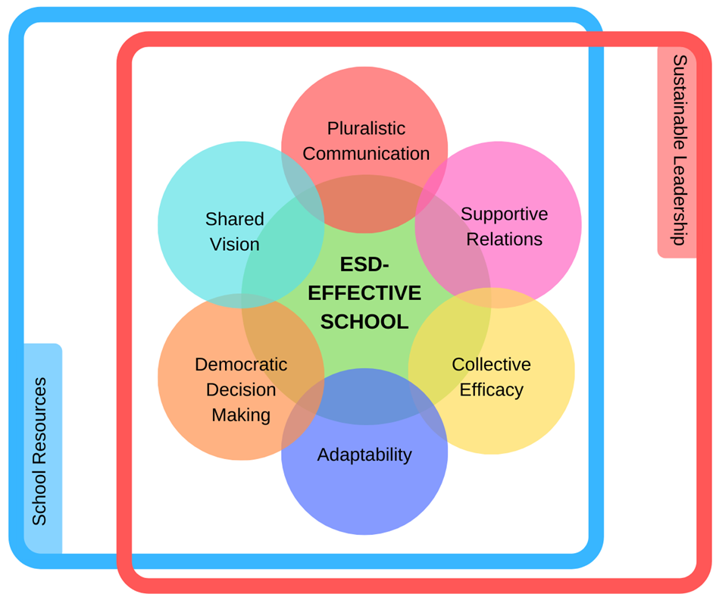
Conceptual framework of an
ESD-effective school
Verhelst, D., Vanhoof, J., Boeve-de Pauw, J., & Van Petegem, P. (2020). Building a conceptual framework for an ESD-effective school organisation. The Journal of Environmental Education, 1-16. doi:10.1080/00958964.2020.1797615. https://www.researchgate.net/publication/344652767_Building_a_conceptual_framework_for_an_ESD-_effective_school_organization

Slide 10
Framing & central elements of the conceptual framework
Framing elements
Sustainable leadership: catalyst of ESD; transformative leadership; monitoring progress
School resources: time management; professional and organisational structure
Central elements
Pluralistic communication: different points of view and dialogue
Supportive relations: school team; networks with external partners
Democratic decision making: distributed leadership
Shared vision: internalised motivation; hidden curriculum
Adaptability: internal and external demands; single and double loop learning; transmission and transformation
Collective ESD-efficacy: Being convinced of positive effects of teams

Slide 11
Theoretical aspects of networks I
mutual intention and goals (Liebermann & Wood, 2003)
trust orientation (McDonald & Klein, 2003; McLaughlin, Black-Hawkins, Mcintyre & Townsend 2008).
voluntary participation (McLaughlin, Black-Hawkins, Mcintyre & Townsend 2008).
principle of exchange (win-win relationship) (McCormick, Fox, Carmichael & Procter 2011)
Lieberman, A. & Wood, D.R. (2003). Inside the National Writing Project. Connecting Network Learning and Classroom Teaching. New York: Teacher College Press. https://www.researchgate.net/publication/271109560_Inside_the_National_Writing_Project_Connecting_Network_Learning_and_Classroom_Teaching
McDonald, J. & Klein, E. (2003). Networking for Teacher Learning: Toward a Theory of Effective Design. Teacher College Record, 105(8), 1606-1621. https://www.researchgate.net/publication/254465663_Networking_for_Teacher_Learning_Toward_a_Theory_of_Effective_Design
McLaughlin, C., Black-Hawkins, K., McIntyre, D. & Townsend, A. (2008). Networking Practitioner Research. London: Routledge.
OECD (2003). Schooling for Tomorrow. Networks of Innovation. Paris: OECD. https://www.imst.ac.at/wp-content/uploads/2024/03/Rauch-Networks-Cambridge-Journal-2013.pdf
McCormick, R., Fox, A., Carmichael, P. & Procter, R. (2011). Researching and Understanding Educational Networks. London: Routledge. https://www.researchgate.net/publication/47343392_Researching_and_Understanding_Educational_Networks

Slide 12
Theoretical aspects of networks II
steering platform (Dobischat, Düsseldorf, Nuissl & Stuhldreier, 2006)
synergy (Schäffter, 2006 )
learning (Czerwanski et al., 2002; O’Hair & Veugelers, 2005)
face-to-face communication supported by electronic networks
Dobischat, R., Düsseldorf, C., Nuissl, E. & Stuhldreier, J. (2006). Lernende Regionen – begriffliche Grund-lagen. In E. Nuissl et al. (eds.), Regionale Bildungsnetze. Bielefeld: Bertelsmann, 23-33.
Schäffter, O. (2006). Lernen in der Zivilgesellschaft - aus der Perspektive der Erwachsenenbildung. In: H. Voesgen (Eds.): Brückenschläge. Neue Partnerschaften zwischen institutioneller Erwachsenenbildung und bürgerschaftlichem Engagement. Bielefeld: Bertelsmann, 21-33.
Czerwanski, A., Hameyer, U. & Rolff, H. G. (2002). Schulentwicklung im Netzwerk – Ergebnisse einer empirischen Nutzenanalyse von zwei Schulnetzwerken. In H. G. Rolff et al. (eds.), Jahrbuch für Schulentwicklung. München: Juventa, 99-130.
O’Hair, Mary John and Wiel Veugelers (2005). The case for network learning. In W. Veugelers & M. John O’Hair (eds.), Network Learning for Educational Change. Maidenhead: Open University Press, 1-16.

Slide 13
Functions of networks in the education system
Information
direct and immediate exchange
of relevant information about
teaching and learning
Learning
extended learning opportunities
by mutual exchange
Psychological Function
possibilities of co-operation and
trust strengthens people
(„risk-taking“)
Political Function
co-operation with likeminded people
foster dissemination and
implementation of
innovations
Dalin, P. (1999). Theorie und Praxis der Schulentwicklung. Neuwied: Luchterhand.

Slide 14
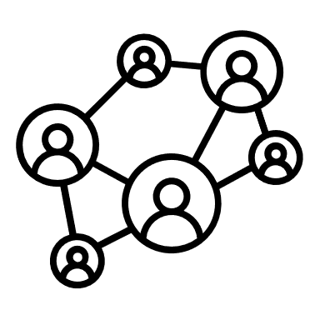
Potential partner institutions for networks in the education system
School authorities
Schools
Universities
Non-Formal
Learning Spaces
Municipal
authorities
Businesses
NGOs
International &
national networks
& cooperations

Slide 15
Examples for networks

Slide 16

Networks in the education system:
example ÖKOLOG
is a programme and network for education for sustainable development (ESD) and school development at Austrian schools.
makes a contribution to the UN Sustainable Development Goals. (Rauch et al. 2024)
was initiated 25 years ago and is supported by the Ministry of Education and scientifically co-ordinated by the University of Klagenfurt
is the development from individual projects to an ‘ecological everyday life’ at school
Rauch, F., Glettler, C., Steiner, R. & Dulle, M. (2024). Environmental and Sustainability Education in Austria, In R. Rieckmann, & R. Thomas (Eds.), World Review: Environmental and Sustainability Education in the Context of the Sustainable De-velopment Goals. RiScience Publishers/CRC. https://www.routledge.com/World-Review-Environmental-and-Sustainability-Education-in-the-Context-of-the-Sustainable-Development-Goals/Rieckmann-Munoz/p/book/9780367702427

Slide 17
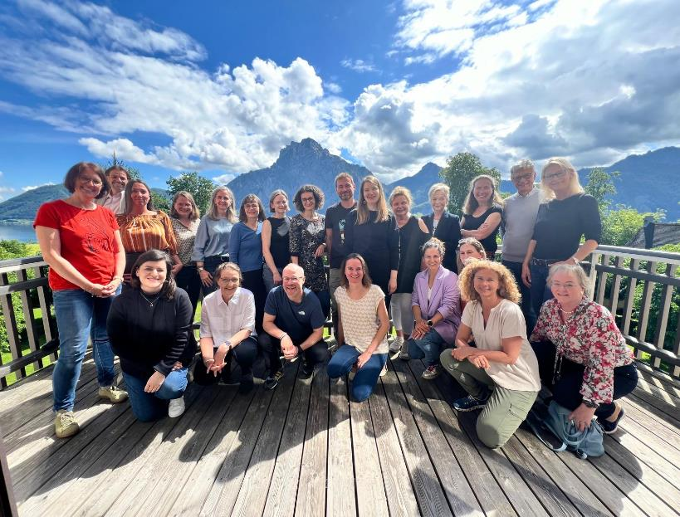
Networks in the education system:
example ÖKOLOG
ÖKOLOG network – acting partners
ÖKOLOG regional teams (educational boards, colleges of teacher education, teachers, regional governments, NGO’s)
Department of Instructional and School development, University of Klagenfurt
Austrian Federal Ministry of Education

Slide 18
Networks in the education system:
example ÖKOLOG
ÖKOLOG – interconnected levels of activity
pedagogical level: creating space for meaningful learning experiences and promoting sustainable attitudes, ways of thinking and actions
ecological level: reduce pollution, biodiversity
social level: build structures, where participation in decision-making is possible, and work together with the school environment
economic level: sustainable use of resources and circular economy
Rauch, F. & Pfaffenwimmer, G. (2020). The Austrian ECOLOG-Schools Programme – Networking for Environmental and Sustainability Education. In A. Gough, J. Chi Kin Lee & E. Po Keung Tsang (eds.), Green Schools Globally: Stories of Impact for Sustainable Development. Dordrecht: Springer, 85-102. https://www.springer.com/gp/book/9783030468194

Slide 19
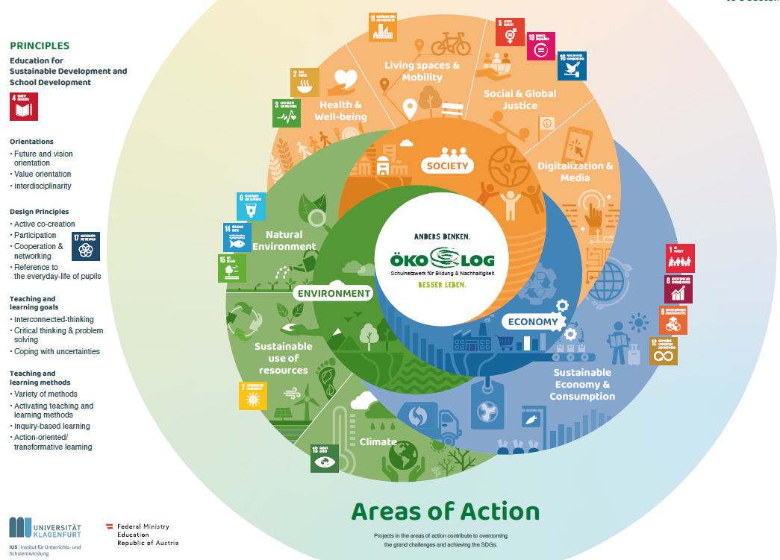
ÖKOLOG offers
Regional support and advice from regional teams
ESD materials for schools
Project funding
Online Tools
Inspiration via ESD examples from and for schools
Further education, meetings and networking opportunities
Exchange of experiences through an Austria-wide network
Publicity & school image
Research and Evaluation (Rauch Pfaffenwimmer 2020, Rauch & Dulle 2023)
International co-operation & projects

Slide 20
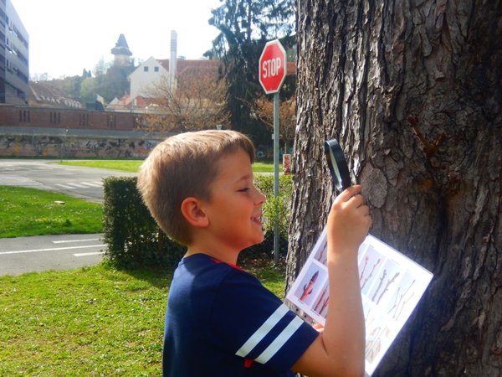
Networks in the education system:
example learning space CITY Park
outdoor learning space for kindergarten and schools in the central park area of Graz, Austria
network – acting partners
NaturErlebnisPark Science Education Center (non-formal learning site)
City of Graz (local authorities)
Kindergarten, schools, universities (educational institutions)

Slide 21
Networks in the education system:
example learning space CITY Park
is a cooperation structure connecting a nonformal learning site, universities for teacher education, schools and local authorities
aims to support intentions of the new curriculum to foster transversal competencies, community involvement and global citizenship education
contributes to ESD by combining socio-cultural and ecological perspectives in an authentic environment
combines educational research and innovation, teacher education and non-formal educational activities adapted to the curriculum
is funded by the city, the universities for teacher education and project grants

Slide 22






networks in the education system: example 2
City of Graz
urban parks as authentic learning space to combine natural and socio-cultural environmental perspectives in ESD
embed outdoor activities into classroom work
City of Graz
School
public kindergarten, primary and secondary schools
local
authorities
provides authentic topics
take impulses for school development
learning space
CITY-PARK
Cooperation
School
Science Center Network
cooperate
subsidises basic staff and infrastructure
Science Center Network
networks
and cooperations
professional exchange, shared applications for grants
public libraries
manages educational offers
continuous action research process to develop and research teaching materials and methods
cooperate
cooperate
Universities for Teacher Education
non-formal
learning site
NaturErlebnisPark
Science Education Center
university
engages students in educational activities for schools
contributes to CPD of pre-service and in-service teachers

Slide 23
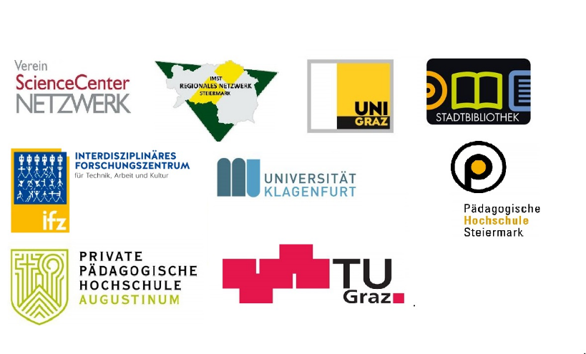

Networks in the education system:
example learning space CITY Park
General conditions of the network
cooperation contracts
resources for coordination
curricula that enable interdisciplinary work
involvement of headmasters
support through city authorities

Slide 24
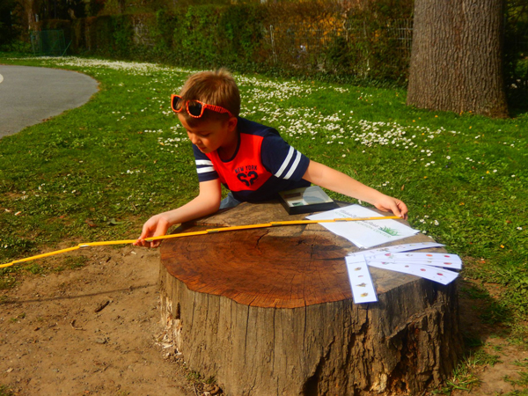
Experiences from learning space City Park
a “safe space” for pre-service teachers to explore innovative teaching methods
motivational effects for students
a wide range of starting points for further lessons
connection between scientific teaching and everyday life
meaningful contexts for ESD

Slide 25
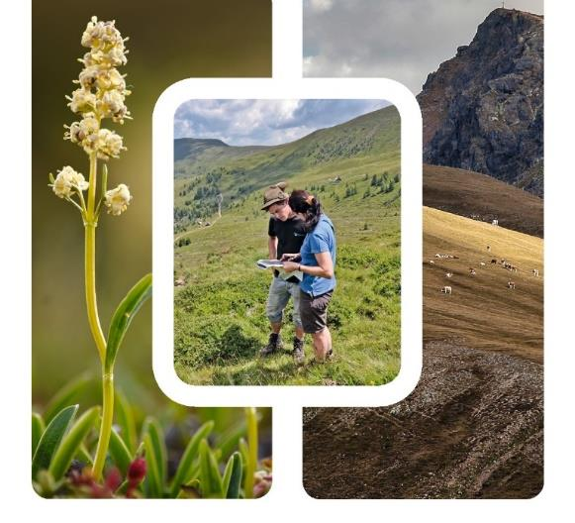
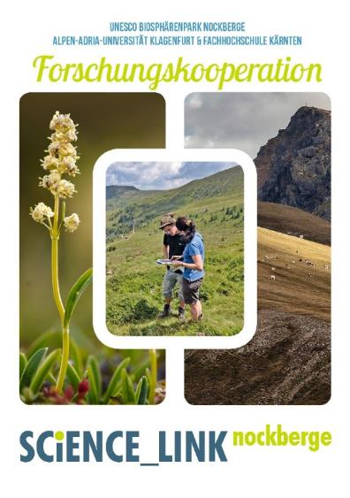

Networks in the education system:
example SCiENCE_LINK^{nockberge}

Slide 26
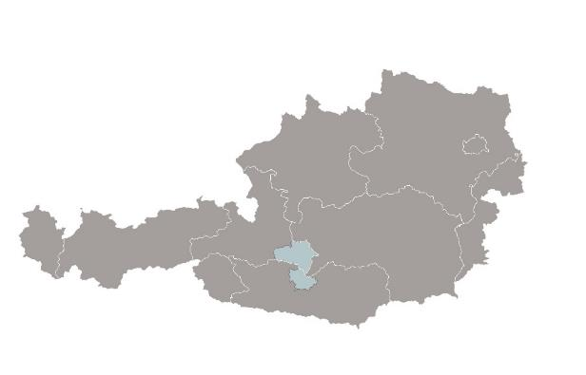
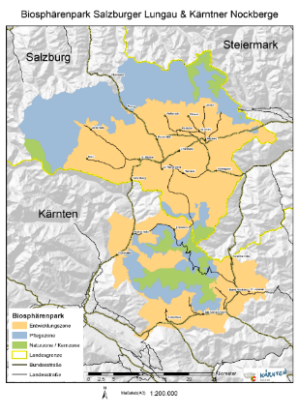

Networks in the education system:
example SCiENCE_LINK^{nockberge}
The Biosphere Reserve Salzburger Lungau & Kärntner Nockberge
area: 1,500 km² in two Austrian provinces (Salzburg & Carinthia)
34,000 inhabitants, 13,000 in Carinthia in four municipalities
internationally recognised UNESCO biosphere reserve since 2012
co-operation SCiENCE_LINK started in 2013

Slide 27





Networks in the education system:
example SCiENCE_LINK^{nockberge}
Partners
Nockberge Biospher Reserve
University of Klagenfurt
University of Applied Sciences Carinthia
Pedagicocal Highschool
E.C.O. Institut for Ecology
Vision
building bridges between international scientific research & real life in a “model region for sustainable development”

Slide 28
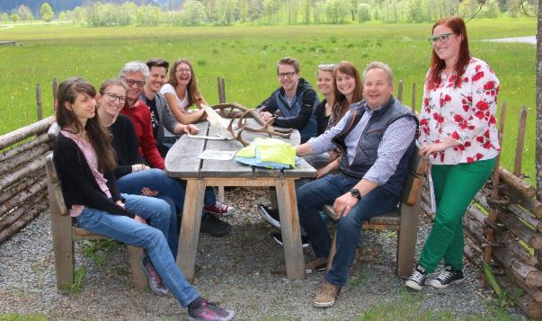
Elements of SciENCE_LINK^{nockberge}
Nockothek
research database on the region
Research question catalogue
collection of topics and challenges that affect the region, its inhabitants and the management of the biosphere reserve
Research Weekend
regularly organised three-day workshop: students looking for topics for their theses meet people and topics from the region

Slide 29

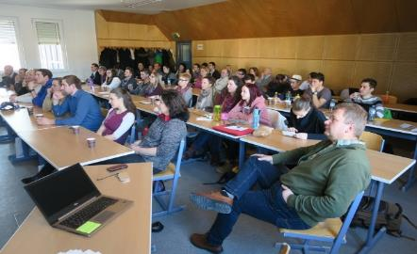
Education for Sustainable Development
Education for sustainable development is understood as constructive negotiation/negotiation of different perspectives and interests of those involved in concrete situations.
This means intensive teaching and learning processes ranging from elementary education to adult education.
The aim is to develop the competence and ability to actively participate in shaping one's own life, living space and the future of societies in the spirit of sustainable development.
The partners contribute their respective expertise and benefit from each other.
Rauch, F. & Falkner, J. (2020). SCIENCE_LINKnockberge – kooperativ Forschen, Lehren und Lernen. In A. Borsdorf, M. Jungmeier, V. Braun & K. Heinrich (eds.), Biosphäre 4.0 - UNESCO Biosphere Reserves als Modellregionen einer nachhaltigen Entwicklung). Dortrecht: Springer, 161-170.

Slide 30
Think about educational networks in your country or community! Who are the key players?
It is suggested to look at these network from different perspectives using the “Four Spectacles” – method (see next slide)
.

Slide 31




Four Spectacles
Analyse the examples you have found in terms of these aspects:
What are the benefits of such a cooperation for each individual partner?
What could be problematic?
What structural, legal and organisational requirements must be taken into account?
What could be the impact on school development?

Slide 32
Think about how networks could support sustainability education!

Slide 33




Create a network
Consider which partnerships could support your work in sustainability education!
Which institutions in the vicinity of your school would be helpful partners?
Design a poster showing the different parts of the network puzzle and how they are connected!

Slide 34
Supplementary literature

Slide 35
Resources to read
Managua, A. & Instance, D. (2018). Teachers as Designers of Learning Environments. The Importance of Innovative Pedagogies. OECD Publishing. Paris. https://www.oecd.org/education/teachers-as-designers-of-learning-environments-9789264085374-en.htm
Rauch, F. (2016). Networking for Education for Sustainable Development in Austria: The Austrian ECOLOG-Schools Programme. Educational Action Research, 24 (1), 34-45. (DOI: 10.1080/09650792.2015.1132000).
Rauch, F. & Dulle, M. (2023). The Austrian ECOLOG Schools Network. Results of a Quantitative Evaluation. Sisyphus, 11(2), 94-107. https://revistas.rcaap.pt/sisyphus/article/view/28591/22582

