Slide 1

אוריינות מדעית במדיה – היבטים מרכזיים עבור PRESS
Notes:
This session relies heavily on the activity of the participants - they should think about why a local perspective is relevant when considering ESD aspects and look for examples themselves.

Slide 2

מהן החוויות שלך עם מדיה מודרנית (למשל רשתות חברתיות) בכיתה המדעית?
Notes:
Here, a short brainstorming session can be conducted.

Slide 3
המדע במדיה

Slide 4

„[Social media are] so widespread and inculcated into our culture that it is futile to try to stop their influence at the classroom door“¹
"הרשתות החברתיות כל כך נפוצות ומשולבות בתרבות שלנו, עד שאין טעם לנסות לעצור את השפעתן בכניסה לכיתה”

Slide 5
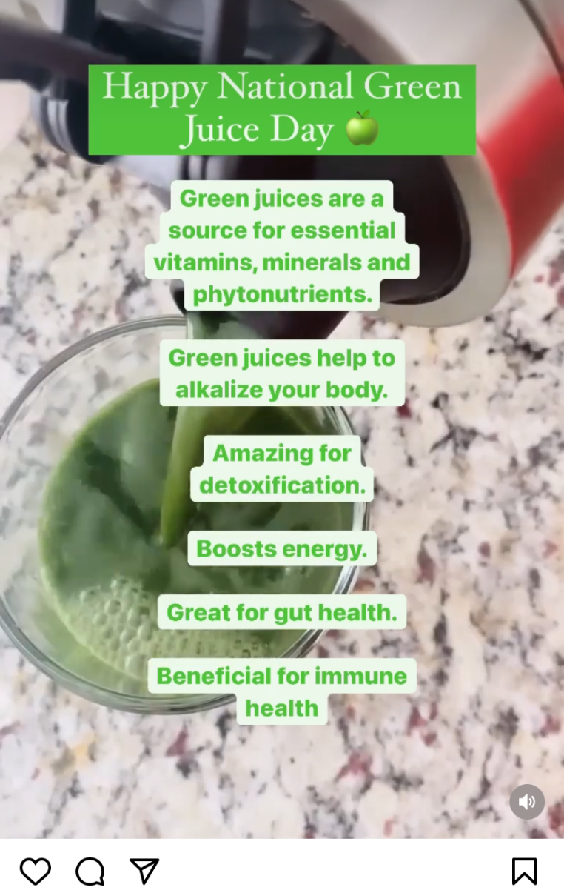
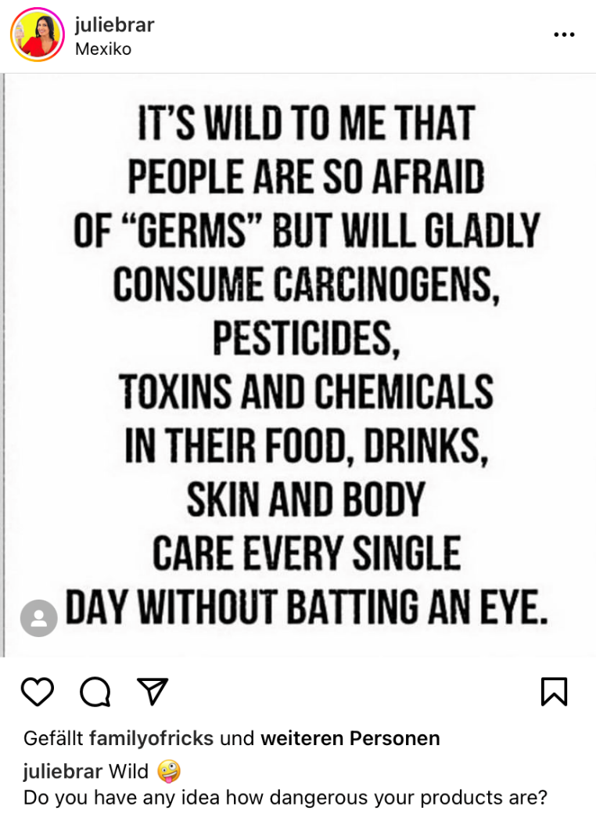
(@juliebrar, 2022a,b)
Notes:
שקופית זו מציגה כיצד נעשה שימוש במונחים מדעיים למטרות שונות לחלוטין.
בפוסט השמאלי, נעשה שימוש במונחים כדי לעורר פחד מ"כימיקלים" ו"חומרי הדברה" ("כימופוביה").
בפוסט הימני (של אותו אדם!), נעשה שימוש במונחים טכניים כמו "אלקליין" כדי להעניק אמינות לטענה.

Slide 6
מהי אוריינות מדיה?
Information L.
Media L.
Social network L.
Library L.
Advertising L.
אוריינות מדיה
ידע על...
- ...תפקידי המדיה
- ...תנאי הפעולה של המדיה
- ...כיצד להעריך תוכן מדיה
FOE and FOI L.
News L.
Digital L.
Television L.
Digital Media L.
Cinema L.
Computer L.
Games L.
Internet L.
(UNESCO, 2011, 2019, L. = Literacy)
Notes:
Media and Information Literacy

Slide 7
Scientific Media Literacy
Domain of skills
Domain of knowledge
Competences of media literacy
Aspects of scientific literacy
Access
Scientific terms and concepts
Analysis
Nature of Science (NOS)
Evaluation
Impact of science and technology to society
Creation
Belova, Chang Rundgren & Eilks, 2015

Slide 8

The Idea of Filtered Information
Science, Scientists, Scientific information
Who filters the information?
How is the information being filtered?
select, understand, be interested (or not), be enthusiastic (or not), ....
Journalists
Politicians
Advertisers
Lobbyists
Interest Groups
…
Interests, beliefs, attitudes, ...
Skills in explaining, writing, illustrating, ...
Citizens (Non-Scientists)
(Lippel, Stuckey & Eilks, 2012; Eilks, Nielsen, & Hofstein, 2012)

Slide 9
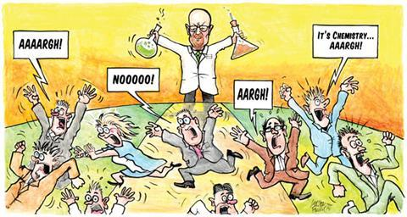
Science and the media
Shapes the public's understanding of science
The more you consume, the more negative it gets.
(Dhingra, 2003; Guerris et all., 2020; Maier et al., 2014; Lee & Niederdeppe, 2011; ¹Hove, Paek & Isaacson, 2011, p. 524; https://edu.rsc.org/soundbite/a-dirty-word/2000517.article - The Hit Man)
Notes:
Media shape the public's understanding of science
Intense exposure to media = negative impact on attitudes toward science
"Chemophobia"
Media influence both young people's ideas about science (or NOS) and their behavior in socio-scientific decisions
But: "The more children know, the harder they are to persuade."¹

Slide 10
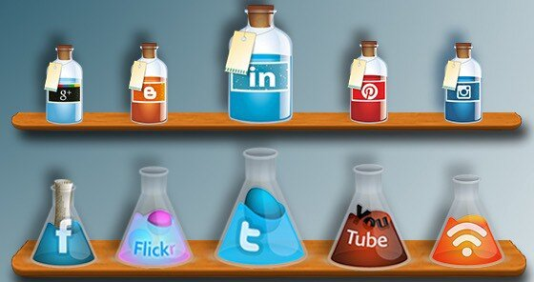
Science and the media
influence young people's ideas
  about science (or NOS)
  their behavior in socio-scientific decisions
(Dhingra, 2003; Guerris et all., 2020; Maier et al., 2014; Lee & Niederdeppe, 2011; ¹Hove, Paek & Isaacson, 2011, p. 524; https://edu.rsc.org/soundbite/a-dirty-word/2000517.article - The Hit Man)
Notes:
Media shape the public's understanding of science
Intense exposure to media = negative impact on attitudes toward science
"Chemophobia"
Media influence both young people's ideas about science (or NOS) and their behavior in socio-scientific decisions
But: "The more children know, the harder they are to persuade."¹

Slide 11
Science and the media
influence young people's ideas
  about science (or NOS)
  their behavior in socio-scientific decisions
"The more children know, the harder they are to persuade.“¹
(Dhingra, 2003; Guerris et all., 2020; Maier et al., 2014; Lee & Niederdeppe, 2011; ¹Hove, Paek & Isaacson, 2011, p. 524; https://edu.rsc.org/soundbite/a-dirty-word/2000517.article - The Hit Man)
Notes:
Media shape the public's understanding of science
Intense exposure to media = negative impact on attitudes toward science
"Chemophobia"
Media influence both young people's ideas about science (or NOS) and their behavior in socio-scientific decisions
But: "The more children know, the harder they are to persuade."¹

Slide 12
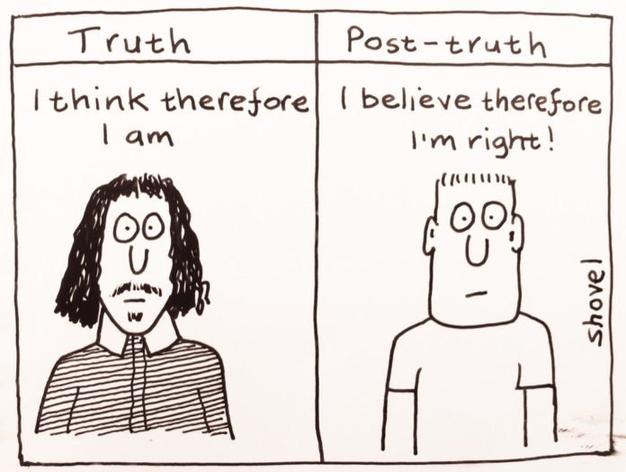
Between misinformation and manipulation
„Post-truth world“ - challenges for the educational landscape
Fake News, misinformation, malinformation, manipulation strategies
 | I | II
Disinformation | x | x
Misinformation | x
Malinformation |  | x
  actually false information (I)
  information that is intended to harm someone (II)
(Dhingra, 2003; Guerris et all., 2020; Maier et al., 2014; Lee & Niederdeppe, 2011; ¹Hove, Paek & Isaacson, 2011, p. 524; https://edu.rsc.org/soundbite/a-dirty-word/2000517.article - The Hit Man)
Notes:
„Post-truth world“ - challenges for the educational landscape
Fake News, misinformation, malinformation, manipulation strategies
Often with a scientific or chemical background
Even short and one-time interventions have a lasting effect
„Inoculation“
Still many research gaps!
– prior exposure of strategies protects against "falling for" misinformation and manipulation

Slide 13

Between misinformation and manipulation
  Even short and one-time interventions have a lasting effect
    „Inoculation“
(Acerbi, Altay & Mercier, 2022; Barzilai & Chinn, 2020; Cook, Lewandowsky & Ecker, 2017; Roozenbeek & van der Linden, 2019 etc.; http://thecrcl.ca/living-post-truth-world/)
Notes:
„Post-truth world“ - challenges for the educational landscape
Fake News, misinformation, malinformation, manipulation strategies
Often with a scientific or chemical background
Even short and one-time interventions have a lasting effect
„Inoculation“
Still many research gaps!
– prior exposure of strategies protects against "falling for" misinformation and manipulation

Slide 14
Between misinformation and manipulation
  Even short and one-time interventions have a lasting effect
    „Inoculation“
Still many research gaps!
(Acerbi, Altay & Mercier, 2022; Barzilai & Chinn, 2020; Cook, Lewandowsky & Ecker, 2017; Roozenbeek & van der Linden, 2019 etc.; http://thecrcl.ca/living-post-truth-world/)
Notes:
„Post-truth world“ - challenges for the educational landscape
Fake News, misinformation, malinformation, manipulation strategies
Often with a scientific or chemical background
Even short and one-time interventions have a lasting effect
„Inoculation“
Still many research gaps!
– prior exposure of strategies protects against "falling for" misinformation and manipulation

Slide 15
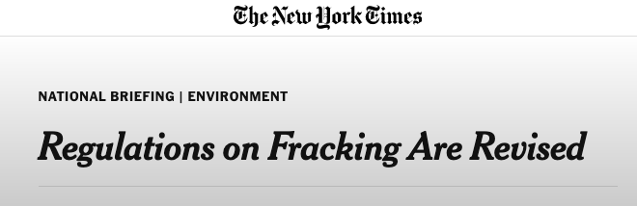

Media in the chemistry classroom – current situation
In chemistry classes - traditional media (newspapers)
Limited number of goals
  Introduction to lessons
  context for experiments or tasks
(Belova & Eilks, 2015; Belova & Tietjen, 2021; Jarman & McClune, 2002; Reid & Norris, 2016; Kachan et al., 2006; https://www.nytimes.com/2013/01/19/us/regulations-on-fracking-are-revised.html?searchResultPosition=5)
Notes:
In chemistry classes - traditional media (newspapers)
Limited number of goals
Introduction to lessons, context for experiments or tasks
Use of e.g. social media and advertising demanded for a long time, but not yet implemented in chemistry classes
Learning with rather than learning about media
Teachers are skeptical and don‘t feel prepared

Slide 16

Media in the chemistry classroom - demands
Use of e.g. social media and advertising demanded for a long time, but not yet implemented in chemistry classes
Learning with rather than learning about media
Teachers are sceptical and don‘t feel prepared!
(Belova & Eilks, 2015; Belova & Tietjen, 2021; Jarman & McClune, 2002; Reid & Norris, 2016; Kachan et al., 2006)
Notes:
In chemistry classes - traditional media (newspapers)
Limited number of goals
Introduction to lessons, context for experiments or tasks
Use of e.g. social media and advertising demanded for a long time, but not yet implemented in chemistry classes
Learning with rather than learning about media
Teachers are skeptical and don‘t feel prepared

Slide 17
Example for a context: sustainability in social media

Slide 18
Go to a social network of your choice and search for the hashtag #sustainability. Describe your impressions!
Here, a QR code to a digital tool such as Mentimeter (mentimeter.com) can be inserted to collect the ideas.

Slide 19
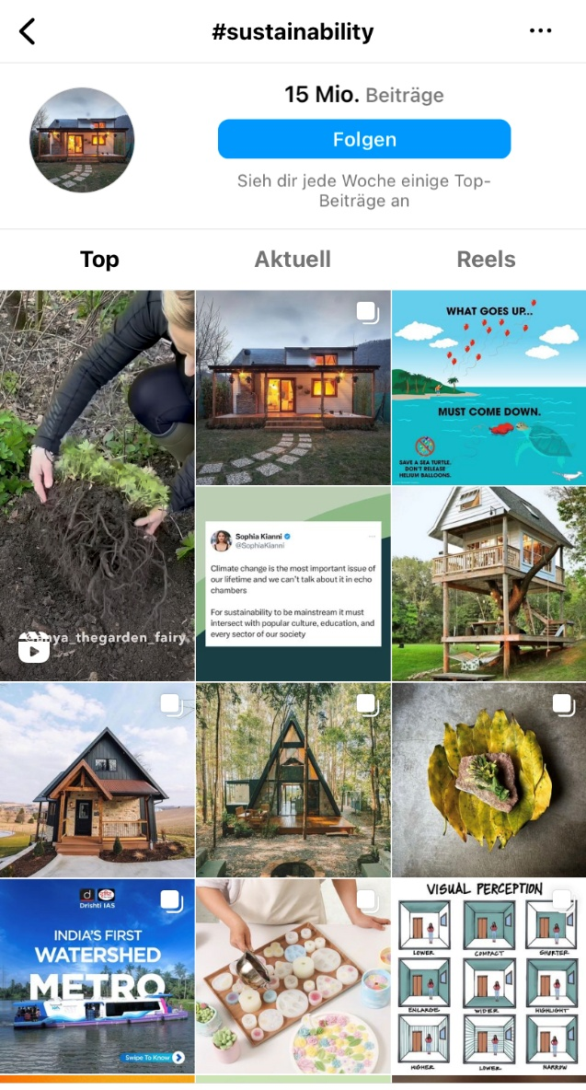
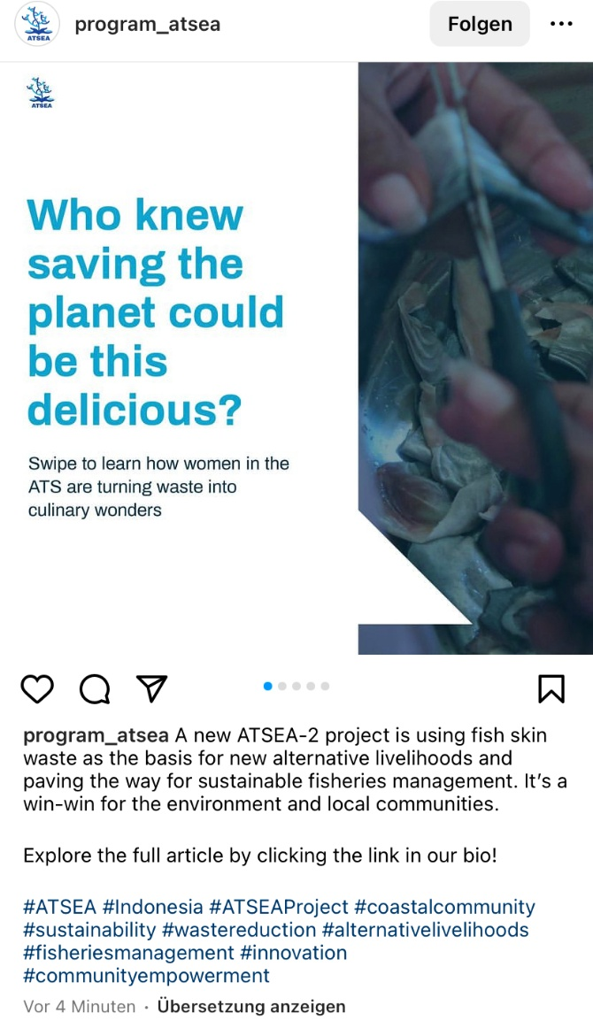
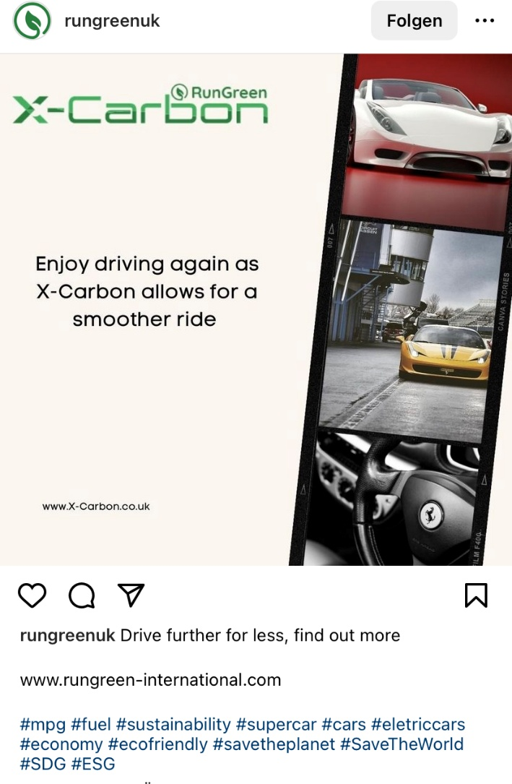
Sustainability in social media
Notes:
There is a lot of content on social media when you search for #sustainability. Most of it provides only a limited picture (Greenwashing, advertising etc.)

Slide 20
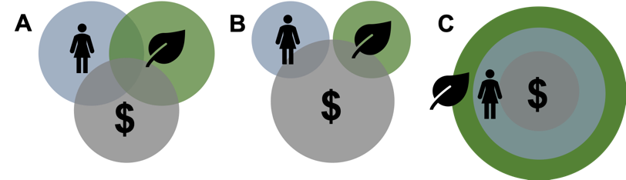
Sustainability – not so easy…
based on Leinfelder, 2018
Notes:
Sustainability as three intersecting circles. Not a easy concept, yet simplified in social media!

Slide 21
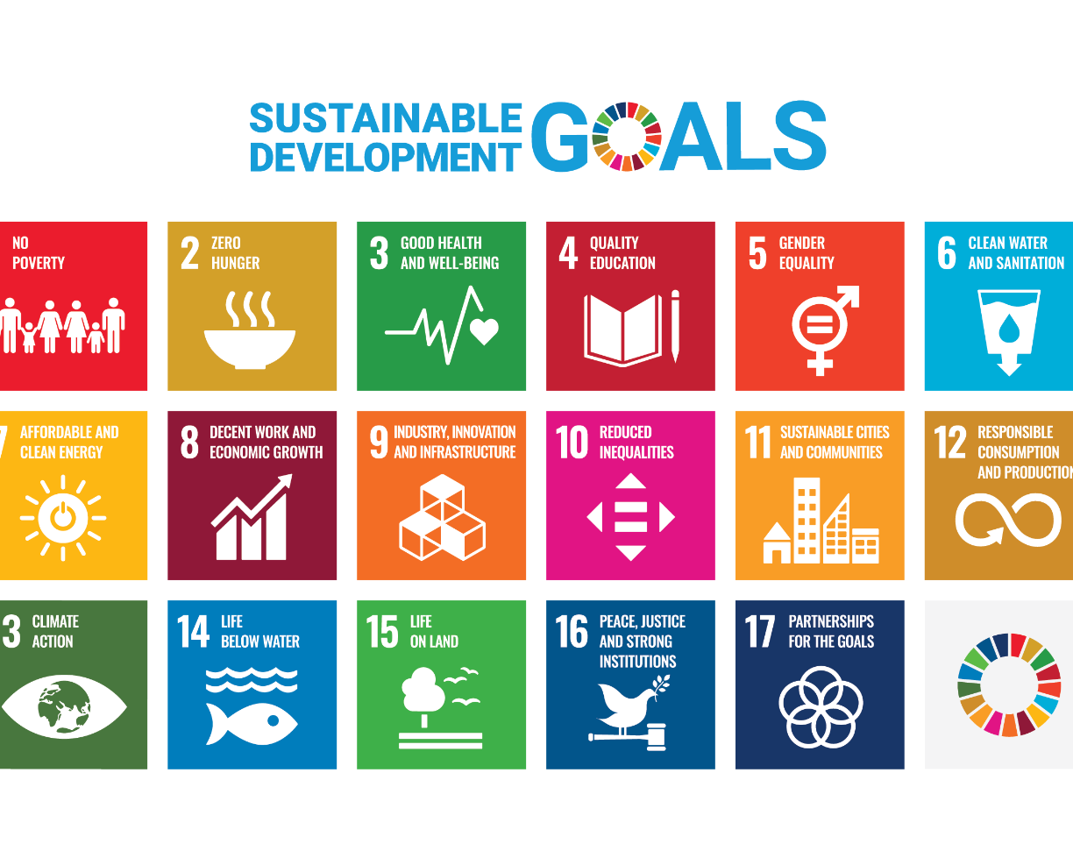


Numbers
#sustainability: 15,4 million posts
#sdgs: 3 million posts
#sustainabledevelopmentgoals: 258 million posts
#sustainability: 5 billion views
“SDGs" von Unbekannter Autor ist lizenziert gemäß CC BY-NC-ND

Slide 22
Analysis of Posts (N = 300)
Environment
Economic
several
Notes:
We analyzed 150 posts from Instagram and 150 posts from TikTok which we found under the hashtag #sustainability. Most of the posts only addressed the environmental dimension.

Slide 23
A short teaching sequence on sustainability in social media
Notes:
You can use any other example from your portfolio or the ones in the supplementary materials.

Slide 24
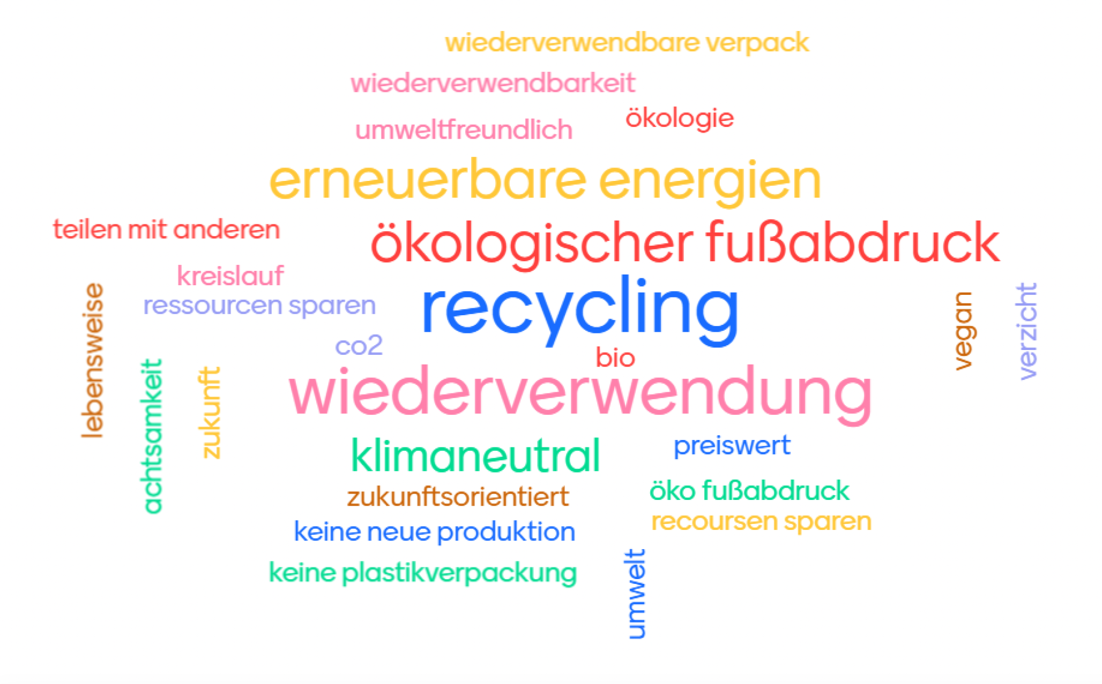
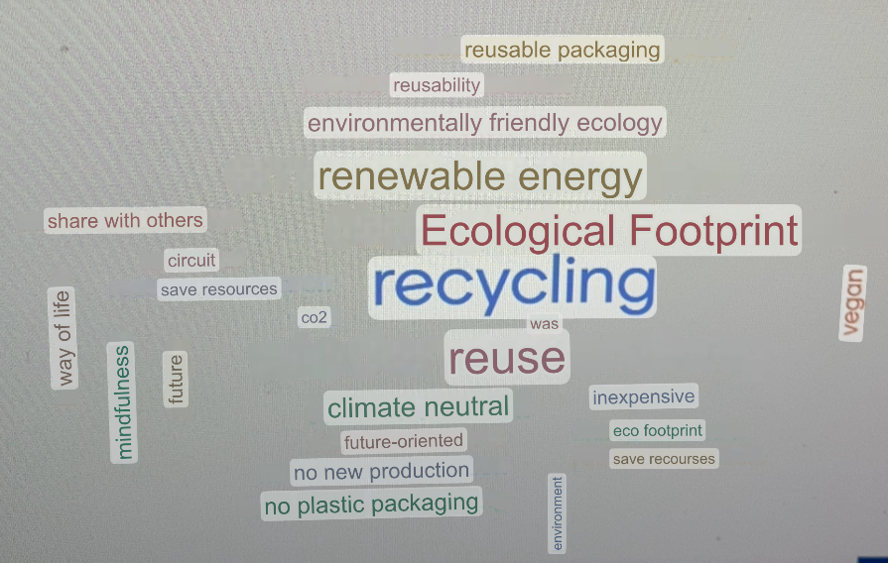
"What goes through your mind when you hear “Sustainability"?
Translation:
Data from 9th grade
Notes:
At the beginning of the 90 minute lesson, the students collected their associations with the term „sustainability“ via Mentimeter. Most of the aspects mentioned referred to the ecological dimension only.

Slide 25
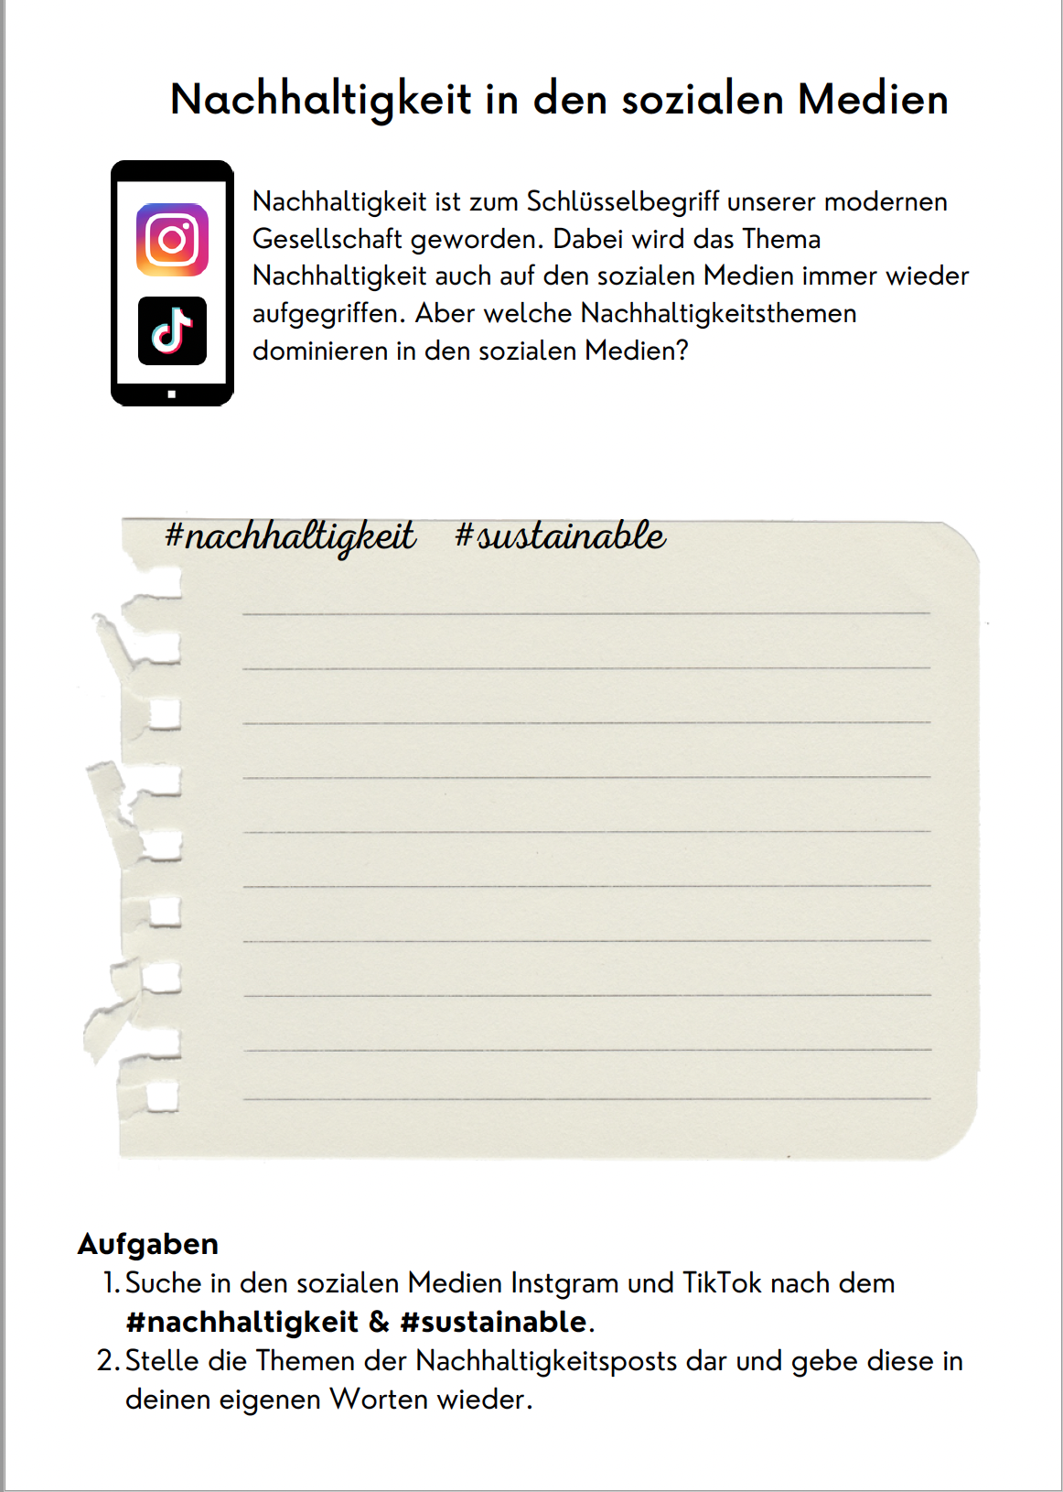
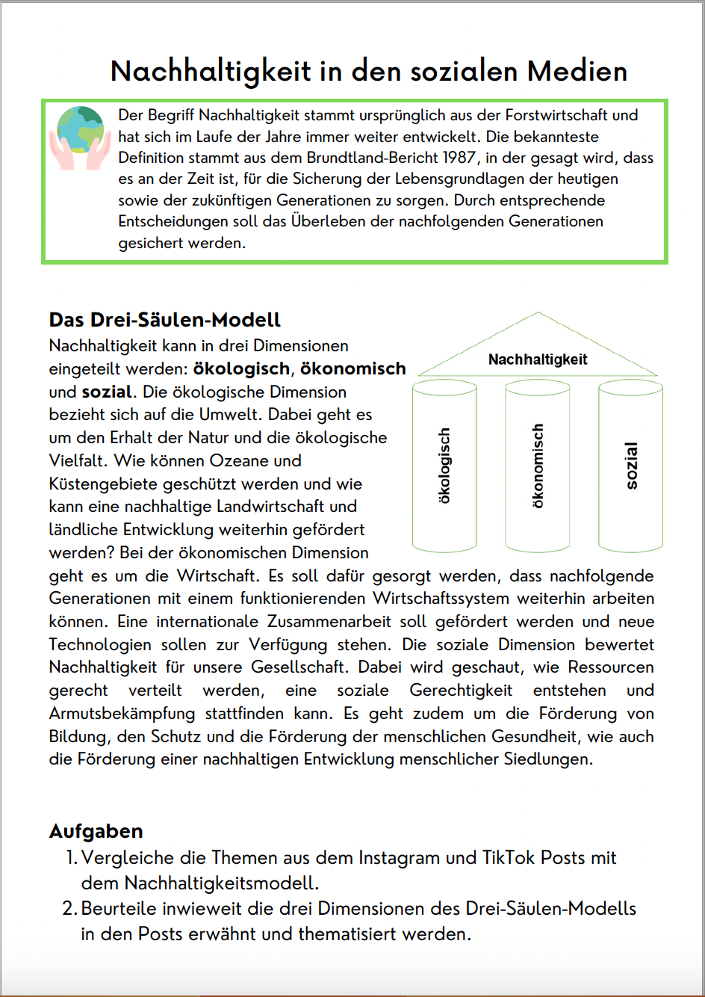
Work Phase
Notes:
In the work phase, the students searched for the #sustainability themselves and compared their findings with the three-pillar-model.

Slide 26
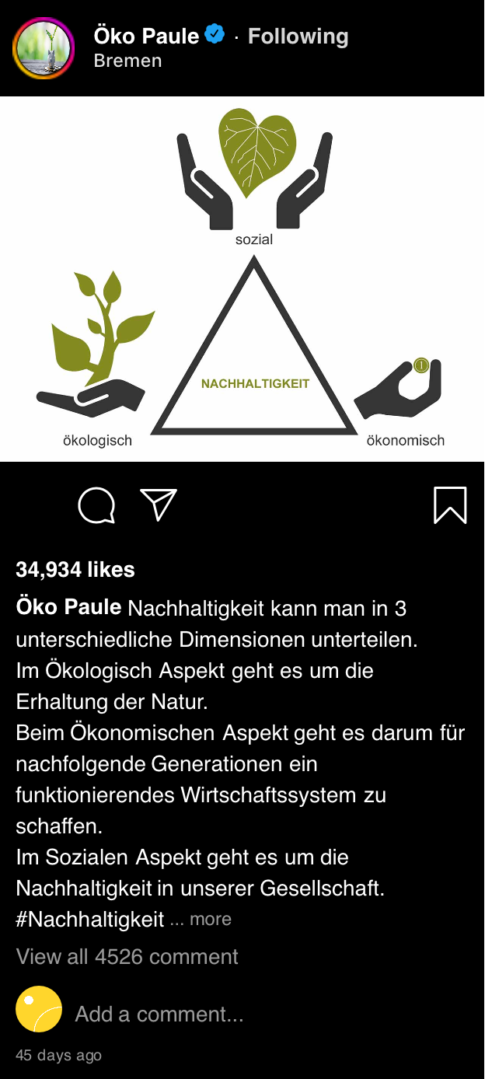
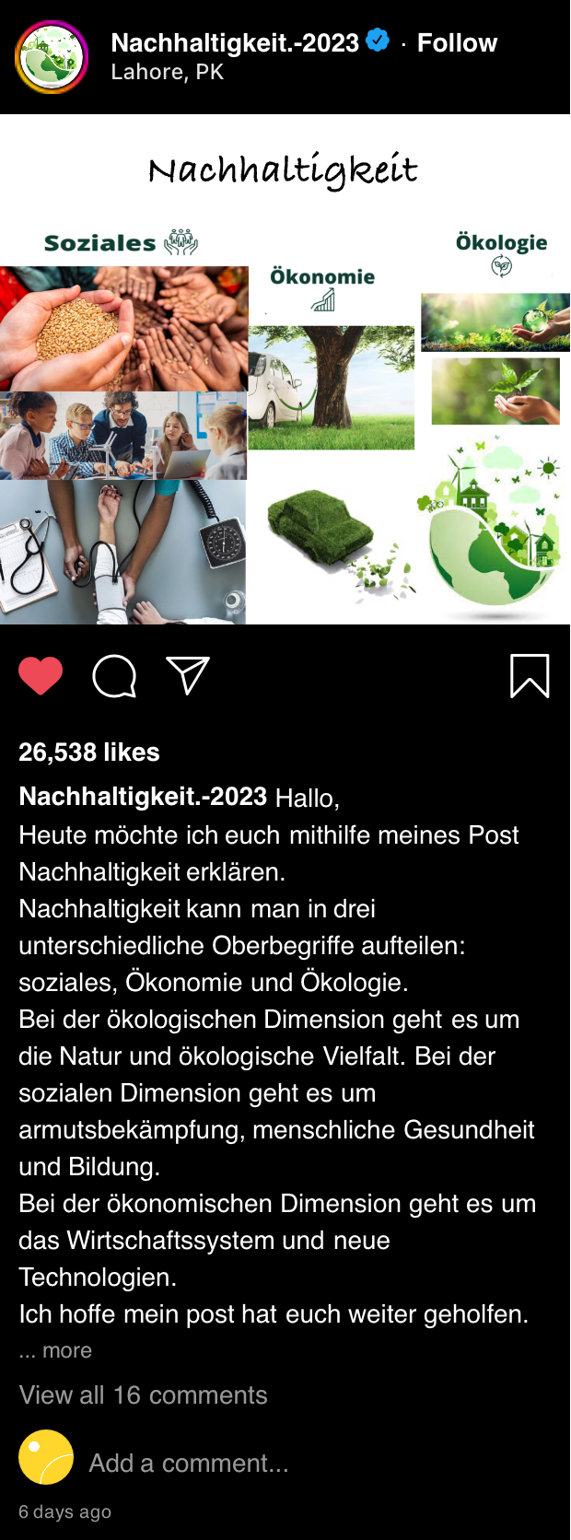
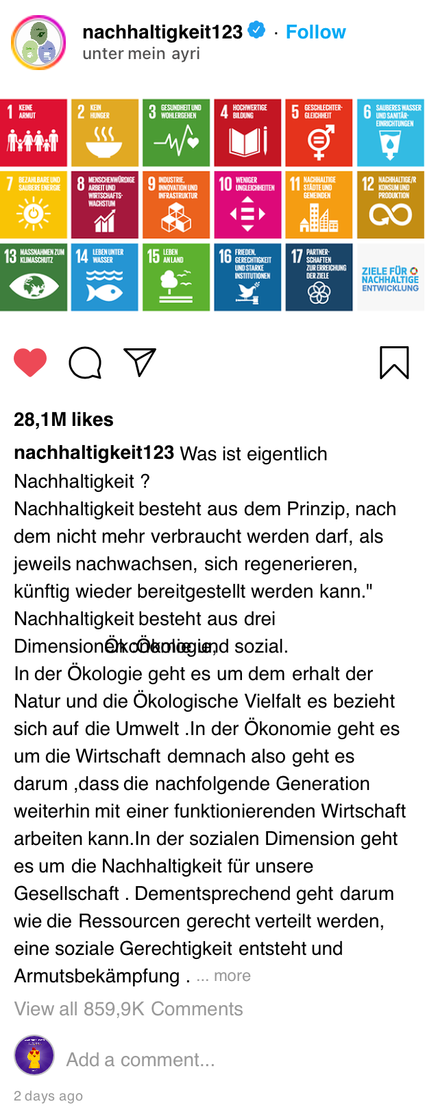
Own Posts – Gallery Walk
Notes:
at the end, the students created their own Instagram posts on the three pillar model.

Slide 27
Mentimeter (l) vs. Post-Questionnaire (r)
Environment
Economic
Social
Personal Action
Future Generations
Guiding Principle for all Actions

Slide 28
Task: Outline your own teaching sequence which fosters scientific media literacy and ESD. Work in groups!

Slide 29
Discussion: How can we foster (critical) scientific media literacy in the science classroom?

Slide 30
Final thoughts
How can we teach (about) sustainability in a post-truth world?
It is important to prepare teachers for their future role: they must provide learners with skills that help them evaluate complex issues.
Future teachers should also be sensitized to the sometimes one-sided portrayals of sustainability aspects in social media.
Notes:
Wissen, Bewerten und Handeln

