Slide 1
Action Research: Theoretical Concepts, Practical Examples, and a Base to Reflect your PRESS- Projects

Slide 2
Overview
Action Research
The Action Research Cycle
Action Research quality criteria
Ethics in Action Research
The Action Research process
Action Research methods, examples and networks
Reflection of the course

Slide 3
Action Research
Action Research is the study of a social situation carried out by those involved in that situation in order to improve both their practice and the quality of their understanding. (Winter & Munn-Giddings 2001)
The research interest is in the service of practice interests.
Winter, R.,Munn-Giddings, C. (2001) A Handbook for Action Research in Health and Social Care. London: Routledge.

Slide 4
Action Research
Action Research is carried out by people (e.g. teachers) directly concerned with the social situation that is being researched (e.g. teaching and learning of science)
Action Research starts from practical questions arising from everyday educational work
Action Research offers a repertoire of simple methods and strategies for researching and developing practice e.g. diaries, observation profiles, interviews, simple questionnaires (sensible ratio of costs to results)
Action Research is characterized by inserting individual findings into a professional discussion and by making knowledge of teachers open to the public

Slide 5
Action Research principles
Practitioners are involved in a systematic reflection on practice
Combines development and research interest
It is a cyclical and iterative approach
It reviews implicit theories
It uses a synopsis of perspectives

Slide 6
The Action Research process
Finding a starting point
Identifying research questions
Choosing methods
Collecting data
Analysing data
Implementing in practice
…. maybe further cycles ….
Publishing results

Slide 7
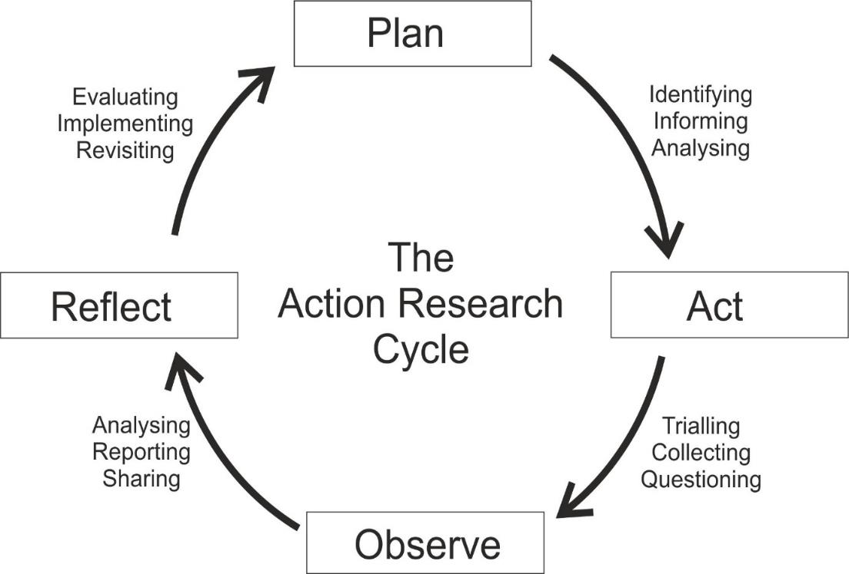
The Action Research Cycle
ARTIST Consortium (Eds.) (2019). The ARTIST Guidebook - A Guidebook to Prepare and Conduct
Workshops on Action Research in Science Teacher Education.
http://idn.digitale-medien.uni-bremen.de/Artist/Material/Guidebook_eng.pdf

Slide 8
Finding a starting point
Pedagogical question
Didactical question
Content question
Wish/need for change
Personal interest/curiosity
Individual experience
(Locally) relevant topic

Slide 9
Identifying research questions
Guiding questions
I would like to improve in …
I am amazed by …
I am really curious about …
Something that I think would really make a difference is …
Something I would really like to change is …

Slide 10
Benefit of Action Research
If my action research will be successful, the benefit will be …
for me
for my students
for my colleagues
for …

Slide 11
Action Research quality criteria
Epistemological quality criteria
Pragmatic quality criteria
Ethical quality criteria
Feldman, A., Altrichter, H., Posch, P.& Somekh, B. (2018). Teachers Investigate Their Work.
An Introduction to Action Research across the Professions. Routledge, London

Slide 12
Ethics of Action Research
In order to support the validity of the research
All persons involved are informed about goal, scope and function of the research.
The “Owner” of data is the person who gives the information (clearing).

Slide 13
Triangulation
Perspective of third person
Perspective of teachers
Perspective of students

Slide 14
Action Research methods
Perspective of Teachers tools for self assessment and evaluation | e.g. research diary, pictures, video and audio recordings, document analysis, SWOT analysis
Perspective of 3rd Person Tools for qualitative and quantitative social research | e.g. questionnaire, observation, intervievs, focus groups, document analysis, poictures, video and audio recordings
Perspective of Students tools for childhood research | e.g. vignettes, puppet interviews, mind maps, focus groups

Slide 15

Example for an Action Research tool: Research diary
Written thinking and reflection
Preventing the loss of important information
Analysis of own experiences
Description
Interpretation

Slide 16

Example for an Action Research tool: Focus group
Group discussions with 5-8 participants
Discussion guide
Group interaction and group dynamics lead to more in-depth information than individual interviews
Audio recording, transcription
Qualitative analysis

Slide 17
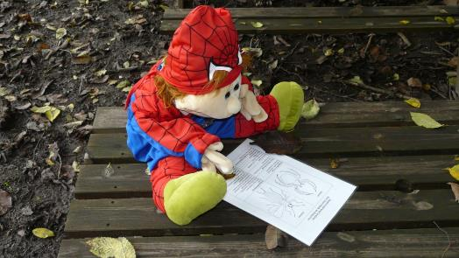
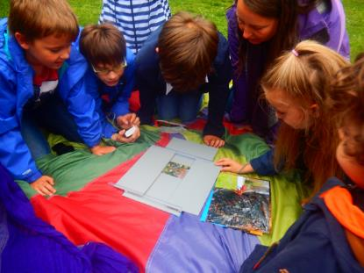
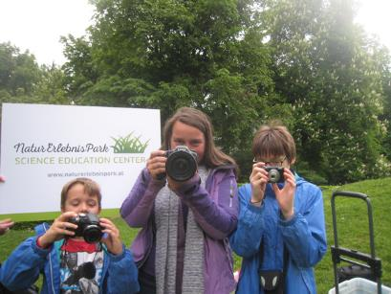
Example: Action research with children
Consider children as competent research participants rather than merely objects or sources of information for adults (Broström 2012)
Less bias by adapting social research methods to children's limited abilities in reading, writing and complex language use (Heinzel 2012)
Research focuses not only on knowledge and skills, but also on attitudes, perceptions and values through a wide range of instruments (Sevon et al. 2023)
Language-based methods | Visual methods | Playful and creative methods
e.g. puppet-supported vignettes | e.g. picture-based mind-maps | e.g. creating a photostory
Broström, S. (2012). Children's participation in research. International Journal of Early Years Education, 20(3), 257–269.
Heinzel, F. (2012) Methoden der Kindheitsforschung. Ein Überblick über Forschungszugänge zur kindlichen Perspektive, Weinheim: Beltz Juventa.
Sevón,E., Mustola, M., Siippainen A. & Vlasov, J. (2023) Participatory research methods with young children: a systematic literature review, Educational Review.
http://dx.doi.org/10.1080/09669760.2012.715407

Slide 18

Action research with children: Puppet discussion
A child-friendly version of the focus group method
A puppet acts as an icebreaker and motivates the children to participate in the discussion
This avoids the exam-like atmosphere and encourages even shy children to participate
The discussion follows a discussion guide
The discussion is recorded and can be analyzed afterwards
The method is well suited for capturing children's attitudes, concepts, and more complex thoughts
Picture generated by https://raphael.app/de

Slide 19

Action research with children: Puppet discussion
Choose a sustainability-related topic that you would like to explore with the children in your class
Develop an interview guide with five questions on this topic
Think about a setting in which the interview and moderation can take place with the help of a hand puppet
Try out the puppet discussion with your colleagues

Slide 20

Action Research: Vignette research
A vignette is a brief, stimulating description of a situation that is intended to encourage the respondents to make assessments or engage in further discussion.
It is advisable to illustrate vignettes for children with a picture.
The children's discussion is recorded and can then be analyzed.
Vignettes are suitable for researching attitudes and opinions, but also for checking the extent to which scientific concepts have been understood.
Picture generated by https://raphael.app/de

Slide 21

Action Research: Vignette research
Think of a topic related to sustainability and find an everyday situation in which this topic is relevant.
Come up with a decision-making situation in which a person has to consider how to behave/react.
Draw a picture of this situation.
Think of three questions to stimulate discussion with the children.
Try out the vignette discussion with your colleagues.

Slide 22
Example for an Action Research project
Context
22 students in secondary school (grade 9)
Subject: Biology (three hours per week)
Question
How can I offer students more space for self-directed inquiry-based learning?
Action
Implementation of project-based teaching on the topic of ‘forest’ chosen by the pupils over a period of one month

Slide 23

Example for an Action Research project
Students go on an excursion to a forest near the school accompanied by a ranger
students work in three groups: (1) Plants of the forest; (2) forests dying (because of air pollution); (3) rainforest in South America
students explore topics in groups (search for information, interviews with experts)
students write reports, present them and discuss them

Slide 24
Example for an Action research project
Data
research diary, survey of students at the end of the project, student reports, observation of students by another teacher
analysis of data
discussion with critical friends (group of teachers)
Results
Students need a clear framework for self-directed and autonomous learning.
It was important to assume certain skills of the students.
Revised Plan
modification in one‘s own role
development of material and publication of a case study

Slide 25
Discuss the following questions:
What makes Action Research different to other research in education?
What are quality criteria for action research?
What needs to be considered when using Action Research?
The following article may be helpful in completing this task and deepening your understanding of action research.
Rauch, F., Zehetmeier, S., & Posch, P. (2019). Educational Action Research. In O. Zuber-Skerritt, & L. Wood (Eds.), Action Learning and Action Research. Genres and Approaches (pp. 111 - 126). Bingley: Emerald Group Publishing Limited. https://doi.org/10.1108/978-1-78769-537-520191012

Slide 26
Reflection on the course

Slide 27
Discuss in groups the following questions:

Slide 28
Reflection I
Does your PRESS project have potential to fulfill criteria for good Action Research?
Good Action Research pursues worthwhile practical purposes
by trying to find solutions to real problems and empowering the people affected to acquire relevant knowledge and share it with others;
by leading to actions that are embedded in a humanistic values system.
Good Action Research is collaborative/participatory
by involving those affected in the research process;
by agreeing on ethical rules for collaboration.

Slide 29
Reflection I
Does your PRESS project have potential to fulfill criteria for good Action Research?
Good Action Research is responsive and developmental
by engaging in a continuous series of research-and-development cycles;
by taking into account the different perspectives of the various interest groups in the search for satisfactory solutions to problems.
Good Action Research connects theory and practice
by balancing action and reflection;
by generating theoretical knowledge, delivering solutions to problems and promoting practical improvements.

Slide 30
Reflect by yourself the following questions along a scale of
non-confident - slightly confident - quite confident - confident:

Slide 31
Reflection II
I feel confident in …
the basic theories of sustainable development and Education for Sustainable Development (ESD).
orienting my teaching towards ESD along international and national policies and examples of good practices.
using a spectrum of different kind of media in my later teaching for ESD.
identifying and using non-formal learning resources and networks to improve my teaching for ESD.
initiating and guiding my later students in sustainability-oriented project-based learning.

Slide 32
To take away:
Investigate the following networks for Action Research:
CARN: https://www.carn.org.uk/
ALARA: https://www.alarassociation.org/ https://www.alarassociation.org/networks/around-the-world/europe
ARNA: https://www.arnaconnect.org/

