Slide 1
Project-based learning and innovative structures for ESD with informal and non-formal partners
“Makers of the future: creating sustainability together”

Slide 2
ESD with informal and non-formal partners: lecture outline
What is a learning environment?
Defining formal, non-formal and informal learning environments with examples
How to collaborate with non- and informal partners?
The criteria for collaboration and an example highlighting its possibilities
Examples of projects in ESD with informal and nonformal partners

Slide 3
1. What is a learning environment?
Formal, non-formal and informal learning environments
Example of a non-formal and an informal learning environment

Slide 4
What is a learning environment?
A LEARNING ENVIRONMENT
Learner
Organisation
Technology
Physical
Technical
Social
Pedagogical
Available space
Furniture and their arrangement
ICT
Accessibility
Group dynamics
Atmosphere, mutual respect
Teaching and learning methods
Air quality, lights, acoustics, etc.
Learning aims
Learning environment has an impact on an individual's learning
Not just a physical space – at least 4 different perspectives
Important to examine a learning environment as a whole
There is also no unequivocally good or bad environment, as its significance varies for different people and is subject to change
Baeten et al., 2010; Majoinen, 2019.
Notes:
Majoinen (2019), suggests that learning environments can be examined from at least four different perspectives, as illustrated in Figure 1:
Physical Perspective: Focuses on the concrete space where learning takes place. Physical learning environment can be seen as a traditional classroom, as the classroom often serves as the meeting place for teaching and learning. In its broadest sense, the physical dimension is a combination of formal and informal educational systems, where learning takes place both within and outside the schools.
Social Perspective: Emphasizes interactivity, where users shape the space into a learning environment through group processes and communication. The social learning environment extends beyond the physical space and includes the psychological atmosphere and factors influencing it, encompassing external communities and relationships affecting learning.
Pedagogical Perspective: Highlights the educational and developmental aspects, the actions of a teacher. This perspective can be approached from various angles, such as physical, psychological, and social. It involves aspects like educational methods and tools, learning aims, and interaction between teacher and student.
Technological Perspective: Centers on learning environments created through technology. It emphasizes that mere use of technology is not sufficient; rather, the definition of a learning environment requires the provision of support and guidance to facilitate learning.
Majoinen, J. (2019). Toimintakulttuuri, resurssit ja pedagogia: Oppilaan tukea edistävät ja vaikeuttavat tekijät fyysisessä, sosiaalis-pedagogisessa ja teknologisessa oppimisympäristössä. Itä-Suomen yliopisto. 31153666_UEF_Vaitoskirja_144_Juha_Majoinen_Fil_sisus_19_08_16.pdf
Baeten, M., Kyndt, E., Struyven, K. & Dochy, F. 2010. Using student‐centred learning environments to stimulate deep approaches to learning: Factors encouraging or discouraging their effectiveness. Educational Research Review, 5, 243–260.

Slide 5
Formal, non-formal and informal learning
Learning (or education) are often divided into formal, non-formal and informal learning
Formal constitute the formal education system of a country - compulsory learning according to a curriculum and typically in schools
Non-formal is goal-oriented and planned by an education provider. Can take place in guided activities or through the learner's own initiative
Informal forms of learning that are somehow intentional, but voluntary and less structured than either formal or non-formal education. Can occur in the family and daily life, on a self-directed, family-directed or socially-directed basis

Slide 6
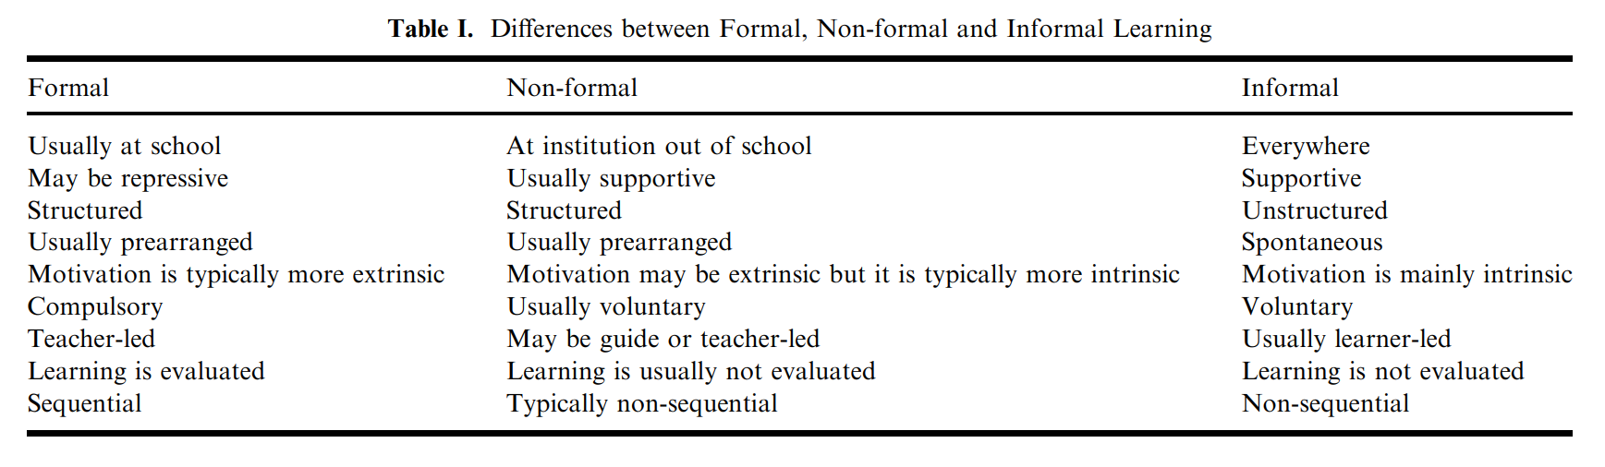
Formal, non-formal and informal learning
Eshach, H. (2007). Bridging In-school and Out-of-school Learning: Formal, Non-Formal, and Informal Education. Journal of Science Education and Technology, 16(2), p. 174. https://doi.org/10.1007/s10956-006-9027-1

Slide 7
What kind of experiences do you have with different learning environments?
How would you classify these learning environments?
It is suggested to collect, classify and discuss students‘ ideas via a card clustering via Miro (https://miro.com/) or a similar tool.
Notes:
Discussion idea: Thinking about different learning environments
1. What kind of experiences do you have with different learning environments (a) as a learner (b) as a teacher (e.g. if you have been a substitute teacher or done your practicum)?
2. How would you classify the learning environments you mentioned?

Slide 8

Formal, non-formal and informal learning: Examples of different kind of learning environments
MOOC / Moodle etc.
Schools afternoon activities
Science competitions and fairs
Science clubs / camps
Nature
Home
Zoom, Teams, etc.
Hobbies
Out-of-school study visits
Science centers
Science /STEM classrooms or laboratories
Libraries
Media
Classroom / School
Social media
Project work
Museums
FORMAL NONFORMAL INFORMAL
LUMALab Gadolin at the Faculty of Science, University of Helsinki
Kemianluokka Gadolin (@kemianluokkagadolin) | TikTok
Notes:
PLEASE NOTE THE ANIMATIONS
Two examples from ChemistryLab Gadolin:
Non-formal learning environment: Study visits to the ChemistryLab Gadolin
Informal: Gadolin TikTok channel and chemistry related videos for youth

Slide 9
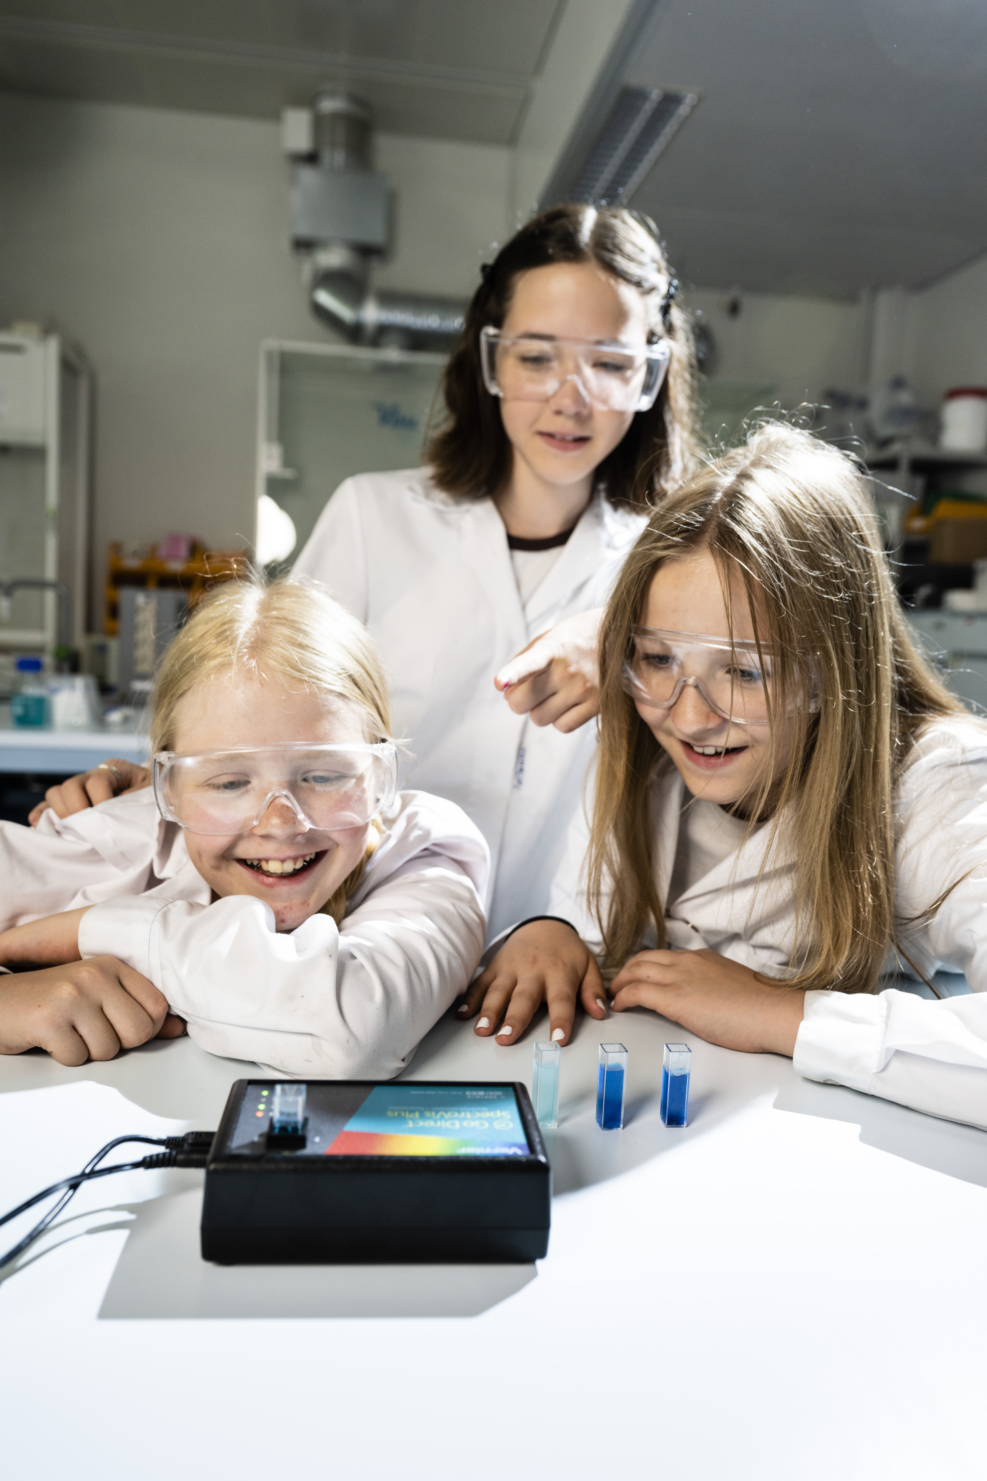

Example 1. A nonformal learning environment
LUMALab Gadolin
Versatile non-formal learning environment / laboratory offering e.g., free-of-charge study visits at the Department of Chemistry, University of Helsinki
Part of LUMA Centre Finland, a science
education network of Finnish universities
Website: LUMALab Gadolin | Science education and Academic Outreach | University of Helsinki
Picture: LUMAlab Gadolin, University of Helsinki

Slide 10
Example 1. A nonformal learning environment: study visit to LUMALab Gadolin
Before the study visit
The teacher books the visit online
The topics of the study visits are planned to support the educational goals of the group (link to curriculum)
The students make preliminary tasks in class
At the study visit (could also be an online visit)
Contextual, Inquiry-based, and hands-on learning
The visits are supervised by university students (future chemistry teachers or future chemists)
After the study visit
Revision tasks for students to reflect on learned
Feedback from the visit
Examples of laboratory works that can be done during a visit:
Experiments Optimized by Green Chemistry Ideas – Chemical Safety in Science Education (chesse.org)

Slide 11
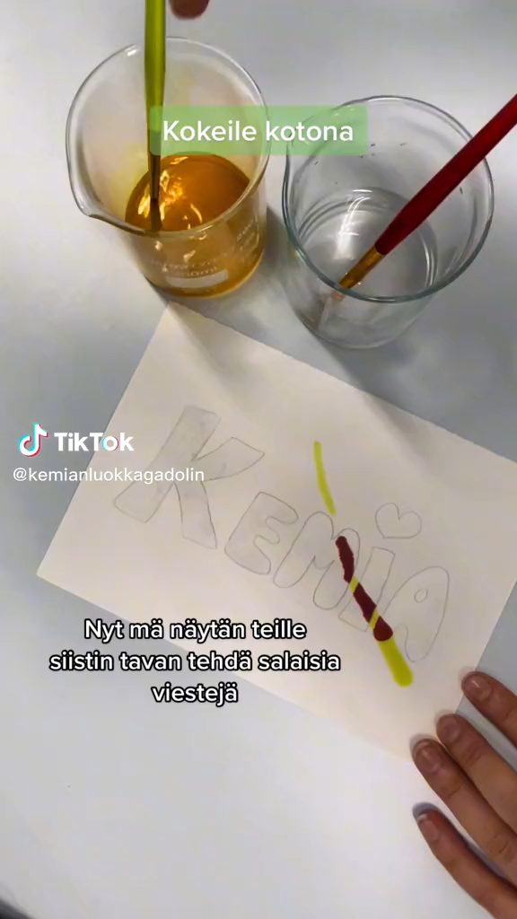
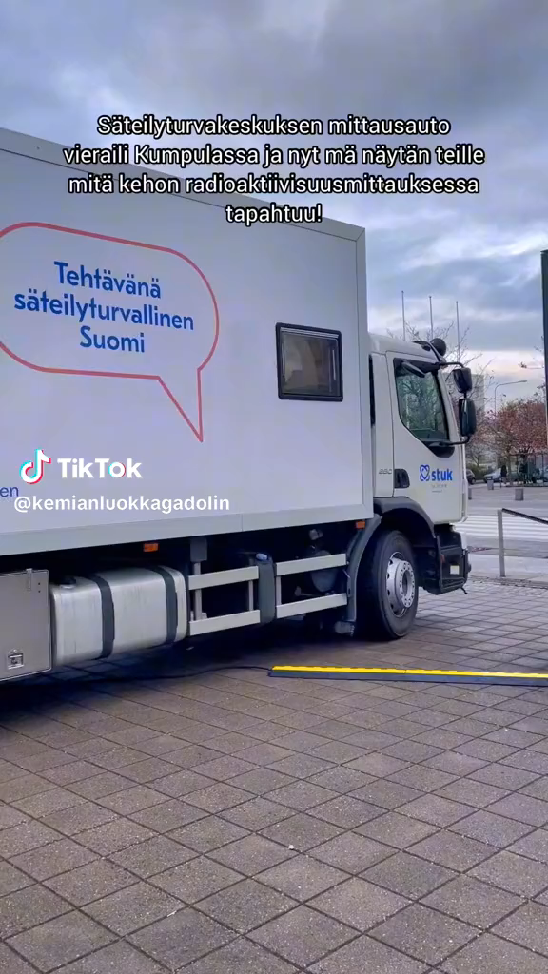
Example 2: Informal learning in Gadolin Tiktok
Informal chemistry learning
Making chemistry interesting
Motivating youth towards science learning and careers
Supporting discussion with youth on science
Interest for teachers
Use as demonstrations
Teasers to support discussion and promote interest in learning
Interdisciplinary workshop supporting science learning and media literacy
Kemianluokka Gadolin (@kemianluokkagadolin) | TikTok
TikTok videos by LUMAlab Gadolin, University of Helsinki
Notes:
PLEASE NOTE: THE VIDEOS ARE LINKED TO THE PRESENTATION (SEE ANIMATION PANE)
Kemianluokka Gadolin (@kemianluokkagadolin) | TikTok

Slide 12
2. How to collaborate with non-formal and informal partners in ESD?
Introduction through an example
Criteria for collaborating with non-/informal partners

Slide 13

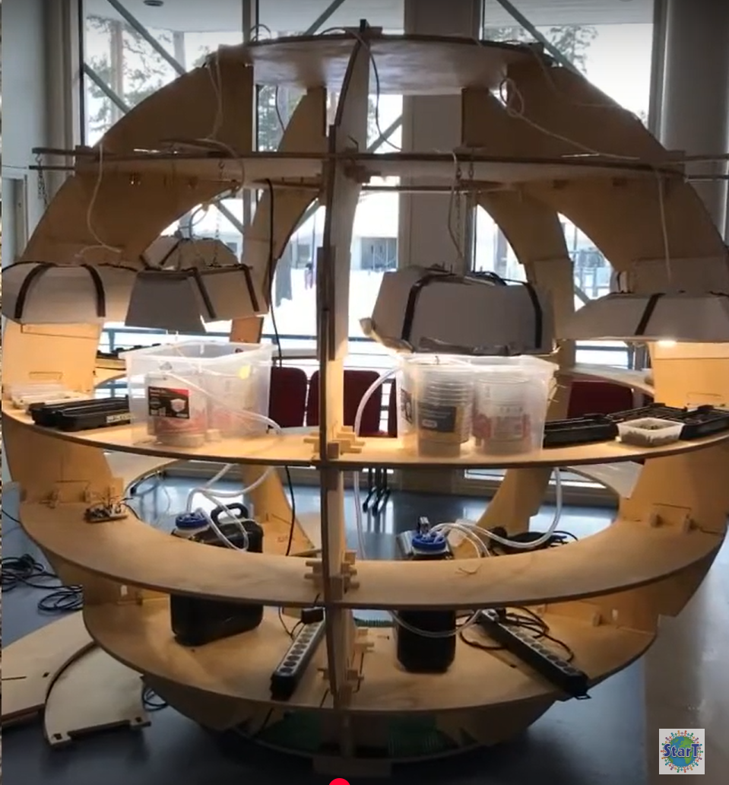
An example on the possibilities of non- / informal collaboration for schools
Green Space project
Name of the learning community:
Veikkolan yhtenäiskoulu, Finland (High school)
School level:
Elementary and lower-secondary school
Incorporated subjects: Mathematics, Handicrafts, Programming, Biology, English
Briefly:
The idea was to build an automated herb growing system to the school. The first task was to design a prototype for testing the idea and then build it. The school has high know-how in handicrafts, so the students wanted to build a stylish one. Several partners, including companies, helped the work by providing materials.
Watch the project video in YouTube (The best of StarT 2022)
Picture: StarT LUMA programme, University of Helsinki
Notes:
PLEASE NOTE: THE VIDEO IS LINKED TO THE PRESENTATION (SEE ANIMATION PANE)

Slide 14
A checklist for planning a visit to a non-formal learning environment
Clearly define the learning objectives and outcomes
Preparation: Familiarize yourself with the organization / company and develop a detailed plan and schedule for the visit, including specific activities or exhibits to explore.
Conduct pre-visit activities in the classroom to introduce students to the topics or key concepts.
Logistics: Arrange transportation, permissions, and any necessary reservations or bookings for the visit. Ensure that you have a sufficient number of chaperones or volunteers to supervise and support students during the visit.
Identify interactive exhibits or hands-on activities that actively engage students in the learning process during the visit.
Differentiation: Take into account the diverse learning styles, needs and abilities of your students.
Plan post-visit activities to facilitate reflection on the experience to ensure connections to the curriculum.
Identify appropriate methods to assess student learning during and after the visit.
Eshach, H. (2007). Bridging In-school and Out-of-school Learning: Formal, Non-Formal, and Informal Education. Journal of Science Education and Technology, 16(2), p. 174. https://doi.org/10.1007/s10956-006-9027-1

Slide 15
What to consider when choosing a non-/informal collaboration partner for ESD
Clearly outline the objectives and outcomes you aim to achieve through the collaboration, ensuring alignment with curriculum goals and principles of sustainable development.
Search and assess: Check partners commitment to sustainability, relevant expertise, and resources to support educational initiatives. It is advisable to assess the partner's alignment with school's values and curriculum.
Consider the partners role. For example, providing expertise and resources to support students learning, or engaging students in meaningful learning experiences, such as hands-on activities or a field trip, etc.
Consider the potential for long-term collaboration and ongoing partnership. What are the contents of this collaboration, which make it relevant for you and also the collaboration partner for long-term.

Slide 16
3. Examples of ESD with informal and nonformal partners
Example 1: two collaborative student projects (StarT LUMA programme)
Example 2: Hyytiälä Forest Station as an example of a study visit to a research station
Please add here your local examples

Slide 17
1. PBL EXAMPLE A. Collaboration with local library
An Action Plan to Save the Moldy Books in Yunhai School Library
Name of the learning community:
Yantian Yunhai School, China
School level: Primary school
What subjects have been used in the project: comprehensive practice, biology, chemistry, physics, computer science and engineering, mathematics, china, art, geography and science.
Briefly: “One day when we went to the library, we came across a book in the corner, with a strong musty smell and some mildews at a closer look. Later, we learned from the librarian that many books in the library grew mildews.”
Project diary:
https://start.luma.fi/wp-content/uploads/2020/04/moldy-books-project-diary-1.pdf
Project video in YouTube:
https://youtu.be/TuFlIoRX0XI?feature=shared
Notes:
Collaborative project-based learning: Example from StarT project-based learning programme
Interdisciplinary and collaborative project-based learning in accordance with the national core curriculum of Finland.
StarT is organized by the LUMA Centre Finland and its cooperation partners since 2016
More materials: https://start.luma.fi/en/materials/

Slide 18
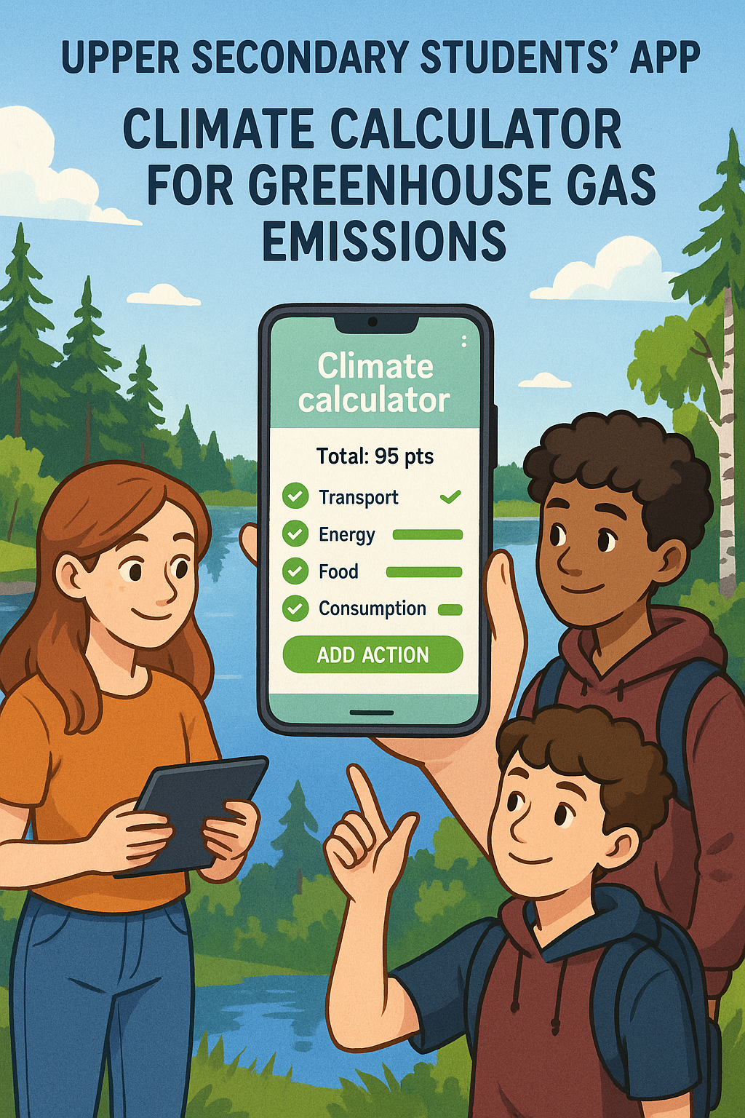
1. PBL EXAMPLE B. Collaboration with university and companies
Upper secondary students’ climate calculator for greenhouse gas emissions
Name of the learning community: Haukiputaan lukio, Finland (High school)
School level: Upper secondary school
What subjects have been used in the project: Mathematics, Physics, Social Studies, Computer Science, Geography
Briefly: The high schoolers wanted to give young people an easy tool to make climate actions with. So came the idea of a climate calculator, where you could mark your climate actions and get points for them.
The app was designed and programmed by students with the help of expert from university and companies.
Project Diary: https://sites.google.com/view/ilmastolaskuri/diary?authuser=0
Project video (YouTube):
https://youtu.be/q2c3yLgyY0g?feature=shared
Picture: AI-generated by Sora
Notes:
PLEASE NOTE: THE VIDEO IS LINKED TO THE PRESENTATION (SEE ANIMATION PANE)
Example on collaboration/study visits with (see project diary):
Valve corporation
University of Oulu and Oulu University of Applied Sciences (OAMK)

Slide 19
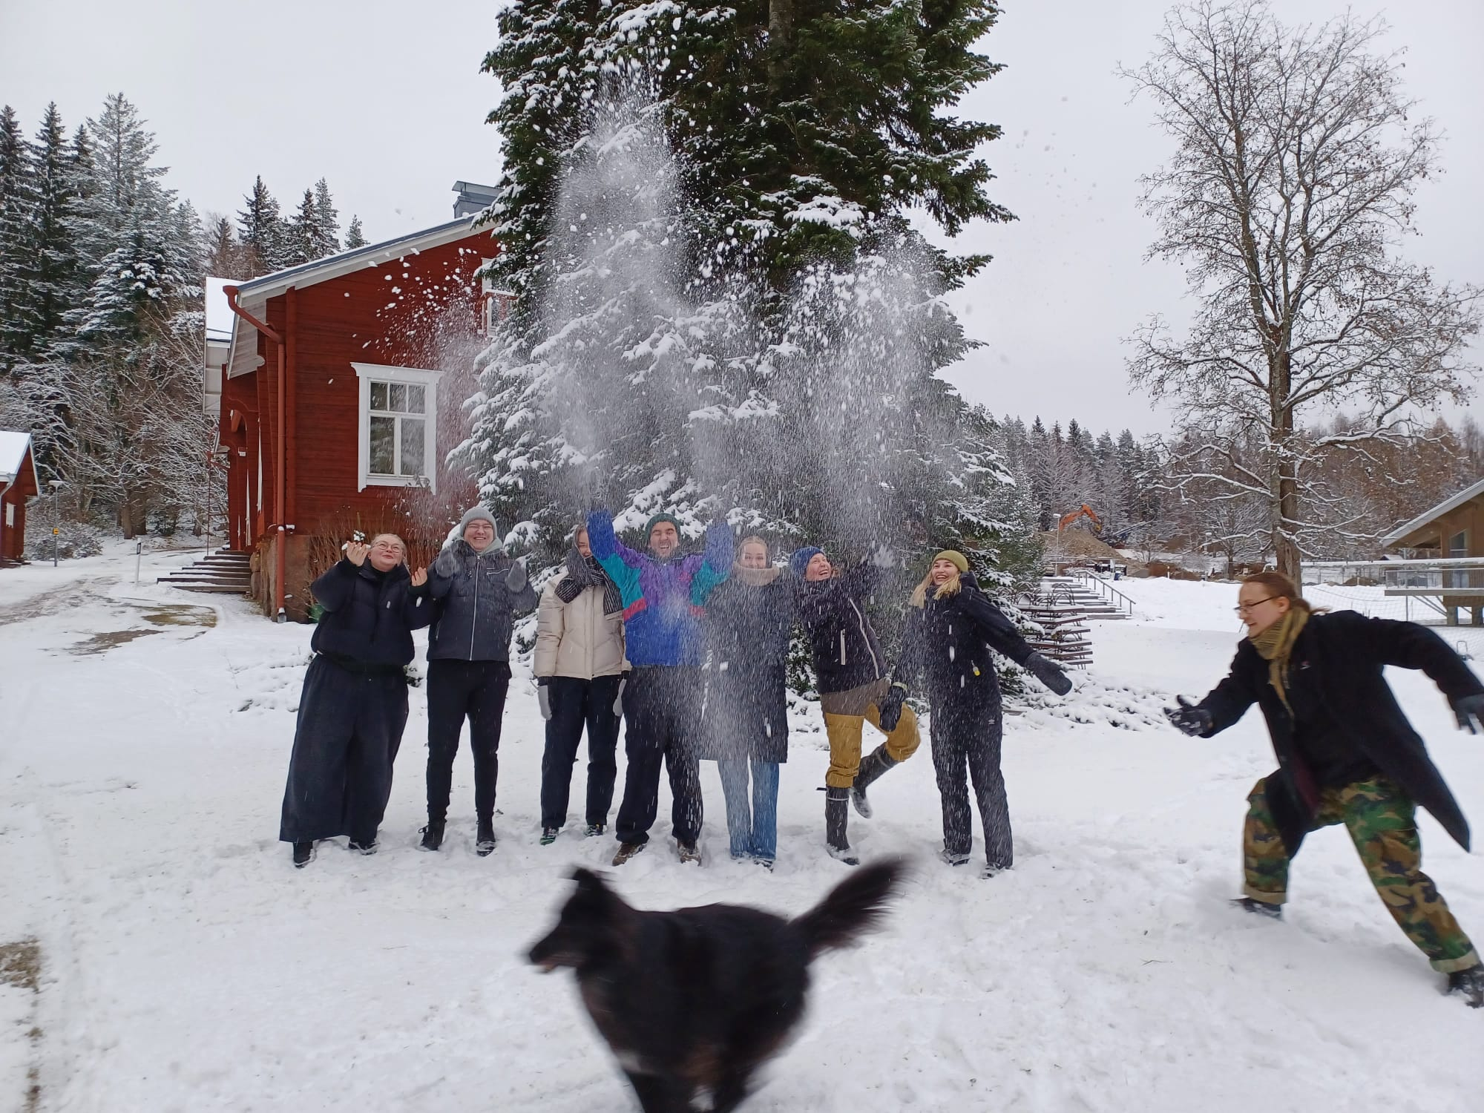
2. Hyytiälä Forest Station:
An example of a study visit to a research station
A traditional field station specializing in forest sciences, which has evolved into an international hub of multidisciplinary top-level research in Juupajoki, Finland
The students from Juupajoki visit the Forest Station every year (1st to 9th grade) – each year different tasks/topics and lectures
2-day trip to Hyytiälä Forest Station with a climate and sustainability themed programme for science student teachers (similar visits are done with primary and secondary school students in Hyytiälä)
Hyytiälä Forest Station | University of Helsinki
Picture: Reetta Matilainen, University of Helsinki
Notes:
Hyytiälä Forestry Field Station, SMEAR II and Open data in ESD (opendata-education.github.io)

Slide 20
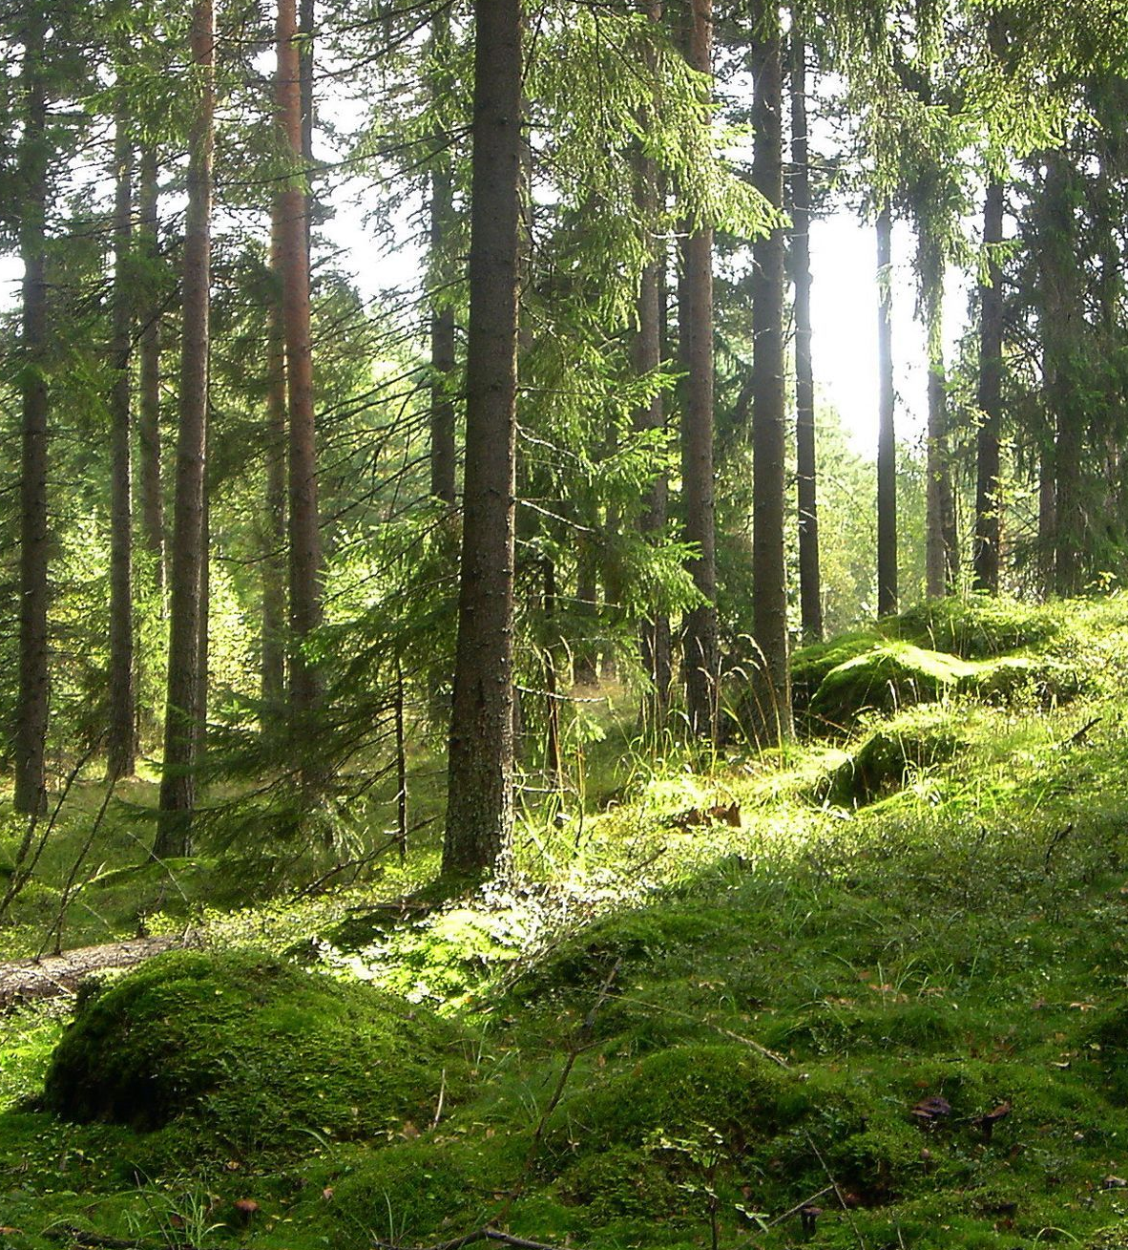
2. Hyytiälä Forest Station: study visit activities
Visit SMEAR II (station for measuring ecosystem-atmosphere relations) research station
  Learn about the research and the measuring equipment from researchers on site
  Open data to be used in learning assignments SmartSMEAR - About (csc.fi)
  Climate measuring station
Nature walk with forest research and science related activities such as
  Measuring the age of a pine tree or the amount of wood mass per square meter
  Arboretum
Lectures from scientist and regular classes
Activities for leisure: Sauna, swimming, etc.
Picture: University of Helsinki
Notes:
The SMEAR station network extends across Finland and, among other countries, to Estonia and China. The SMEAR II station at Hyytiälä is the largest and most versatile station in the network.
SmartSMEAR is a data visualization and download tool for the database of continuous atmospheric, flux, soil, tree physiological and water quality measurements at SMEAR research stations of the University of Helsinki and the University of Eastern Finland. Data with basic metadata can be visualized and downloaded

Slide 21
2. Hyytiälä Forest Station:
Open data learning assignment
Open data in education (opendata-education.github.io)
  Materials in English, Swedish and Finnish (workshops, basics on Python and Jupyter, text analysis etc)
  Instructions on how to use the material
  Ongoing project, you can participate in the development
  Example of a computational essay (in Finnish) Aerosoleja ilmassa? — Mallipohjat (opendata-education.github.io)
Relevance of learning: use the same international adn current data as researchers
Open research data portals:
  CERN Open Data Portal
  SmartSMEAR - About (csc.fi)
When searching for open data it is important to discuss about the source criticism
Notes:
The Open data in education (opendata-education.github.io) material is currently being developed as part of the Helsinki Institute of Physics’ project Education and Open Data.

Slide 22
Local examples
Please add here your local examples

Slide 23
Brainstorm and list local non-/informal partners that could be potential collaboration partners for promoting ESD
It is suggested to collect, classify and discuss students‘ ideas via a card clustering via Miro (https://miro.com/) or a similar tool.
Notes:
The discussion task has a second phase (separate slide):
Once a comprehensive list is generated, discuss the potential benefits and opportunities for collaboration with each partner. Consider factors such as shared goals, resources, expertise, or community impact. Provide detailed insights into what elements the collaboration could include, such as workshops, field trips, guest speakers, project-based learning initiatives, or resource sharing

Slide 24
Discuss the potential benefits and opportunities for collaboration with each of the non-/informal partner listed in earlier task
Notes:
The second phase of the discussion task.
Consider factors such as shared goals, resources, expertise,or community impact. Provide detailed insights into what elements the collaboration could include, such as workshops, field trips, guest speakers, project-based learning initiatives, or resource sharing

Slide 25
Literature and web resources
Eshach, H. (2007). Bridging In-school and Out-of-school Learning: Formal, Non-Formal, and Informal Education. Journal of Science Education and Technology, 16(2), 171–190. https://doi.org/10.1007/s10956-006-9027-1
Haatainen, O. & Aksela, M. (2021). Project-Based Learning in Science Education: Active Teachers’ Perceptions and Practices. LUMAT: International Journal on Math, Science and Technology Education, 9(1), 149–173. https://doi.org/10.31129/LUMAT.9.1.1392
Markula, A, & Aksela, M. (2022). The key characteristics of project-based learning: how teachers implement projects in K-12 science education. Disciplinary and Interdisciplinary Science Education Research, 4:2
Tolppanen, S., Vartiainen, J., Ikävalko, V.-M., & Aksela, M. (2015). Relevance of Non-Formal Education in Science Education. In I. Eilks & A. Hofstein (Eds.), Relevant Chemistry Education: From Theory to Practice (pp. 335–354). SensePublishers. https://doi.org/10.1007/978-94-6300-175-5_18
PBLWorks by Buck Institute for Education
StarT: international PBL programme
StarT material bank
https://www.bu.edu/ctl/guides/project-based-learning/
https://teachingcommons.stanford.edu/resources/learning/learning-activities/project-based-learning
https://www.edutopia.org/blog/pbl-through-a-makers-lens-patrick-waters
https://er.educause.edu/articles/2015/1/using-design-thinking-in-higher-education

