Slide 1
Promoting Relevant Education in Science for Sustainability (6)

Slide 2
Best Practices of the Implementation of ESD in Indonesia

Slide 3
Example of the Integration of Sustainable Development in the Curriculum
In some university in Indonesia, some has integrated the courses with the Sustainable Goal. We can find it explicitly the curriculum, such as shown in the following course:
Science Education for Sustainable Development, which is the compulsory course at undergraduate program of Science Education, IPA Universitas Negeri Malang.
Science and Sustainability, which is the compulsory course at the faculty of Mathematics and Science, Universitas Negeri Malang.

Slide 4
Example of the Integration of Sustainable Development in the Curriculum
3. Innovation of Sustainable Chemistry Education, which is implemented by undergraduate program of Chemistry Education, Universitas Sultan Ageng Tirtayasa, Banten
4. Environmental Physics, which is implemented by undergraduate program of Chemistry Education, Universitas Sultan Ageng Tirtayasa, Banten

Slide 5
Search at the internet about the courses at university leverl which support education for sustainable development then present it to your classmates

Slide 6
Example of the Integration of Sustainable Development in the University Activity
Green Charity activity by planting bamboo trees around landfill in Paras, Malang Indonesia. The charity was conducted by the collaboration of various stakehoders, including students of Science Education Department of Universitas Negeri Malang, Research Institute and Community Engagement of Universitas Negeri Malang; Environmental Agency of Malang district.
https://www.instagram.com/reel/DI_b0DEh98P/?igsh=MXkwOWxxdzZ0OXFlaQ==

Slide 7
Example of the Integration of Sustainable Development in the University Activity
2. Sustainable Development Goal is supported by the civil engineering study program of Universitas Islam Indragiri through education, research and community service activities. Alfa, A. (2018). Pemetaan Tridarma Program Studi Teknik Sipil Universitas Islam Indragiri Dalam Pencapaian Sustainable Development Goals (SDGs). Selodang Mayang: Jurnal Ilmiah Badan Perencanaan Pembangunan Daerah Kabupaten Indragiri Hilir, 4(2).
https://doi.org/https://doi.org/10.47521/selodangmayang.v4i2.94

Slide 8
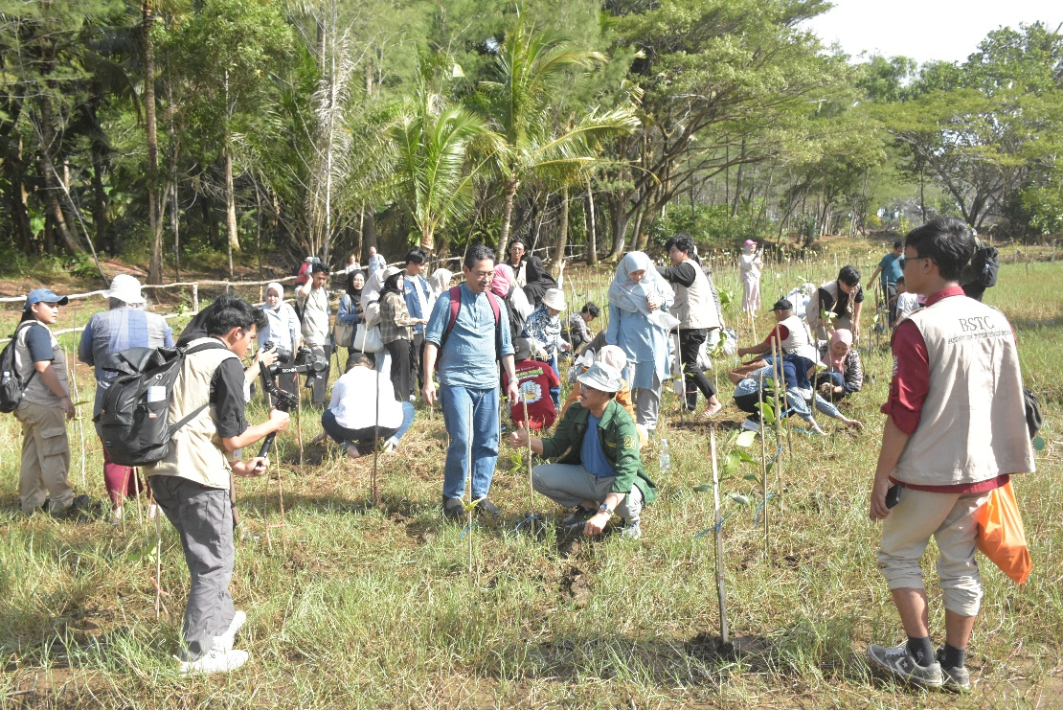
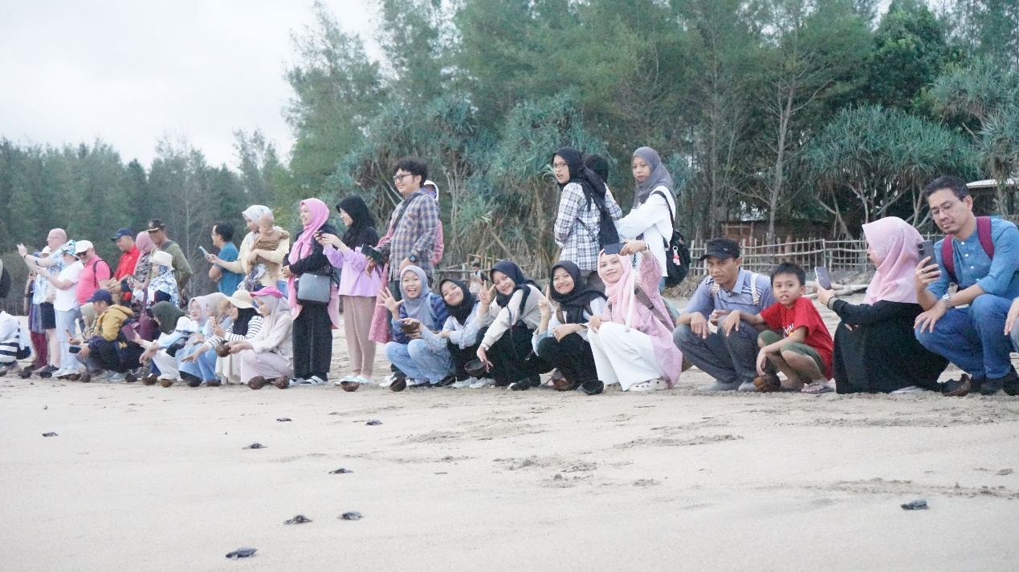
Example of the Integration of Sustainable Development in the University Activity
3. Collaboration with various stakeholders
Mangrove planting
Sea turtle release

Slide 9
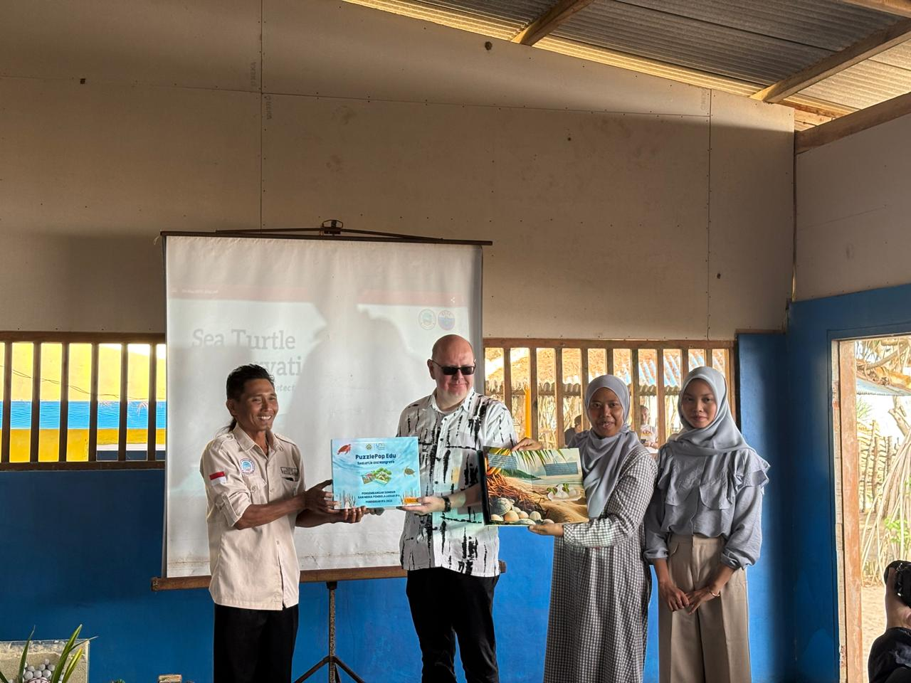
Example of the Integration of Sustainable Development in the University Activity
The development of teaching media on sea turtle conservation that has been conducted by the students of science education department of Universitas Negeri Malang. This activity is a part of the collaboration between university and NGO, Bajulmati Sea Turtle Conservation.

Slide 10
Search in the internet, observe and interview relevant stakeholders about the examples of activities in university of school leverl which support education for sustainable development.

Slide 11
Questions and discussion

Slide 12
Online resources to read
https://doi.org/https://doi.org/10.47521/selodangmayang.v4i2.94
Potensi Implementasi STEAM Berorientasi ESD dalam Pembelajaran Zat dan Perubahannya | Riyanto | Jurnal Penelitian Pembelajaran Fisika
https://www.instagram.com/reel/C-CayUiAeAp/?igsh=dHVhc2Vuam5qYXI5

