Slide 1
Promoting Relevant Education in Science for Sustainability (3)

Slide 2
National Regulations and Policies for ESD
Indonesia

Slide 3
Hierarchy of Law in Indonesia Concerning SDGs
The regulation regarding SDGs/ESD in Indonesia
The hierarcy of regulation regarding SDGs in Indonesia
How to accelerate SGDs through education sector
Policy and regulations related to ESD implementation in Indonesia
Questions and discussion

Slide 4
Present Indonesian regulation regarding SDGs and ESD that you have searched and discussed with your group It is suggested to collect and discuss students‘ associations via a Mentimeter Word Cloud (https://www.mentimeter.com/features/word-cloud) or a similar tool.

Slide 5
Hierarchy of law in Indonesia

Slide 6
Concerning Environmental Protection and Management
Article 28 H and section 3 of article 33 Guarantee every citizen the right to a good and healthy environment with a green economy.
Indonesia Constitution 1945
Environmental Protection and Management
Law No. 32 of 2009
Indonesia’s Presidential Regulation
no. 59/2017
Concerning the implementation of
SDGs in Indonesia
Ministry of National Development Planning of the Republic of Indonesia
Provide the Roadmap of SDGs Indonesia in 2019

Slide 7
The Goals of Law Number 32 of 2009
The purpose of this law can be divided into 10 main goals:
Protect the territory of the Unitary State of the Republic of Indonesia from pollution and environmental damage;
Ensuring human safety, health, and life
Ensuring the survival of living things and the preservation of ecosystems
Maintain the preservation of environmental functions
Achieve harmony, harmony, and balance Environment,
Ensure the fulfillment of justice for present and future generations.
Ensure the fulfillment and protection of the right to the environment as part of human rights;
Controlling the wise use of natural resources
Realizing sustainable development
Anticipating global environmental issues.

Slide 8
How we accelerate the SDG through Education Sector?

Slide 9

Speed up the sustainability development by integrating all SDG sectors into every level of education.
Elementary School
Junior High School
Senior High School
Under graduate Student
Post Graduate Student

Slide 10
Regulation and Policies Related To ESD Implementation In Indonesia

Slide 11
Preamble to the Constitution of the Republic of Indonesia Year 1945
“…promote general welfare, make the nation's life intelligent, and participate in implementing world order based on freedom, eternal peace and social justice …”

Slide 12
Vision of the Ministry of Education and Culture
The vision of the Ministry of Education and Culture is to support the President's Vision and Mission to create an Advanced Indonesia that is sovereign, independent, and has personality through the creation of Pancasila Students who reason critically, creatively, independently, have faith, are devoted to God Almighty, and have noble character, work together, work together, and global diversity

Slide 13
President's Mission => Mission of the Directorate General of Higher Education
The President's mission is known as the second Nawacita, namely mission number (1) Improving the quality of Indonesian people; and number (8) Clean, effective and trustworthy government management.
The mission of the Directorate General of Higher Education in implementing the second Nawacita is as follows:
1. Realizing education that is relevant and of high quality, equitable and sustainable, supported by infrastructure and technology.
2. Optimize the participation of all stakeholders to support the transformation and reform of education and culture management.

Slide 14
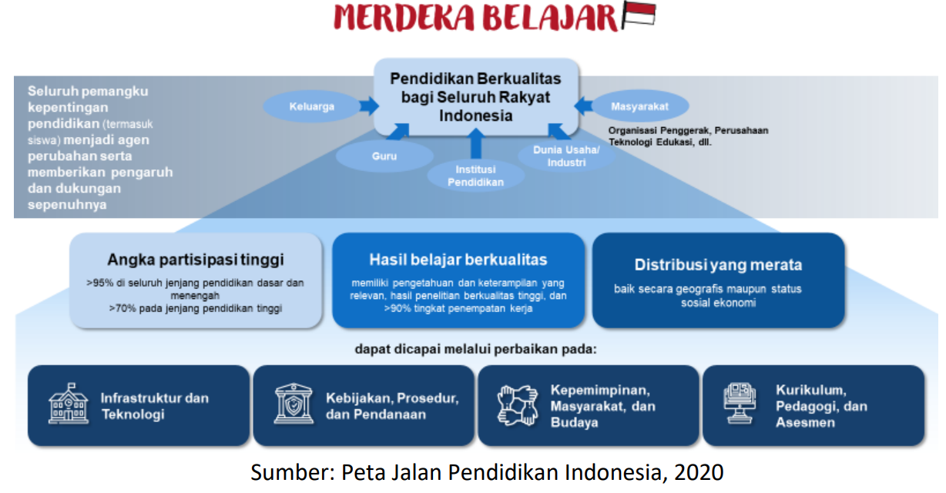
Policy Direction and Strategy for Higher Education
The policy direction and strategy of higher education supports the policy direction and strategy of the Ministry of Education and Culture through the Independent Learning policy

Slide 15
Joint Agreement between the State Ministry of the Environment (MenLH) and the Ministry of National Education, 2010
The Minister of Environment as the first party is responsible in the field of environmental protection and management and is obliged to preserve environmental functions and prevent environmental pollution and/or damage.
The Minister of National Education as the second party is responsible for managing the national education system and national education standards to ensure the quality of Indonesian education.

Slide 16
United Nations in Indonesia Country Result Report 2022
G20
In 2022, the UN provided policy support to many of the Government’s priority initiates including its G20 Presidency, developing a Blue Economy roadmap, advancing an Economic Transformation Agenda toward Indonesia becoming a high-income country by 2045, and financing the Sustainable Development Goals (SDGs).

Slide 17
Law of the Republic Indonesia Number 20 of 2003 concerning the National Education System
This law establishes the principles of democratic, fair and non-discriminatory education, and upholds human rights, religious values, cultural values ​​and national pluralism.

Slide 18
Education for Development, Development and/or Sustainable Development (PuP3B)
The PuP3B paradigm invites humans to think about the sustainability of planet Earth and the entire universe.
Education must provide an understanding of the values ​​of social and natural responsibility to give students an idea that they are part of a natural system that must be in synergy with other humans and part of a natural system that must be in synergy with the rest of nature.

Slide 19
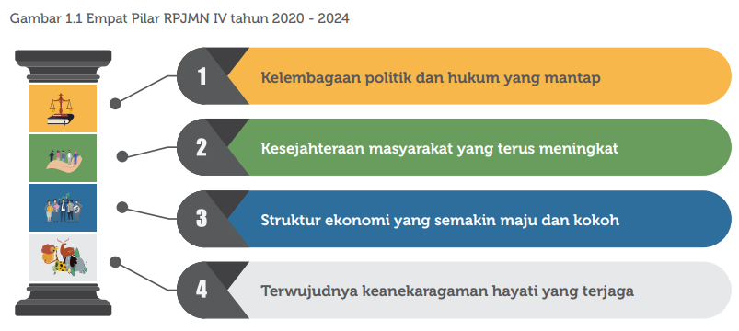
National Medium Term Development Plan (RPJMN) 2020-2024
There are 4 (four) pillars of the IV RPJMN 2020-2024 which are the mandate of the 2005-2025 RPJPN to achieve the main objectives of the national development plan for the last period.

Slide 20
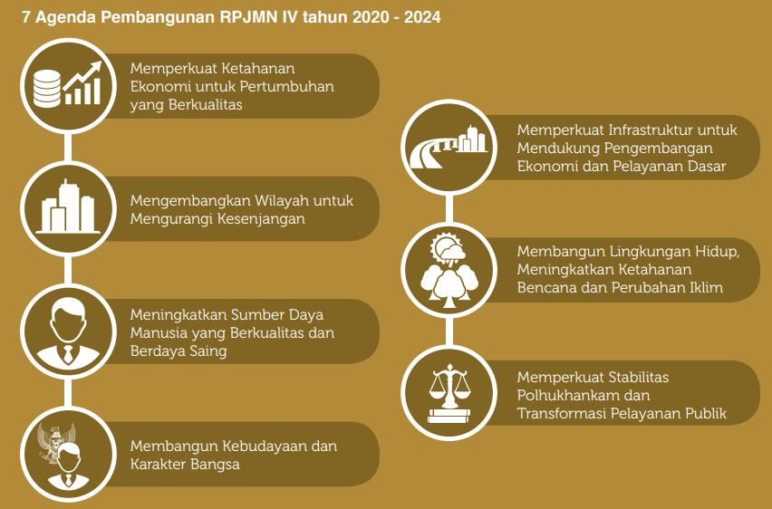
National Medium Term Development Plan (RPJMN) 2020-2024
The objectives of RPJMN IV 2020 – 2024 are in line with the Sustainable Development Goals (SDGs). The targets of the 17 goals in the Sustainable Development Goals (SDGs) and their indicators have been accommodated in 7 development agendas.

Slide 21
Search the Internet about national policy legacies for sustainable development and the implementation of the SDGs. It is suggested to collect and discuss students‘ findings via a Padlet via predefined topics (https://padlet.com/) or a similar tool.

Slide 22
Questions and discussion

Slide 23
Online resources to read
https://drive.google.com/file/d/1QukEIoi3GP74CpJwArNwvLebQzw1Jnqb/view?usp=sharing
https://drive.google.com/file/d/153Jn5VjDDs2FCnp5vBTkriOTkFgHiIrr/view?usp=drive_link
https://drive.google.com/file/d/1bKpGdw2HybeNH1iiImu18NvouCwWTkRt/view?usp=sharing
https://drive.google.com/file/d/15irgnAVRpmmhtSYvZZPEdbBXe7AGLFJJ/view?usp=sharing
https://drive.google.com/file/d/1EC18_o-cRoyaMDdxw3M1KiZjIw9U2tRK/view?usp=sharing
https://drive.google.com/file/d/1rMUBmUekISjBTY87eeORpPcIinJK_zDR/view?usp=sharing
https://jdih.bappenas.go.id/peraturan/detailperaturan/1037/peraturan-presiden-nomor-18-tahun-2020

