Slide 1
Best practices of ESD from an international perspective
Notes:
This session relies heavily on the activity of the participants - they should think about why a local perspective is relevant when considering ESD aspects and look for examples themselves.

Slide 2
Why do you think it is important to deal with specific ESD aspects on an individual country level?
Notes:
Here, a short brainstorming session can be conducted.

Slide 3
Different regions – different issues
Insert examples of headlines on ESD related issues in different countries here. To find the headlines, you can use Google, enter keywords such as „sustainability + Indonesia“ and go to „News“.
Notes:
You can exchange the headlines if you with to show more locally relevant issues.

Slide 4
Different regions – different issues
What specific priorities would you set when teaching ESD aspects in your region?
Here, a QR code to a digital tool such as Mentimeter (mentimeter.com) can be inserted to collect the ideas.
XXX

Slide 5
Current review/overview publications

Slide 6
Overview
Bourn, D., Kalsoom, Q., Soysal, N. & Ince, B. (2023). Student Teachers’ Understanding and Engagement with Education for Sustainable Development (ESD) in England, Türkiye (Turkey) and Pakistan. DERC Research Paper no. 23. London: UCL Institute of Education.
Rocksén, M., Vhurumuku, E., & Svensson, M. (2022). Sustainability and science and technology teacher education: A review of the literature. Science and Technology Teacher Education in the Anthropocene, 13-32.
Algurén, B. (2021). How to bring about change–a literature review about education and learning activities for sustainable development. Discourse and Communication for Sustainable Education, 12(1), 5-21.
Notes:
The papers can be found in the supplementary materials folder.

Slide 7
Some findings
Institution’s own commitment to sustainability and ESD is pivotal in developing student teachers’ conceptions of ESD, and empowering them to act as ESD educators in their future teaching (Bourn et al., 2021)
Education and learning activities in ESD are mostly grounded in discussions and reflections, starting with concrete problems or experiences, and are commonly not discipline specific, but rather interdisciplinary (Algurén, 2021)
ELA mostly use participatotry teaching methods, problem-based learning and collaboration (Algurén, 2021)
Although UNESCO outlined behavioral learning objectives as particularly important for ESD, the review revealed that these had hardly been reached by the used ELA (Algurén, 2021)
Internationally, research efforts have been underpinned by a wide range of dominant theoretical paradigms including cognitive theories, critical theory and socio-ecological theory, but the research appears to be driven by different ideological and philosophical orientations and beliefs (Western imperatives vs. indigenisation, decolonisation etc.) (Rocksén et al., 2022)

Slide 8
Some findings
(Bourne et al., 2023, p. 23)

Slide 9
Cases on selected trends
Notes:
We inserted three exemplary cases, the respective papers can be found in the supplementary materials. You can decide to put in other examples, maybe from your region.

Slide 10
Case I
Doxsee, K. M. (2015). Collaborative Development of a High School Green Chemistry Curriculum in Thailand. In Worldwide Trends in Green Chemistry Education (pp. 61-75). The Royal Society of Chemistry.
The author brought safe, cost-efficient GC experiments to partner institutions in Thailand and established a „Green Laboratory“ in Thonburi.
Experiments have been tested in US institutions beforehand
Doxsee used distance learning techniques (camera streaming) more than 10 years before the pandemic to reach thousands of students
He faced cultural/linguistic obstacles (for instance, the word „green“ does not have the same positive connotation in Thai language)
This case shows a good example of how a 1:1 transition of existing, successful teaching strategies to other countries can be challenging.

Slide 11
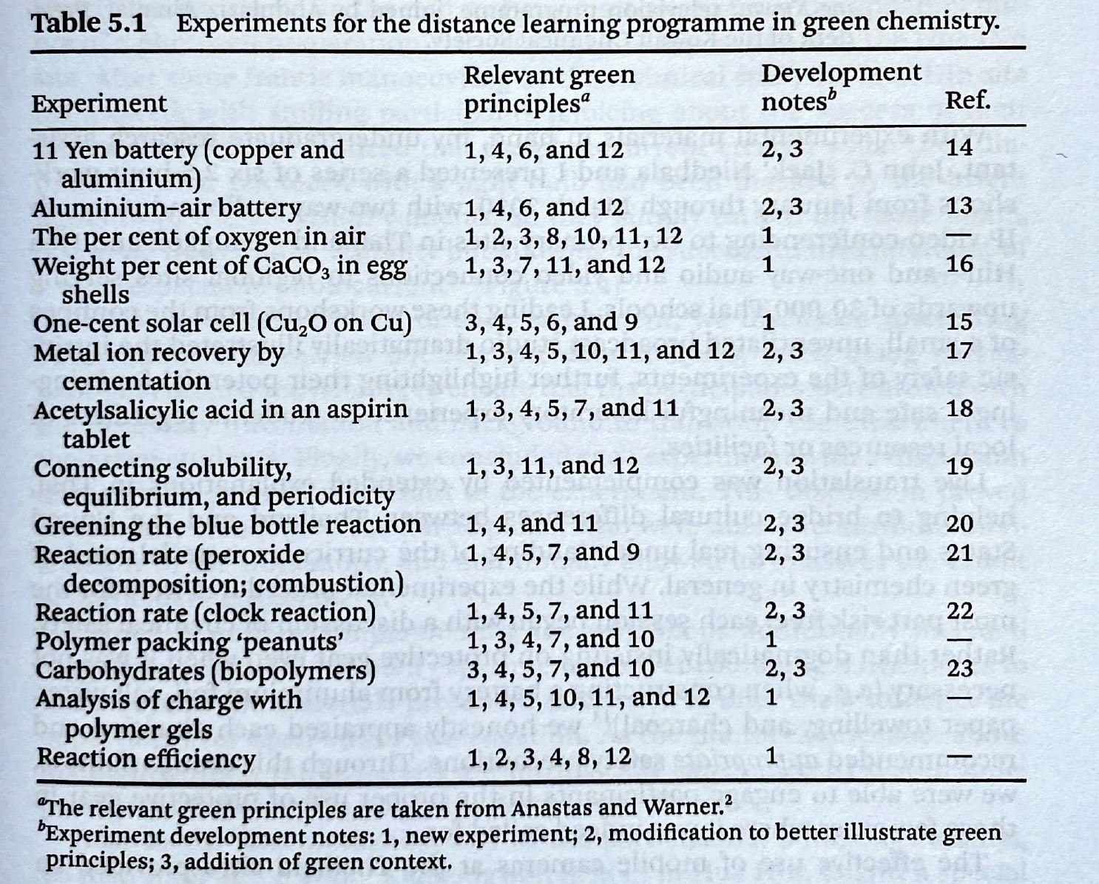
Doxsee, 2015, p. 65

Slide 12
Case II
Linkwitz, M., & Eilks, I. (2022). An Action Research Teacher’s Journey while Integrating Green Chemistry into the High School Chemistry Curriculum. Sustainability, 14(17), 10621.
In an Action Research project (suppeorted by an chemistry education reserach group), a teacher re-structured his first-year upper secondary chemistry course based on the pronciples of Green Chemistry
The course was (re)designed over a timeframe of four school years
Main topic: „From sugar beet to bioplastics“
The students perceived the course very positively
The project showed that it was possible to fulfill the (quite open) German school chemistry curriculum, at the same time integrating GC principles

Slide 13
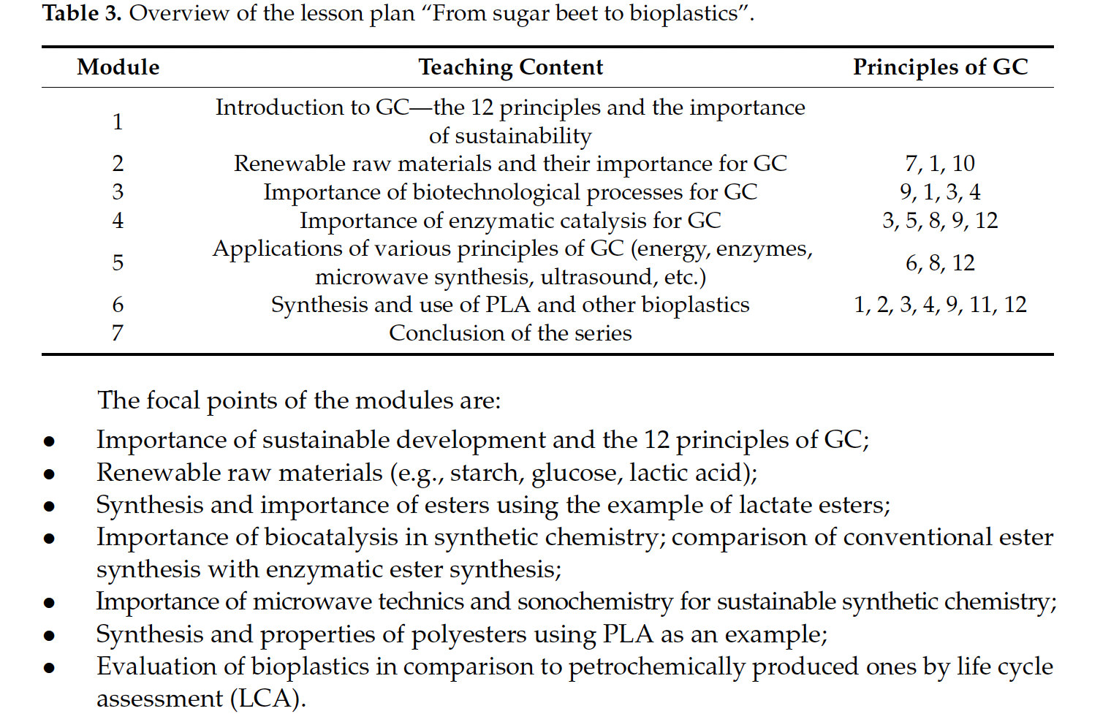
Linkwitz & Eilks, 2022, p. 7

Slide 14
Case III
Dzerefos, C. (2020). Reviewing education for sustainable development practices in South African eco-schools. Environmental Education Research, 26(11), 1621-1635.
The desribed Eco-Schools programme in South Africa is the longest-running Education for Sustainable Development (ESD) initiative in Africa.
In South Africa, Eco Schools describe themselves as being especially change-oriented (p. 1624).
In Eco Schools, the programme „starts in the classroom and expands to the community by engaging the next generation in action-based learning“ (p. 1624) by addressing locally relevant ESD issues
For example, the Department of Water and Sanitation in South Africa has supported the Eco-Schools programme to build community resilience during drought
The study looks at criteria/indicators that can be used to rate the successfulness of such an initiative (see next slide).

Slide 15
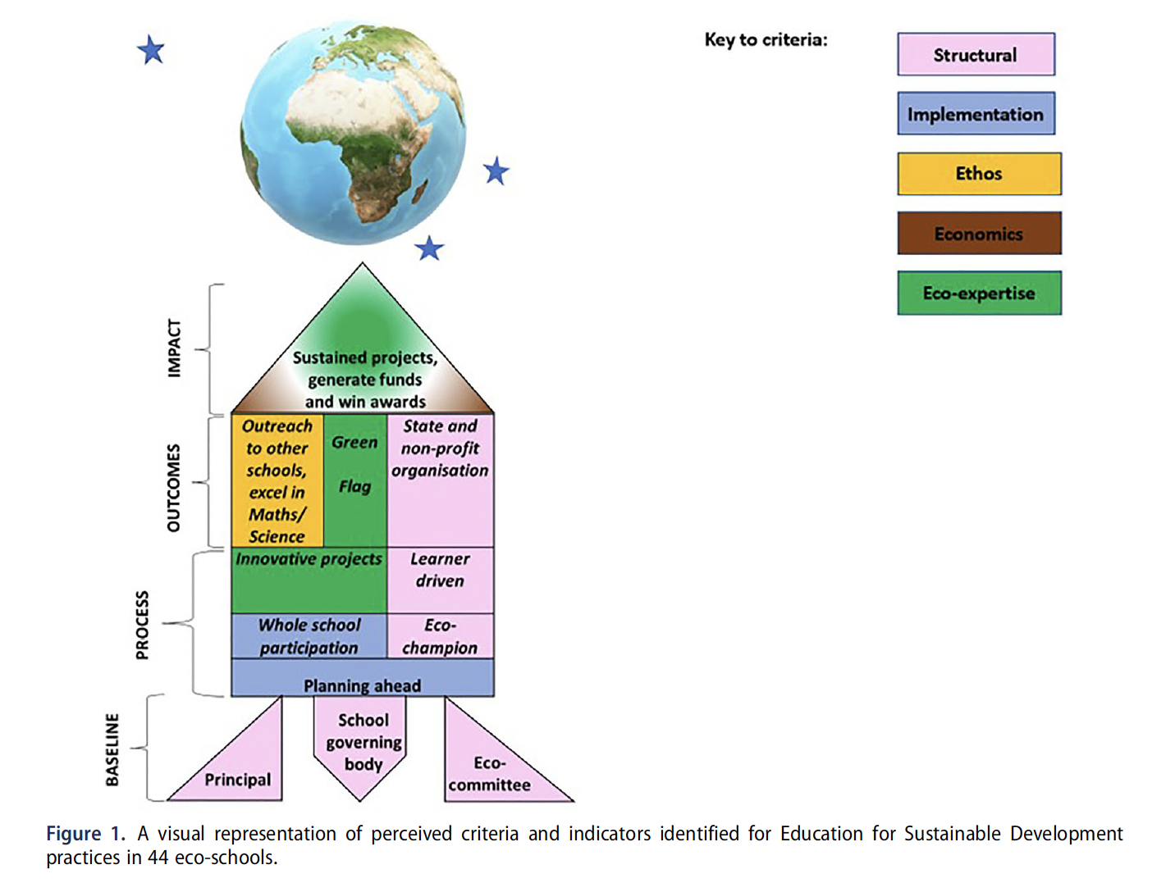
Dzeferos, 2020, p. 1630

Slide 16
Task: Using literature databases, find and present one more current case from your (extended) region.
Notes:
Here, databases such as Google Scholar or ERIC (eric.ed.gov) can be used.

Slide 17
Present your case!

Slide 18
Discussion: What can we learn from international „best practice“ examples?

