Slide 1
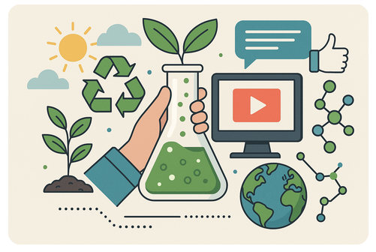
Scientific Media Literacy – Key Aspects for PRESS
Image created with ChatGPT
Notes:
This session relies heavily on the activity of the participants - they should think about why a local perspective is relevant when considering ESD aspects and look for examples themselves.

Slide 2
What are your experiences with modern media (e.g. social media) in the science classroom?
Notes:
Here, a short brainstorming session can be conducted.

Slide 3
Science in the media

Slide 4
„[Social media are] so widespread and inculcated into our culture that it is futile to try to stop their influence at the classroom door“¹

Slide 5
What is Media Literacy?
Information L.
Media L.
Social network L.
Library L.
Advertising L.
Media/Information Literacy
Knowledge about…
…functions of media.
…conditions of media operations.
…how to evaluate media content.
FOE and FOI L.
News L.
Digital L.
Television L.
Digital Media L.
Cinema L.
Computer L.
Games L.
Internet L.
(UNESCO, 2011, 2019, L. = Literacy)
Notes:
Media and Information Literacy

Slide 6
Scientific Media Literacy
Domain of skills
Domain of knowledge
Competences of media literacy
Aspects of scientific literacy
Access
Scientific terms and concepts
Analysis
Nature of Science (NOS)
Evaluation
Impact of science and technology to society
Creation
Belova, Chang Rundgren & Eilks, 2015

Slide 7
The Idea of Filtered Information
Science, Scientists, Scientific information
Who filters the information?
How is the information being filtered?
select, understand, be interested (or not), be enthusiastic (or not), ....
Journalists
Politicians
Advertisers
Lobbyists
Interest Groups
…
Interests, beliefs, attitudes, ...
Skills in explaining, writing, illustrating, ...
Citizens (Non-Scientists)
(Lippel, Stuckey & Eilks, 2012; Eilks, Nielsen, & Hofstein, 2012)

Slide 8
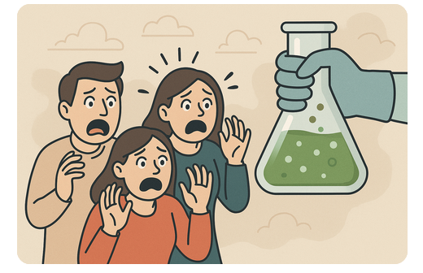
Science and the media
Shapes the public's understanding of science
The more you consume, the more negative it gets.
(Dhingra, 2003; Guerris et all., 2020; Maier et al., 2014; Lee & Niederdeppe, 2011; ¹Hove, Paek & Isaacson, 2011, p. 524; image created with ChatGPT)
Notes:
Media shape the public's understanding of science
Intense exposure to media = negative impact on attitudes toward science
"Chemophobia"
Media influence both young people's ideas about science (or NOS) and their behavior in socio-scientific decisions
But: "The more children know, the harder they are to persuade."¹

Slide 9
Science and the media
influence young people's ideas
about science (or NOS)
their behavior in socio-scientific decisions
(Dhingra, 2003; Guerris et all., 2020; Maier et al., 2014; Lee & Niederdeppe, 2011; ¹Hove, Paek & Isaacson, 2011, p. 524; image created with ChatGPT)
Notes:
Media shape the public's understanding of science
Intense exposure to media = negative impact on attitudes toward science
"Chemophobia"
Media influence both young people's ideas about science (or NOS) and their behavior in socio-scientific decisions
But: "The more children know, the harder they are to persuade."¹

Slide 10
Science and the media
influence young people's ideas
about science (or NOS)
their behavior in socio-scientific decisions
"The more children know, the harder they are to persuade.“¹
(Dhingra, 2003; Guerris et all., 2020; Maier et al., 2014; Lee & Niederdeppe, 2011; ¹Hove, Paek & Isaacson, 2011, p. 524; image created with ChatGPT)
Notes:
Media shape the public's understanding of science
Intense exposure to media = negative impact on attitudes toward science
"Chemophobia"
Media influence both young people's ideas about science (or NOS) and their behavior in socio-scientific decisions
But: "The more children know, the harder they are to persuade."¹

Slide 11
Between misinformation and manipulation
„Post-truth world“ - challenges for the educational landscape
Fake News, misinformation, malinformation, manipulation strategies
Truth: I think therefore I am!
 | I | II
Disinformation | x | x
Misinformation | x
Malinformation |  | x
Post-Truth: I believe therefore I’m right!
actually false information (I)
information that is intended to harm someone (II)
(Dhingra, 2003; Guerris et all., 2020; Maier et al., 2014; Lee & Niederdeppe, 2011; ¹Hove, Paek & Isaacson, 2011, p. 524)
Notes:
„Post-truth world“ - challenges for the educational landscape
Fake News, misinformation, malinformation, manipulation strategies
Often with a scientific or chemical background
Even short and one-time interventions have a lasting effect
„Inoculation“
Still many research gaps!
– prior exposure of strategies protects against "falling for" misinformation and manipulation

Slide 12
Between misinformation and manipulation
Even short and one-time interventions have a lasting effect
„Inoculation“
(Acerbi, Altay & Mercier, 2022; Barzilai & Chinn, 2020; Cook, Lewandowsky & Ecker, 2017; Roozenbeek & van der Linden, 2019 etc.)
Notes:
„Post-truth world“ - challenges for the educational landscape
Fake News, misinformation, malinformation, manipulation strategies
Often with a scientific or chemical background
Even short and one-time interventions have a lasting effect
„Inoculation“
Still many research gaps!
– prior exposure of strategies protects against "falling for" misinformation and manipulation

Slide 13
Between misinformation and manipulation
Even short and one-time interventions have a lasting effect
„Inoculation“
Still many research gaps!
(Acerbi, Altay & Mercier, 2022; Barzilai & Chinn, 2020; Cook, Lewandowsky & Ecker, 2017; Roozenbeek & van der Linden, 2019 etc.; http://thecrcl.ca/living-post-truth-world/)
Notes:
„Post-truth world“ - challenges for the educational landscape
Fake News, misinformation, malinformation, manipulation strategies
Often with a scientific or chemical background
Even short and one-time interventions have a lasting effect
„Inoculation“
Still many research gaps!
– prior exposure of strategies protects against "falling for" misinformation and manipulation

Slide 14
Media in the chemistry classroom – current situation
In chemistry classes - traditional media (newspapers)
Limited number of goals
Introduction to lessons
context for experiments or tasks
(Belova & Eilks, 2015; Belova & Tietjen, 2021; Jarman & McClune, 2002; Reid & Norris, 2016; Kachan et al., 2006; https://www.nytimes.com/2013/01/19/us/regulations-on-fracking-are-revised.html?searchResultPosition=5)
Notes:
In chemistry classes - traditional media (newspapers)
Limited number of goals
Introduction to lessons, context for experiments or tasks
Use of e.g. social media and advertising demanded for a long time, but not yet implemented in chemistry classes
Learning with rather than learning about media
Teachers are skeptical and don‘t feel prepared

Slide 15
Media in the chemistry classroom - demands
Use of e.g. social media and advertising demanded for a long time, but not yet implemented in chemistry classes
Learning with rather than learning about media
Teachers are sceptical and don‘t feel prepared!
(Belova & Eilks, 2015; Belova & Tietjen, 2021; Jarman & McClune, 2002; Reid & Norris, 2016; Kachan et al., 2006)
Notes:
In chemistry classes - traditional media (newspapers)
Limited number of goals
Introduction to lessons, context for experiments or tasks
Use of e.g. social media and advertising demanded for a long time, but not yet implemented in chemistry classes
Learning with rather than learning about media
Teachers are skeptical and don‘t feel prepared

Slide 16
Example for a context: sustainability in social media

Slide 17
Go to a social network of your choice and search for the hashtag #sustainability. Describe your impressions!
Here, a QR code to a digital tool such as Mentimeter (mentimeter.com) can be inserted to collect the ideas.

Slide 18
Sustainability in social media
Insert your own examples: Search for the hashtag “sustainability” or “sustainable development” in social media and make screenshots.
Notes:
There is a lot of content on social media when you search for #sustainability. Most of it provides only a limited picture (Greenwashing, advertising etc.)

Slide 19
Sustainability – not so easy…
based on Leinfelder, 2018
Notes:
Sustainability as three intersecting circles. Not a easy concept, yet simplified in social media!

Slide 20
Numbers
#sustainability: 15,4 million posts
#sdgs: 3 million posts
#sustainabledevelopmentgoals: 258 million posts
#sustainability: 5 billion views
“SDGs" von Unbekannter Autor ist lizenziert gemäß CC BY-NC-ND

Slide 21
Analysis of Posts (N = 300)
Environment
Economic
several
Notes:
We analyzed 150 posts from Instagram and 150 posts from TikTok which we found under the hashtag #sustainability. Most of the posts only addressed the environmental dimension.

Slide 22
A short teaching sequence on sustainability in social media
Notes:
You can use any other example from your portfolio or the ones in the supplementary materials.

Slide 23
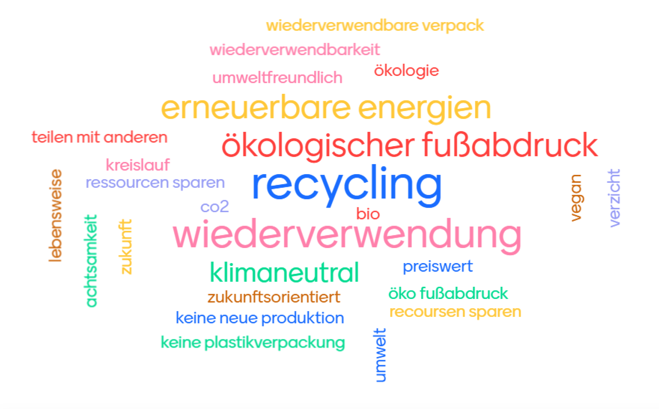
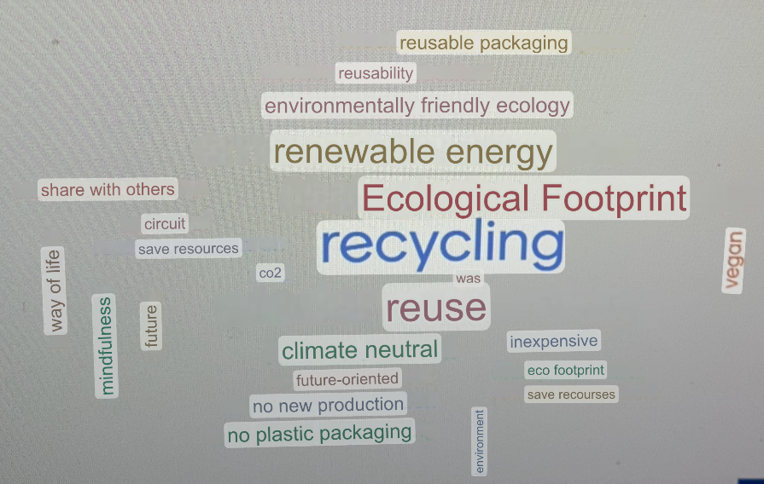
"What goes through your mind when you hear “Sustainability"?
Translation:
Data from 9th grade
Notes:
At the beginning of the 90 minute lesson, the students collected their associations with the term „sustainability“ via Mentimeter. Most of the aspects mentioned referred to the ecological dimension only.

Slide 24
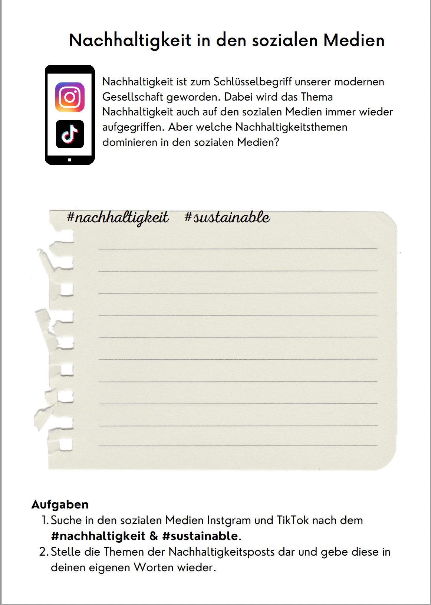
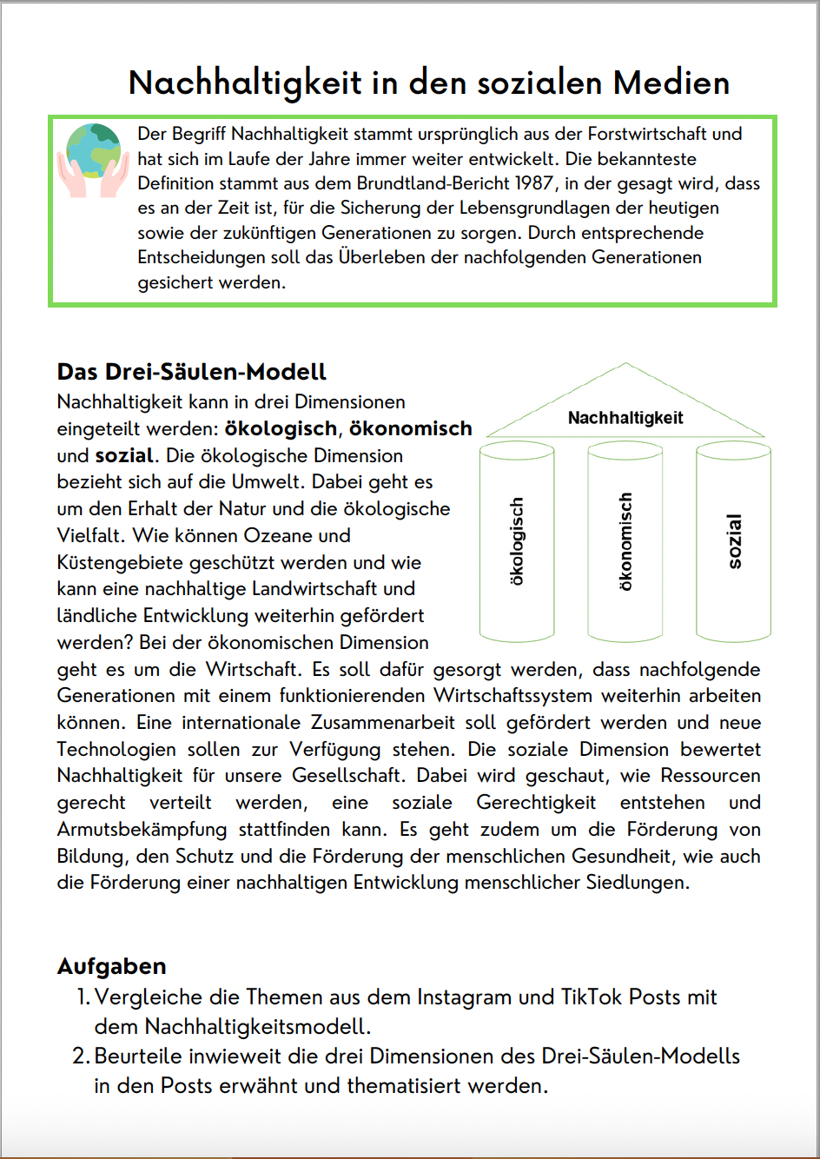
Work Phase
Notes:
In the work phase, the students searched for the #sustainability themselves and compared their findings with the three-pillar-model.

Slide 25
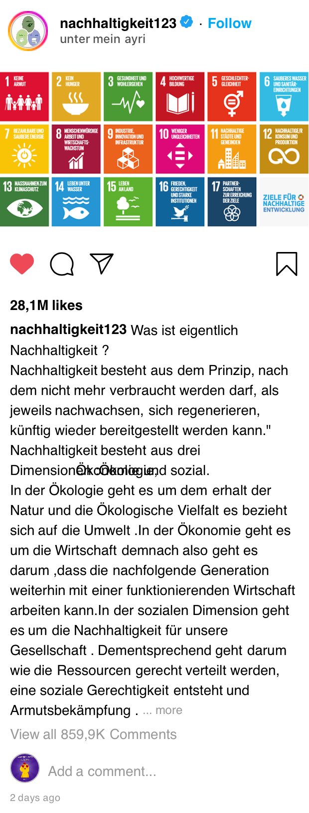
Own Posts – Gallery Walk
Notes:
at the end, the students created their own Instagram posts on the three pillar model.

Slide 26
Mentimeter (l) vs. Post-Questionnaire (r)
Environment
Economic
Social
Personal Action
Future Generations
Guiding Principle for all Actions

Slide 27
Task: Outline your own teaching sequence which fosters scientific media literacy and ESD. Work in groups!

Slide 28
Discussion: How can we foster (critical) scientific media literacy in the science classroom?

Slide 29
Final thoughts
How can we teach (about) sustainability in a post-truth world?
It is important to prepare teachers for their future role: they must provide learners with skills that help them evaluate complex issues.
Future teachers should also be sensitized to the sometimes one-sided portrayals of sustainability aspects in social media.
Notes:
Wissen, Bewerten und Handeln

Slide 30
Acerbi A., Altay S., & Mercier H. (2022). Research note: Fighting misinformation or fighting for information? Harvard Kennedy School of Misinformation Review, 3(1), 1–15.
Allen, J., Howland, B., Mobius, M., Rothschild, D., & Watts, D. J. (2020). Evaluating the fake news problem at the scale of the information ecosystem. Science advances, 6(14), eaay3539.
Baacke, D. (1997): Medienpädagogik, Tübingen: Niemeyer (Grundlagen der Medienkommunikation Band 1).
Barzilai, S., & Chinn, C. A. (2020). A review of educational responses to the “post-truth” condition: Four lenses on “post-truth” problems. Educational Psychologist, 55(3), 107-119.
Belova, N., & Eilks, I. (2015). Learning with and about advertising in chemistry education with a lesson plan on natural cosmetics – A case study. Chemistry Education Research and Practice, 16(3), 578-588.
Belova, N., Chang-Rundgren, S.-N., & Eilks, I. (2015). Advertising and science education: A multi-perspective review of the literature. Studies in Science Education, 51(2), 169-200.
Belova, N., & Krause, M. (2023). Inoculating students against science-based manipulation strategies in social media: debunking the concept of ‘water with conductivity extract‘. Chemistry Education Research and Practice, 24, 192-202.
Belova, N., Krause, M., & Siemens, C. (2022). Students’ strategies when dealing with science-based information in social media – a group discussion study. Education Sciences, 12, 603.
Cook, J., Lewandowsky, S., & Ecker, U. K. (2017). Neutralizing misinformation through inoculation: Exposing misleading argumentation techniques reduces their influence. PloS one, 12(5), e0175799.

Slide 31
Craig-Hare, J., Rowland, A., Ault, M., & Ellis, J. D. (2018). Practicing Scientific Argumentation Through Social Media. In Information Resources Management Association (Ed.), Social Media in Education: Breakthroughs in Research and Practice (pp. 234-256). Hershey, PA: IGI Global.
Hove, T., Paek, H.-J., & Isaacson, T (2011). Using adolescent eHealth literacy to weigh trust in commercial web sites: The more Lorrie, B., Shalmon, M. (2005). Cosmetic surgery and the cultural construction of beauty. Art Education, 58(3), 14-18.
Kuckartz, U. (2018). Qualitative Inhaltsanalyse. Methoden, Praxis, Computerunterstützung. Weinheim: Beltz.
McGrew, S., Breakstone, J., Ortega, T., Smith, M., & Wineburg, S. (2018). Can students evaluate online sources? Learning from assessments of civic online reasoning. Theory & Research in Social Education, 46(2), 165-193.
Roozenbeek, J., & Van der Linden, S. (2019). Fake news game confers psychological resistance against online misinformation. Palgrave Communications, 5(1), 1-10.
Tseng, A. S. (2018). Students and evaluation of web-based misinformation about vaccination: critical reading or passive acceptance of claims?. International Journal of Science Education, Part B, 8(3), 250-265.
UNESCO (2019). Le Programme d'éducation fondamental Péruvien face au modèle d'EMI de l'UNESCO - F. Espinosa - IHECS 2018-2019. Retreived from https://www.researchgate.net/publication/337404033_Le_Programme_d'education_fondamental_Peruvien_face_au_modele_d'EMI_de_l'UNESCO_-_F_Espinosa_-_IHECS_2018-2019 (20.11.2022).
van der Linden, S. (2022). Misinformation: susceptibility, spread, and interventions to immunize the public. Nature Medicine, 28(3), 460-467.

