Slide 1
Promoting Relevant Education in Science for Sustainability (2)

Slide 2
Theories and foundations of education for sustainable development (ESD)

Slide 3
What practices and topic come into your mind if you hear the term Education for Sustainable Development?
It is suggested to collect and discuss students‘ ideas via a card clustering via Miro (https://miro.com/) or a similar tool.

Slide 4
Education for sustainable development (ESD)
Policies and definitions of ESD
Concepts and models of ESD
  Shaping competencies
  Key competencies
  Dynamic model of ESD competencies for teaching
  Different strategies to do ESD in science teaching
  A curriculum model for ESD teaching
  Questions and discussion

Slide 5
Policies and definitions für Education for Sustainable Development

Slide 6

The role of education for sustainable development
„Education is critical for promoting sustainable development and improving the capacity of the people to address environment and development issues.”
(Agenda 21, 1998)

Slide 7
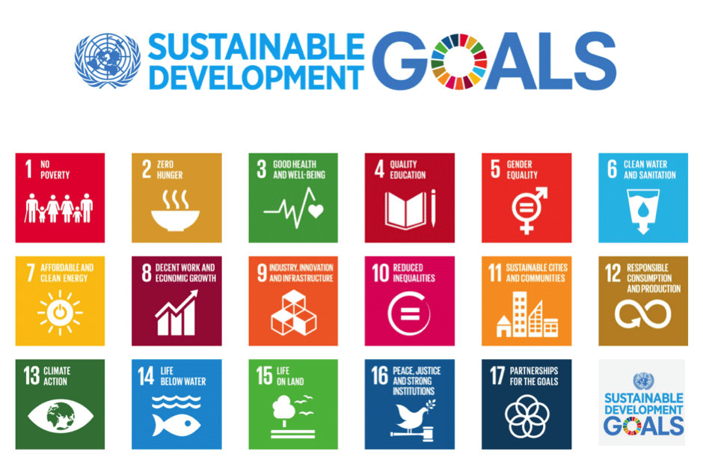
Education in the Sustainable Development Goals (SDGs) from the Agenda 2030 (UN, 2015)
Figure: https://www.globalcompact.de/en/our-work/sustainable-development-goals-1

Slide 8

 | Targets: 4.1 Universal primary and secondary education By 2030, ensure that all girls and boys complete free, equitable and quality primary and secondary education leading to relevant and effective learning outcomes
 | 4.2 Early childhood development and universal pre-primary education By 2030, ensure that all girls and boys have access to quality early childhood development, care and pre-primary education so that they are ready for primary education
 | 4.3 Equal access to technical/vocational and higher education By 2030, ensure equal access for all women and men to affordable and quality technical, vocational and tertiary education, including university
 | 4.4 Relevant skills for decent work By 2030, substantially increase the number of youth and adults who have relevant skills, including technical and vocational skills, for employment, decent jobs and entrepreneurship
 | 4.5 Gender equality and inclusion By 2030, eliminate gender disparities in education and ensure equal access to all levels of education and vocational training for the vulnerable, including persons with disabilities, indigenous peoples and children in vulnerable situations
 | 4.6 Universal youth literacy By 2030, ensure that all youth and a substantial proportion of adults, both men and women, achieve literacy and numeracy
https://en.unesco.org/education2030-sdg4/targets

Slide 9

Target 4.7: Education for Sustainable Development
Agenda 2030 (UN, 2015) states in target 4.7 of the SDGs:
“by 2030 ensure all learners acquire knowledge and skills needed to promote sustainable development, including among others through ESD and sustainable lifestyles, human rights, gender equality, promotion of a culture of peace and non-violence, global citizenship, and appreciation of cultural diversity and of culture’s contribution to sustainable development.”
https://en.unesco.org/education2030-sdg4/targets

Slide 10


Definitions of sustainability and sustainable development
The World Commission on Environment and Development (Brundtland Commission, 1987): Sustainable development is
  “development that meets the needs of the present without compromising the ability of future generations to meet their own needs.”
“Sustainable development is how we must live today if we want a better tomorrow, by meeting present needs without compromising the chances of future generations to meet their needs. The survival of our societies and our shared planet depends on a more sustainable world.” (UN, w.y.)

Slide 11

Objectives of ESD
„Education for Sustainable Development (ESD) enables the learner for active participation in analyzing and evaluating processes of non-sustainable development, to orient own life on principles of sustainability, and to start processes of sustainable development with others on the global and local level.“
(German World-Decade Framework: Transfer 21)
Source: http://www.transfer-21.de/

Slide 12
Objectives of ESD
Ecology
„ESD suggests a holistic and interdisciplinary vision of education that aims on knowledge and skills important for a sustainable development of our planet.“
„ESD aims on enabling students for shaping actively an ecologically compatible, economic powerful and socially fair environment for living under consideration of democratic principles and cultural diversity.“
(German Ministers of Education, 2006)
Education
For
Sustainable
Development
Economy
Society

Slide 13
ESD: What it is and what not (Huber, 2001)
Education for sustainable development
• is not merely directed at protecting the environment from damages or preserving nature, but is also directed at development and changes;
• is not only prohibitive or austere but is also tempting—it calls for creativity and activity;
• does not only stir up fears but points out perspectives as well;
• is not confined to ecology but includes economy and politics, too, and takes culture into consideration;
• does not stick to local perspectives, but operates on a global frame of reference;
• is interested in analysing social relationships and development alongside the action in one’s own everyday life.

Slide 14

The role of STEM education for sustainable development
UN-World-Decade on „Education for Sustainable Development“ (DESD), 2005-2014
Pupils need special competences for shaping their life, today and in future, within a democratic society
All domains and levels of education are asked to contribute
Since developments in science and technology are crucial for most fields of sustainable development, education in STEM subjects should prominently incorporate an ESD philosophy on all levels

Slide 15
Models and Concepts for ESD

Slide 16
Shaping competencies
Shaping competence has 12 sub-competencies: The abilities to
• gather knowledge in a spirit of openness to the world, integrating new perspectives
• think and act in a forward-looking manner
• acquire knowledge and acting in an interdisciplinary manner
• deal with incomplete and overly complex information
• cooperate in decision-making processes
• cope with individual dilemmatic situation of decision-making
• participate in collective decision-making processes
• motivate oneself as well as others to become active
• reflect upon one’s own principles and those of others
• refer to the idea of equity in decision-making and planning actions
• plan and act autonomously
• show empathy for and solidarity with the disadvantaged
How to work with the competencies: http://www.transfer-21.de/daten/grundschule/didaktik_leitfaden_engl.pdf

Slide 17
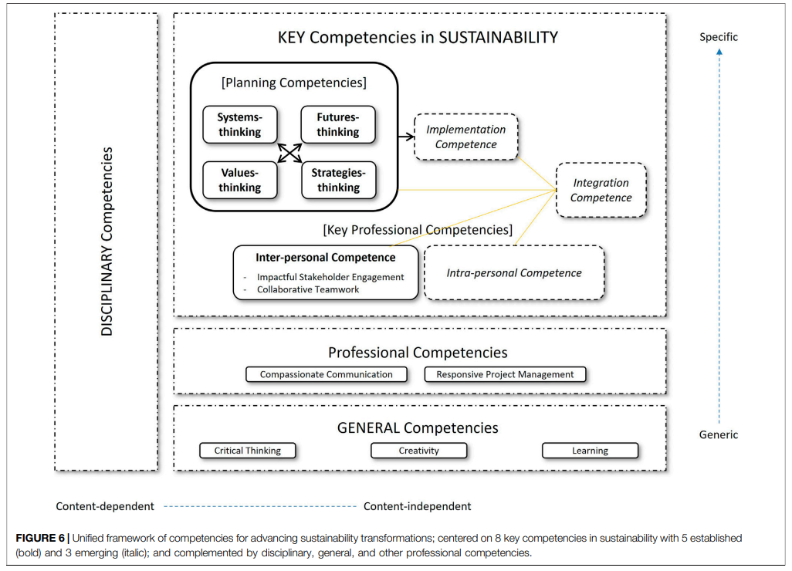
Key competencies for sustainability
Redman, A., & Wiek, A. (2021). Competencies for advancing transformations towards sustainability. Frontiers in Education, 6, [785163].
http://fox.leuphana.de/portal/files/21178885/feduc_06_785163.pdf

Slide 18
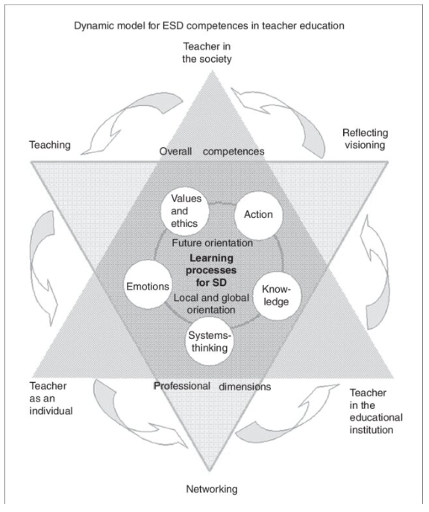
Dynamic model for ESD competencies in teaching
Schauer, J. R., Holt, J., Patel, R. & Nolet, V (2016). Environmental beliefs and values: In search of models and methods. In C. Shealy (ed.), Making Sense of Beliefs and Values: Understanding the Global Implications of Human Nature.: Springer

Slide 19
Different strategies to do ESD in science teaching

Slide 20
Strategy 1: Applying green technolgies in class
Green science and technology is applied to practical work and any other action in science classes.
Traditional practices are replaced by less poisonous, less dangerous and less resource-consuming alternatives.
Students can learn, compare and reflect upon the altered strategies.
However, development of general educational skills for ESD is not necessarily in focus.
(Burmeister, M., Rauch, F., & Eilks, I. (2012). Education for Sustainable Development (ESD) and secondary chemistry education. Chemistry Education Research and Practice, 13 (2), 59-68.)

Slide 21

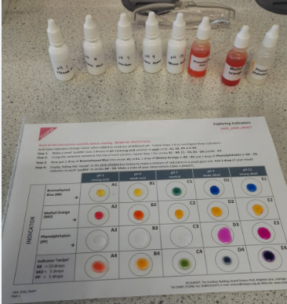

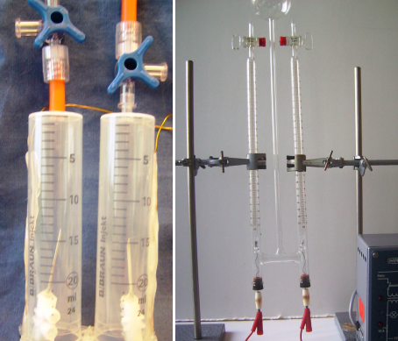

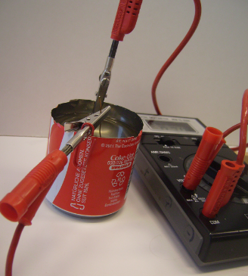
Examples: Low-cost- and micro-scale-science
Low-cost and small-scale experiments for practical work with less environmental impact

Slide 22
Strategy 2: Making green science and technology an explicit content for STEM education
Applications of sustainable science are made an explicit content in the science curriculum.
The approach highlights the science behind sustainable processes and products as part of the curriculum, e.g. chemistry of biofuels, physics of photovoltaic applications, bio-engineering.
The approach makes science meaningful to students and offers conceptual knowledge for understanding societal discourse.
However, understanding of the interplay of economic, ecological and societal sustainability and gaining generals educational skills for societal participation is not necessarily in focus.
(Burmeister, M., Rauch, F., & Eilks, I. (2012). Education for Sustainable Development (ESD) and secondary chemistry education. Chemistry Education Research and Practice, 13 (2), 59-68.)

Slide 23
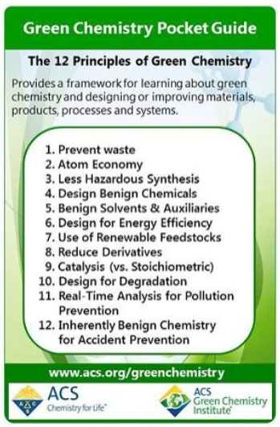
Example: A green chemistry curriculum
Teaching organic chemistry along the twelve principles of green chemistry (e.g. in the first year of upper secondary education or the undergraduate lab
Green chemistry principles
Renewable resources
Microwave-induced reactions
Solid-state acids as catalysts
Enzymatic catalysis
Bio-polymer synthesis
Source: https://www.acs.org/green-chemistry-sustainability/
principles/12-principles-of-green-chemistry.html
(Further reading: Linkwitz, M., & Eilks, I. (2020). Greening the senior high school chemistry curriculum – An action research initiative. In S. Obare, K. Peterman & C. Middlecamp (Eds.), Chemistry Education for a Sustainable Society Volume 1: High School, Outreach, & Global Perspectives (pp. 55-68). Washington: ACS.)

Slide 24
Strategy 3: Sustainability in SSI-based science education
Socio-scientific issues become the driver for science education, e.g. climate change, biofuels, risks and chances of products or processes.
The lessons are either context-based learning or focus controversial SSIs to make both learning of science and societal discourse about them balanced parts of science education.
SSI approaches (and if reflected CBSL) contributes understanding on the interplay of economic, ecological and societal sustainability and helps developing generals educational skills.
However, there is no direct contribution to developing innovative structures.
(Burmeister, M., Rauch, F., & Eilks, I. (2012). Education for Sustainable Development (ESD) and secondary chemistry education. Chemistry Education Research and Practice, 13 (2), 59-68.)

Slide 25
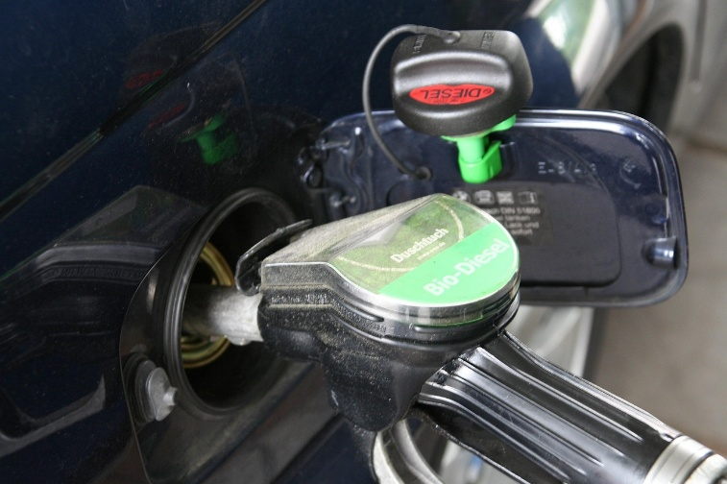

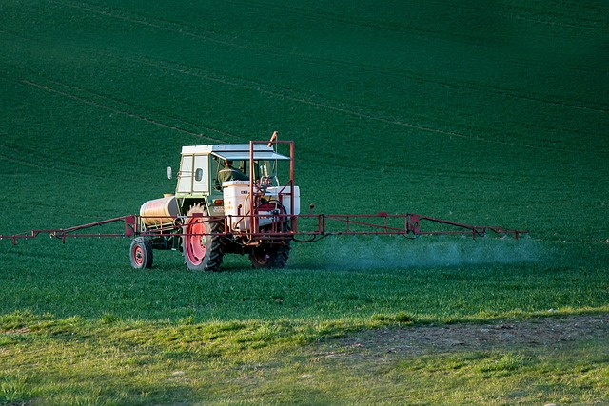

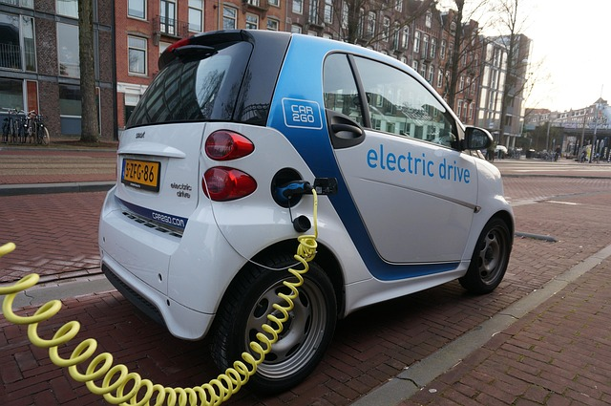
Examples: Sustainability-oriented SSIs
Biofuels
Healthy nutrition
Pesticides use
Cosmetics
E-mobility

Slide 26
Model 4: ESD in school development
School life is reorganized according to ESD goals.
Reforms focus innovative structures, interdisciplinary knowledge, and participatory learning (lived learning).
ESD becomes an essential component of a school‘s life, e.g. project work or networking schools with businesses.
This appraoch allows for development of competences in the broadest means.
It has potential for contributing to sustainable development and innovative structures.
(Burmeister, M., Rauch, F., & Eilks, I. (2012). Education for Sustainable Development (ESD) and secondary chemistry education. Chemistry Education Research and Practice, 13 (2), 59-68.)

Slide 27


Examples: Climate-friendly and eco certified institutions
Look furher: https://www.climatefriendlyschools.org.uk/climate-friendly-themes/
Look fruther https://green-forum.ec.europa.eu/emas_en

Slide 28
Potentials of the different models in connection to science education
Potential for … | Model 1 | Model 2 | Model 3 | Model 4
… learning about sustainable development. | (+) | ++ | ++ | +
… learning for sustainable development. | - | - | ++ | ++
… directly contributing to sustainable development. | (+) | - | - | +
(Burmeister, M., Rauch, F., & Eilks, I. (2012). Education for Sustainable Development (ESD) and secondary chemistry education. Chemistry Education Research and Practice, 13 (2), 59-68.)

Slide 29
A curriculum model for SSI-based ESD teaching

Slide 30
How to identify and reflect SSIs for ESD?
Authenticity | The issue is authentic because it is - in fact - discussed in society. | It is checked for to whether the issue actually is discussed in everyday life media (newspapers, magazines, TV, advertisings, social media, Internet, …)?
Relevance | The issue is relevant, because societal decisions on the issue will have direct impact on students’ life, today or in future. | Scenarios are outlined and reflected upon regarding the impact specific societal decisions will have on how the individual could potentially act, e.g. as a consumer.
Evaluation undetermined in a socio-scientific respect | The societal evaluation is undetermined, it allows for different points of view. | The public debate is analysed to whether there are - in fact - different, controversial points of view outlined (by lobbyists, media, politicians, …).
Allows for open discussions | The issues can be openly discussed. | Thought experiments are conducted in order to consider whether expressing different points of view will harm the feelings of persons and groups because of their socio-economic background or religious and ethical concerns.
Deals with questions from science and technology | The issue centres around scientific and technological questions, for which the understanding of science and technology is fundamental. | The discourse in the media is analysed to examine whether basic concepts of science and technology are touched or used for argumentation – explicit or implicit.
(Stolz, M., Witteck, T., Marks, R., & Eilks, I. (2013). Reflecting socio-scientific issues for science education coming from the case of curriculum development on doping in chemistry education. EURASIA Journal of Mathematics, Science and Technological Education, 9 (4), 273-282.)

Slide 31
How to start and sequence? – An example
1. Textual approach and problem analysis | The students are asked to read and analyse authentic media, e.g. from a political magazine reporting the growing use of bioethanol as fuels and critically mentioning potential side effects such as cutting down rain forests and a rise in food prices on the world market.
2. Clarifying the chemistry background in a lab-environment | In the bioethanol topic, the students learn about the structure of alcohols, fermentation, and the problems and benefits of the use of alcohols as fuels in cars in cooperative mode of a jigsaw classroom in combination with a learning at stations lab.
3. Resuming the societal debate | A joint reflection leads to the understanding that the chemistry background might be sufficiently clear. But, the base for a political decision also will have to include consideration of ecological, economical and social effects.
4. Discussing and evaluating different points of view | A parliaments’ hearing is mimicked in a role play. The preparation and presentation explicates the different arguments and points of view of different stakeholders from within society.
5. Meta-reflection | A meta-reflection on the debate highlights the different roles of scientists, pressure groups and politicians and not only makes clear the complexity of the decision but also how society is handling such decision making.
(Feierabend, T. & Eilks, I. (2011). Teaching the societal dimension of chemistry using a socio-critical and problem-oriented lesson plan on bioethanol usage. Journal of Chemical Education, 88, 1250-1256)

Slide 32
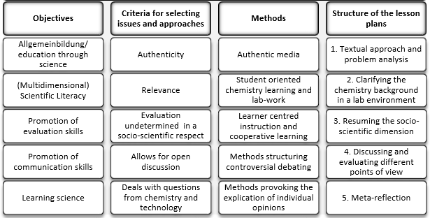
A curriculum model for ESD
(Marks, R., & Eilks, I. (2009). Promoting Scientific Literacy using a socio-critical and problem-oriented approach in chemistry education: Concept, examples, experiences. International Journal of Environmental and Science Education 4 (2), 131-145.)

Slide 33
A search for national policies

Slide 34
Search the Internet about national policy legacies for ESD.
It is suggested to collect and discuss students‘ findings via a Padlet (https://padlet.com/) via predefined topics.

Slide 35
Questions and discussion

Slide 36
Online resources to read
https://www.unesco.org/en/sustainable-developmen/education
https://www.unesco.org/en/education-sustainable-development/need-know
https://www.oecd.org/education/education-policy-outlook-4cf5b585-en.htm
https://education.ec.europa.eu/focus-topics/green-education/learning-for-the-green-transition
https://www.globaleslernen.de/sites/default/files/files/pages/curriculum_framework_education_for_sustainable_development_barrierefrei.pdf

