Slide 1
Promoting Relevant Education in Science for Sustainability (1)

Slide 2
Overview on the course

Slide 3
Overview on the course
Sustainability and modern concepts of sustainable development
Theories and foundations of education for sustainable development (ESD)
National regulations and policies for ESD
The role of critical scientific media literacy for ESD
Best practices of ESD from an international perspective
Best practices of ESD in our country
Innovative structures for ESD with informal and non-formal partners
Networks, networking, school partnerships as part of school development
Introduction and planning for students’ projects
Students’ project work
Public presentation and reflection on students’ projects and the course

Slide 4
Sustainability and contemporary concepts of sustainable development
An introduction

Slide 5
What associations do you have when you hear the terms sustainability or sustainable development? It is suggested to collect and discuss students‘ associations via a Mentimeter Word Cloud (https://www.mentimeter.com/features/word-cloud) or a similar tool.

Slide 6
Contemporary concepts of sustainability
Definitions of sustainability and sustainable development
Concepts and models of sustainable development
The dimensions of sustainability
The Sustainable Development Goals (SDGs)
The concept of planetary boundaries
The anthropocene
The concept of critical raw materials (A European view)
A search for national policies
Questions and discussion

Slide 7
Definitions of sustainability and sustainable development

Slide 8
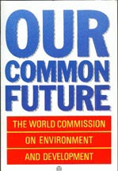
Definitions of sustainability and sustainable development
The World Commission on Environment and Development (Brundtland Commission, 1987): Sustainable development is
“development that meets the needs of the present without compromising the ability of future generations to meet their own needs.”
“Sustainable development is how we must live today if we want a better tomorrow, by meeting present needs without compromising the chances of future generations to meet their needs. The survival of our societies and our shared planet depends on a more sustainable world.” (UN, w.y.)

Slide 9
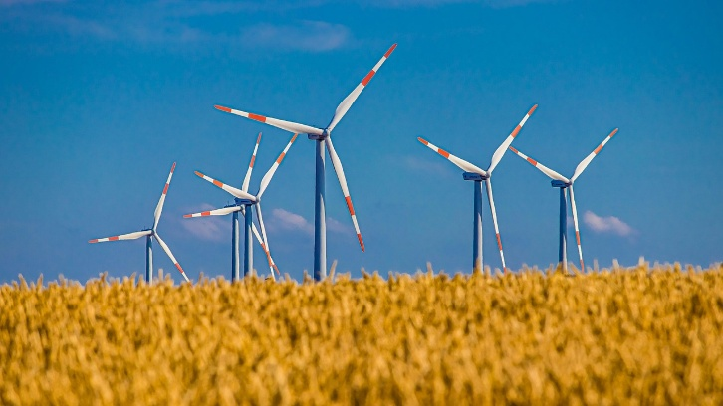
Definitions of sustainability and sustainable development
Sustainability in the beginning was often interpreted as a static concept.
The idea of sustainable development gave it a more dynamic component.
Sustainable development is now the most commonly used terms in international policies when it comes to the development of modern societies.
Current challenges (such as climate change, biodiversity loss, or ocean acidification) cannot be handled in a fair-minded way without using strategies of sustainable development and not without the science and technology fields.

Slide 10
Models of sustainable development
Dimensions of sustainability

Slide 11
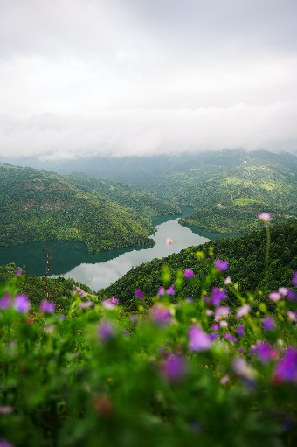
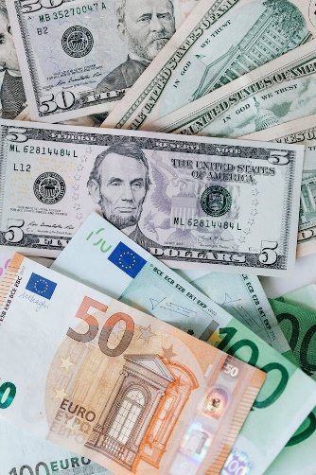
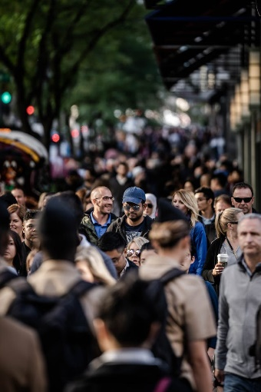
The dimensions of sustainability
Single-pillar-model
Sustainable forestry, 19th century
Cultivate the forest in a way that ecological processes, productivity and biodiversity are kept: Cut only as much trees, as can grow in the same time.
Three-pillars-model
Defined by the Agenda 21
Finding a balance between: ecological, economic and societal sustainability
Four- and More-pillars-models
Integrating further dimensions, e.g. cultural and institutional sustainability

Slide 12
The dimensions of sustainability
A: In the beginning a balanced view in the three dimensions was suggested.
B: Policies often over-emphasized the economic dimension.
C: Today, most concepts suggest priority to the environment and natural resources, in which the society develops, supported by a decent economy.

Slide 13
Models of sustainable development
The sustainable development goals

Slide 14
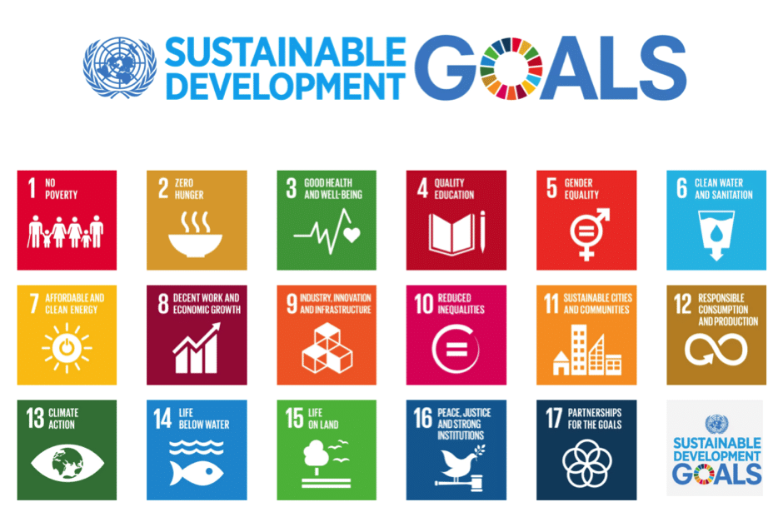
The sustainable development goals (SDGs) from in the Agenda 2030 (UN, 2015)
Adopted by all United Nations Member States in 2015
Shared blueprint for peace and prosperity for people and the planet, now and into the future.
Understood as an urgent call for action by all countries - developed and developing - in a global partnership.
They recognize that ending poverty and other deprivations must go hand-in-hand with strategies that improve health and education, reduce inequality, and spur economic growth – all while tackling climate change and working to preserve our oceans and forests.
Figure: https://www.globalcompact.de/en/our-work/sustainable-development-goals-1

Slide 15
The sustainable development goals (SDGs) from in the Agenda 2030 (UN, 2015)
History:
June 1992: Earth Summit in Rio de Janeiro issued the Agenda 21 (178 countries) suggesting a comprehensive plan of action to build a global partnership for sustainable development to improve human lives and protect the environment.
September 2000: UN in New York agreed Millennium Declaration elaborating eight Millennium Development Goals (MDGs) to reduce extreme poverty by 2015.
September 2002: World Summit on Sustainable Development in Johannesburg described in the Johannesburg Declaration on Sustainable Development the global community's commitments to poverty eradication and the environment, and built on Agenda 21 and the Millennium Declaration by including more emphasis on multilateral partnerships.
June 2012: United Nations Conference on Sustainable Development (Rio+20) in Rio de Janeiro UN issued the document "The Future We Want" in which they decided, inter alia, to launch a process to develop a set of SDGs to build upon the MDGs and to establish the UN High-level Political Forum on Sustainable Development.
2013: The UN General Assembly set up a 30-member Open Working Group to develop a proposal on the SDGs.
January 2015: The UN General Assembly began the negotiation process on the post-2015 development agenda.
September 2015: Adoption of the 2030 Agenda for Sustainable Development, with 17 SDGs at its core, at the UN Sustainable Development Summit.

Slide 16
The goals from in the Agenda 21 (UN, 1992)
Section I: Social and Economic Dimensions is directed toward combating poverty, especially in developing countries, changing consumption patterns, promoting health, achieving a more sustainable population, and sustainable settlement in decision-making.
Section II: Conservation and Management of Resources for Development includes atmospheric protection, combating deforestation, protecting fragile environments, conservation of biological diversity (biodiversity), control of pollution, and the management of biotechnology, and radioactive wastes.
Section III: Strengthening the Role of Major Groups includes the roles of children and youth, women, NGOs, local authorities, business and industry, and workers; and strengthening the role of indigenous peoples, their communities, and farmers.
Section IV: Means of Implementation includes science, technology transfer, education, international institutions, and financial mechanisms.

Slide 17
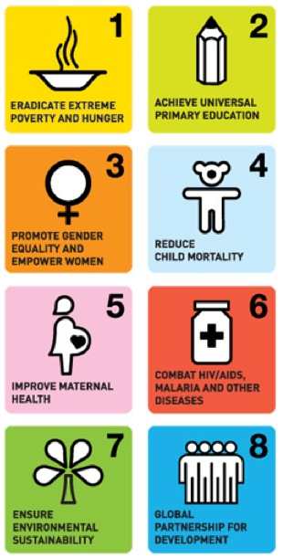
The millennium development goals (MDGs) (UN, 2000)
To be achieved by 2015:
Goal 1: To eradicate extreme poverty and hunger
Goal 2: To achieve universal primary education
Goal 3: To promote gender equality and empower women
Goal 4: To reduce child mortality
Goal 5: To improve maternal health
Goal 6: To combat HIV/AIDS, malaria, and other diseases
Goal 7: To ensure environmental sustainability
Goal 8: To develop a global partnership for development
Figure: https://nachhaltig-entwickeln.dgvn.de/agenda-2030/
ziele-fuer-nachhaltige-entwicklung/milleniumsentwicklungsziele

Slide 18
The Sustainable Development Goals (SDGs) from in the Agenda 2030 (UN, 2015)
Figure: https://www.globalcompact.de/en/our-work/sustainable-development-goals-1

Slide 19
The Sustainable Development Goals (SDGs) from in the Agenda 2030 (UN, 2015)
Goal 1: No poverty: "End poverty in all its forms everywhere."
Goal 2: Zero hunger (No hunger): "End hunger, achieve food security and improved nutrition, and promote sustainable agriculture."
Goal 3: Good health and well-being: "Ensure healthy lives and promote well-being for all at all ages."
Goal 4: Quality education: "Ensure inclusive and equitable quality education and promote lifelong learning opportunities for all."
Goal 5: Gender equality: "Achieve gender equality and empower all women and girls."
Goal 6: Clean water and sanitation: "Ensure availability and sustainable management of water and sanitation for all."
Goal 7: Affordable and clean energy: "Ensure access to affordable, reliable, sustainable and modern energy for all."
Goal 8: Decent work and economic growth: "Promote sustained, inclusive and sustainable economic growth, full and productive employment and decent work for all."
Goal 9: Industry, Innovation and Infrastructure: "Build resilient infrastructure, promote inclusive and sustainable industrialization, and foster innovation."

Slide 20
The Sustainable Development Goals (SDGs) from in the Agenda 2030 (UN, 2015)
Goal 10: Reduced inequality: "Reduce income inequality within and among countries."
Goal 11: Sustainable cities and communities: "Make cities and human settlements inclusive, safe, resilient, and sustainable."
Goal 12: Responsible consumption and production: "Ensure sustainable consumption and production patterns."
Goal 13: Climate action: "Take urgent action to combat climate change and its impacts by regulating emissions and promoting developments in renewable energy."
Goal 14: Life below water: "Conserve and sustainably use the oceans, seas and marine resources for sustainable development."
Goal 15: Life on land: "Protect, restore and promote sustainable use of terrestrial ecosystems, sustainably manage forests, combat desertification, and halt and reverse land degradation and halt biodiversity loss."
Goal 16: Peace, justice and strong institutions: "Promote peaceful and inclusive societies for sustainable development, provide access to justice for all and build effective, accountable and inclusive institutions at all levels."
Goal 17: Partnership for the goals: "Strengthen the means of implementation
and revitalize the global partnership for sustainable development."

Slide 21
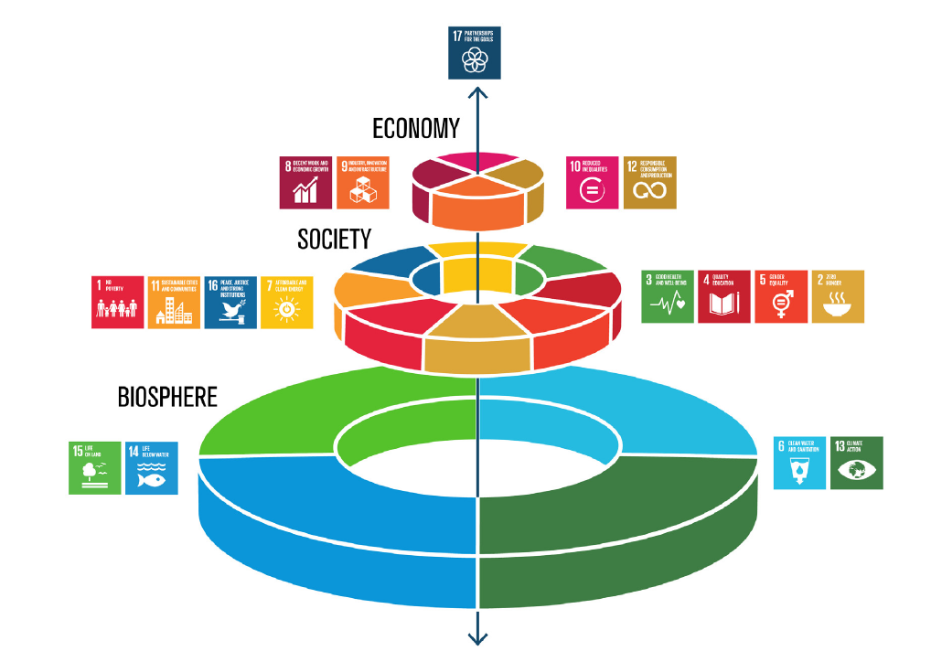
The wedding cake model from Rockström & Sukhdev (2016)
https://www.stockholmresilience.org/research/research-news/
2016-06-14-the-sdgs-wedding-cake.html

Slide 22
The sustainable development goals (SDGs) from in the Agenda 2030 (UN, 2015)
Further agreements in 2015 :
Sendai Framework for Disaster Risk Reduction (March 2015)
Addis Ababa Action Agenda on Financing for Development (July 2015)
Paris Agreement on Climate Change (December 2015)

Slide 23
Models of sustainable development
The concept of planetary boundaries

Slide 24
The development of the system earth in its planetary boundaries: The idea
The planetary boundaries concept presents a set of nine planetary boundaries within which humanity can continue to develop and thrive for generations to come
These nine planetary boundaries were first proposed by former centre director Johan Rockström and a group of 28 internationally renowned scientists in 2009.
Since then, their framework has been revised several times.
These are:
climate change, ocean acidification, stratospheric ozone depletion, biogeochemical flows in the nitrogen cycle and phosphorus cycle, global freshwater use, land system change, the erosion of biosphere integrity, chemical pollution, and atmospheric aerosol loading.
https://www.stockholmresilience.org/research/planetary-boundaries.html

Slide 25
The development of the system earth in its planetary boundaries: Criteria
Criteria
climate change (CO₂ concentration in the atmosphere < 350 ppm and/or a maximum change of +1 W/m² in radiative forcing)
ocean acidification (mean surface seawater saturation state with respect to aragonite ≥ 80% of pre-industrial levels)
stratospheric ozone depletion (less than 5% reduction in total atmospheric O₃ from a pre-industrial level of 290 Dobson Units)
biogeochemical flows in the nitrogen (N) cycle (limit industrial and agricultural fixation of N₂ to 35 Tg N/yr) and phosphorus (P) cycle (annual P inflow to oceans not to exceed 10 times the natural background weathering of P)
global freshwater use (< 4000 km³/yr of consumptive use of runoff resources)
land system change (< 15% of the ice-free land surface under cropland)
the erosion of biosphere integrity (an annual rate of loss of biological diversity of < 10 extinctions per million species)
chemical pollution (introduction of novel entities in the environment)
atmospheric aerosol loading
https://en.wikipedia.org/wiki/Planetary_boundaries

Slide 26
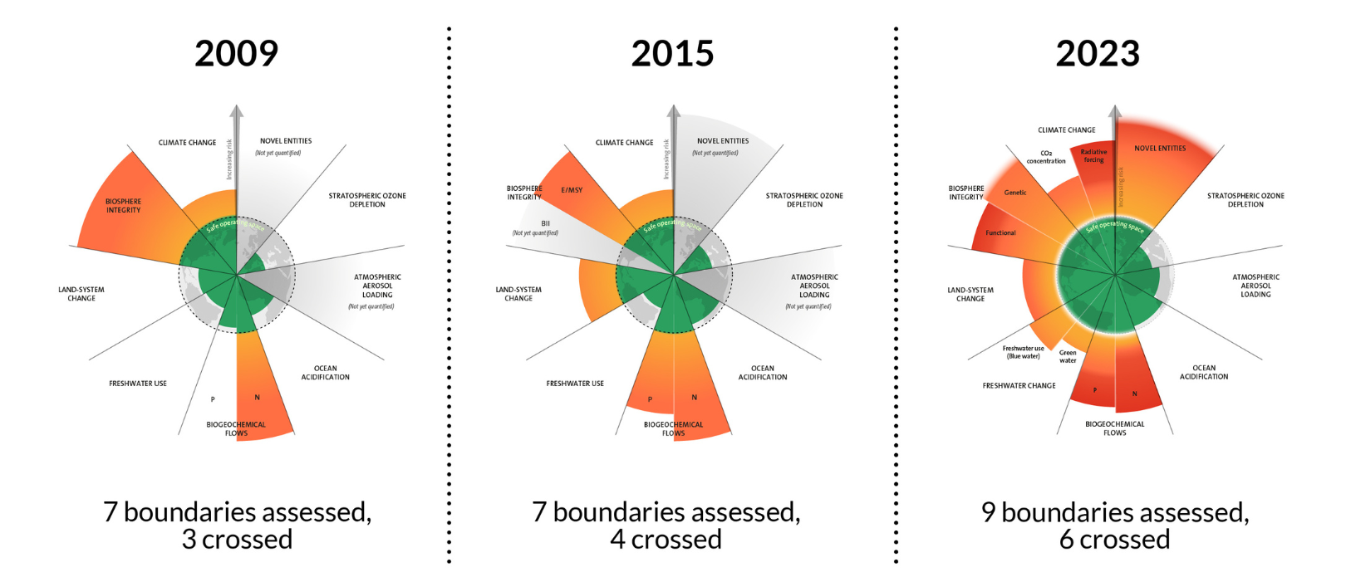
The state of the system earth in its planetary boundaries 2023: Developments
https://www.stockholmresilience.org/research/planetary-boundaries.html

Slide 27
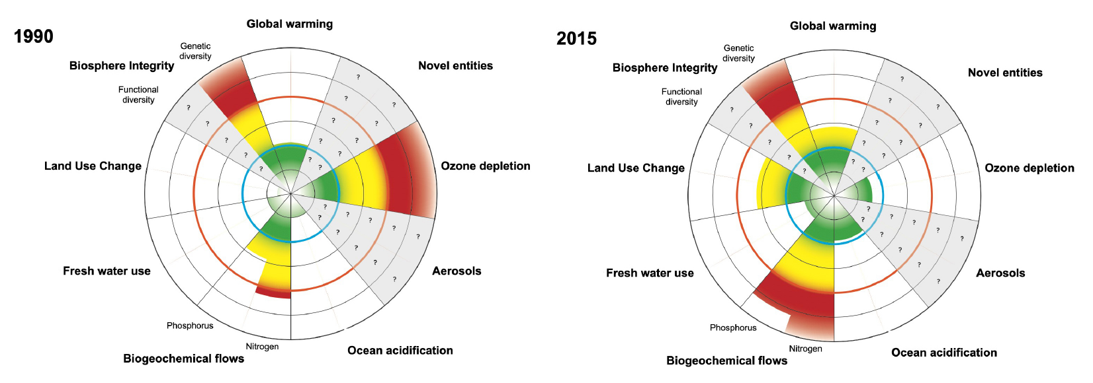
The development of the system earth in its planetary boundaries: Decisions and human activity can help!
Further reading: Steffen, W., Richardson, K., Rockström, J., Cornell, S. E., Fetzer, I., Bennett, E. M., ... & Sörlin, S. (2015). Planetary boundaries:
Guiding human development on a changing planet. science, 347(6223), 1259855.

Slide 28
Models of sustainable development
The anthropocene

Slide 29
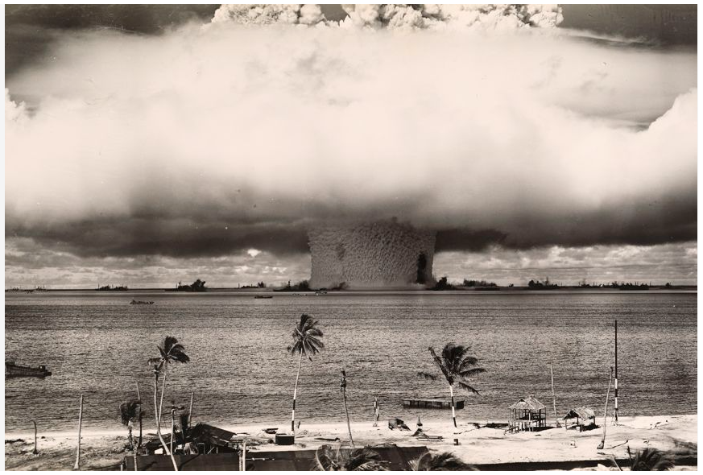
The anthropocene
https://education.nationalgeographic.org/resource/anthropocene/

Slide 30
The anthropocene
Earth’s history is divided into a hierarchical series of smaller chunks of time, referred to as the geologic time scale.
Units are classified based on Earth’s rock layers, or strata, and the fossils found within them.
Officially, the current epoch is called the Holocene, which began 11,700 years ago after the last major ice age. The Anthropocene Epoch is an unofficial unit of geologic time, used to describe the most recent period in Earth’s history when human activity started to have a significant impact on the planet’s climate and ecosystems. The word Anthropocene is derived from the Greek words anthropo, for “man,” and cene for “new,” coined and made popular by biologist Eugene Stormer and chemist Paul Crutzen in 2000.
The term has not been formally adopted by the International Union of Geological Sciences (IUGS), the international organization that names and defines epochs. The primary question that the IUGS needs to answer before declaring the Anthropocene an epoch is if humans have changed the Earth system to the point that it is reflected in the rock strata.
Those who do think the Anthropocene describes a new geological time period, the next question is, when did it begin. A popular theory is that it began at the start of the Industrial Revolution of the 1800s, when human activity had a great impact on carbon and methane in Earth’s atmosphere. Others think that the beginning of the Anthropocene should be 1945. This is when humans tested the first atomic bomb, and then dropped atomic bombs on Hiroshima and Nagasaki, Japan. The resulting radioactive particles were detected in soil samples globally.
https://education.nationalgeographic.org/resource/anthropocene/

Slide 31
Models of sustainable development
Dealing with critical raw materials (European view)

Slide 32
The EU need for critical raw materials
Definition:
Critical Raw Materials (CRMs) are those raw materials which are economically and strategically important for the European economy, but have a high-risk associated with their supply.
https://single-market-economy.ec.europa.eu/sectors/raw-materials/areas-specific-interest/critical-raw-materials_en

Slide 33
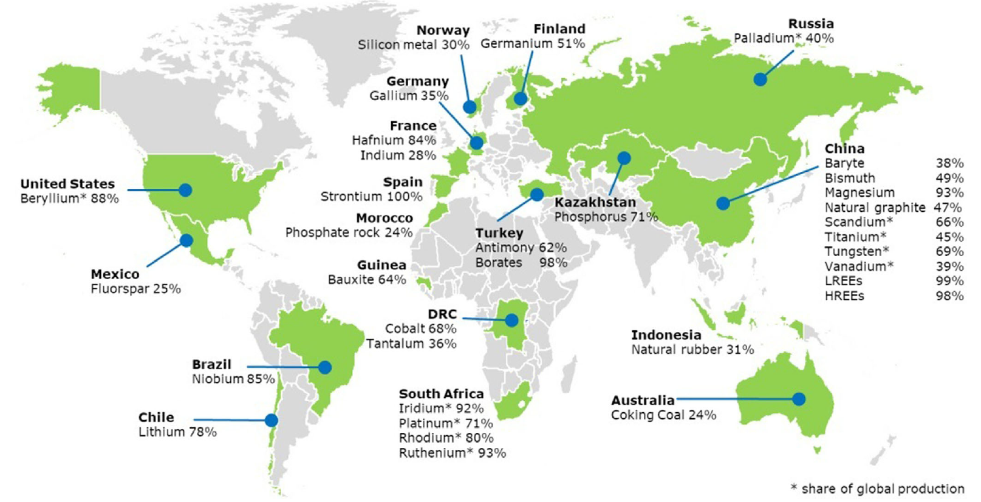
The EU need for critical raw materials
Dependency of the EU on raw materials suppliers
https://single-market-economy.ec.europa.eu/sectors/raw-materials/areas-specific-interest/critical-raw-materials_en

Slide 34
The EU need for critical raw materials
Report issued by the EU every 3 years since 2011
Analysis of raw materials that are of high econimic importance and in the same time subject to a certain supply risk
2011: 14 materials or material groups
2014: 20 materials or material groups
2017: 27 materials or material groups
2020: 30 materials or material groups with over 40 single materials
https://single-market-economy.ec.europa.eu/sectors/raw-materials/areas-specific-interest/critical-raw-materials_en

Slide 35
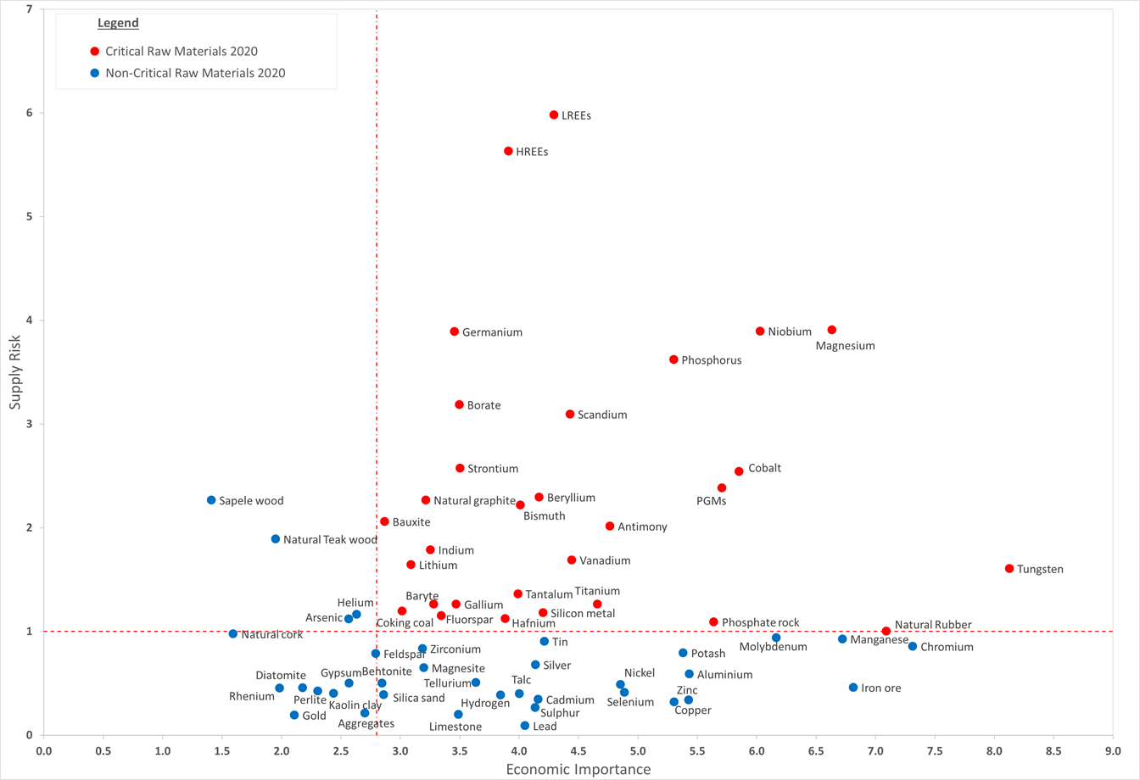
The EU need for critical raw materials
https://single-market-economy.ec.europa.eu/sectors/raw-materials/areas-specific-interest/critical-raw-materials_en

Slide 36
A search for national policies

Slide 37
Search the Internet about national policy legacies for sustainable development and the implementation of the SDGs. It is suggested to collect and discuss students‘ findings via a Padlet via predefined topics (https://padlet.com/) or a similar tool.

Slide 38
Questions and discussion

Slide 39
Online resources to read
https://sdgs.un.org/goals
https://www.stockholmresilience.org/research/planetary-boundaries.html
https://www.stockholmresilience.org/research/planetary-boundaries.html
https://education.nationalgeographic.org/resource/anthropocene
https://single-market-economy.ec.europa.eu/sectors/raw-materials/areas-specific-interest/critical-raw-materials_en

